Slide 1

Estimating Costs
on WisDOT Projects
Jill Fehrman
Proposal Management Chief
and
Fred Schunke
Estimating Engineer
Traffic Improvement Conference
March 9, 2022
Notes:
Hello. My name is Fred Schunke. I am the statewide estimating engineer, and I work in Proposal Management Section in the Bureau of Project Development. I have been in this position since January 2015.

Slide 2
What are we going to talk about today?
Learning Objectives
Review current bidding trends with all the uncertainty revolving around the pandemic, material, and labor shortages.
Understand the latest estimating guidance and recommendations and learn where to find this information.
Learn about other guidance and recommendations that would make estimates more consistent and reliable.
Notes:
The learning objective we are going to discuss today include the following:
Review current bidding trends with all the uncertainty revolving around the pandemic, material, and labor shortages.
Understand the latest estimating guidance and recommendations and learn where to find this information.
Learn about other guidance and recommendations that would make estimates more consistent and reliable.
We also are going to share some guidance and information about Bid Express questions and answers and justification email responses.

Slide 3
Item Trends
Recent Trends Document
  FDM 19-5-5.6.2 pg. 19 & FDM 19-5-7.3.1 pg. 24
  Updated almost monthly
  Contains latest item estimating guidance
  Latest bidding trends
Bid Item Estimating Guidance
  FDM 19-5-5.6.3 pg. 19
  Contains estimating guidance for
Notes:
A significant portion of what we will be discussing for items is in the Recent Trends Document. Recent Trends is linked in two places in the FDM, under Other Considerations of Project Characteristics on pg. 19 of FDM 19-5 and under Updating the estimate after PS&E on pg. 24 of FDM 19-5.
It is updated almost monthly, it contains the latest estimating item guidance, and the latest bidding trends.
The latest bid item estimating guidance is eventually moved to FDM 19-5, pg. 19, Bid Item Estimating Guidance when I feel comfortable with the guidance in the recent rends document and the guidance is not for temporary trends.
For item trends, the first thing I am going to show are commodity trends, then I will share some additional information about estimating asphalt pavement items, milling, concrete masonry and how to review the Top Items Bid Above and Below Estimate Tables of the Recent Trends Document.

Slide 4
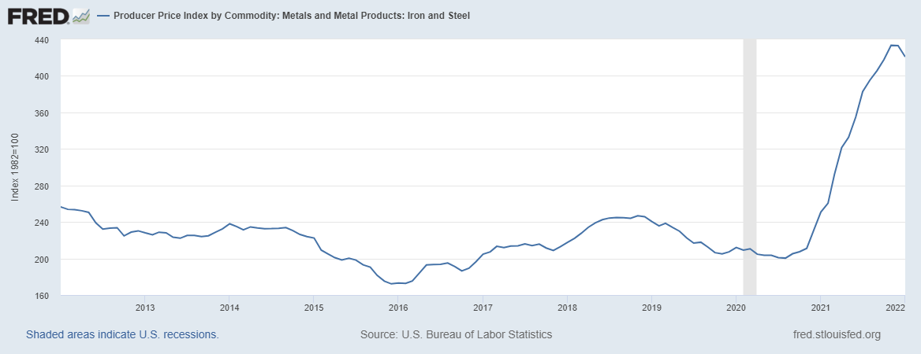
Producer Price Index Commodities
Nationwide Iron and Steel (10 years)
Notes:
First is iron and steel. National steel commodities have increased much faster to unprecedented amounts since January 2021. Bid prices for piling, rebar, steel railing and guardrail items have increased and have remained high. We expect prices to remain high and would recommend construction estimates for piling, rebar, steel rail and guardrail items to be increased to the upper range of historic values, especially if the contract is being let in the next year.
The Producer Price Index for Nationwide Iron and Steel for the past 10 years is shown. These trends are consistent in Steel Mill Products and Concrete Reinforcing Bars Producer Price Indices. The Producer Price Index Graphs are from FRED Economic Data Webpages and the data comes from the U.S. Bureau of Labor Statistics.

Slide 5
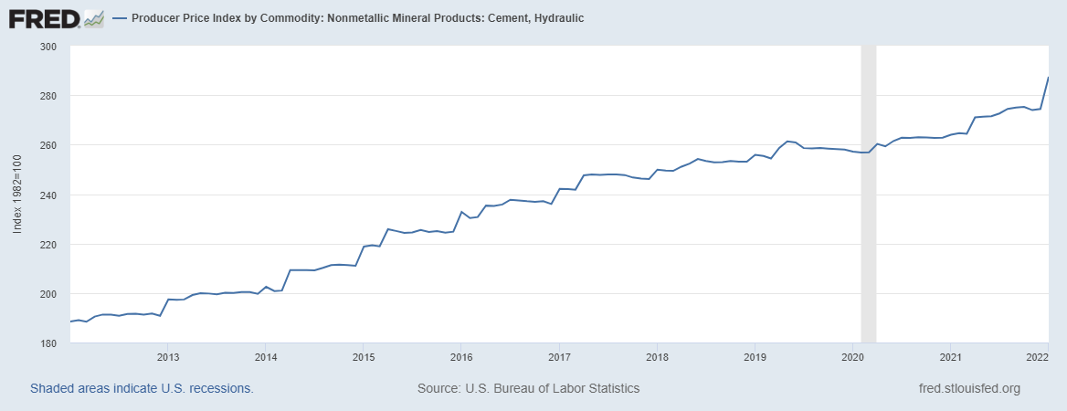
Producer Price Index Commodities
Nationwide Cement (10 years)
Notes:
Here is the Producer Price Index of Cement for the last 10 years. There are similar trends with sand and gravel. As you can see there is a consistent increase each year and a slightly larger jump from December to January. Nothing surprising or exciting here, but it’s good to know there is no drastic increase as we saw with steel.
On a side note, the Nationwide Producer Price Index for Construction Machinery and Equipment have similar trends.

Slide 6
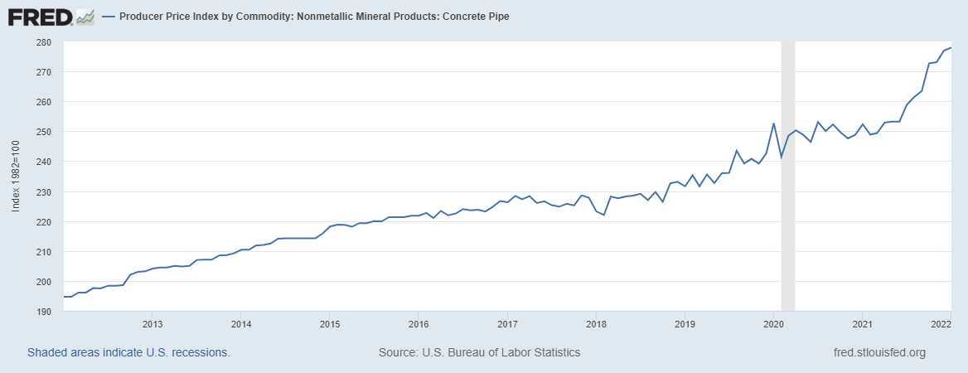
Producer Price Index Commodities
Nationwide Concrete Pipe (10 years)
Notes:
A common item we use that contains cement and steel is concrete pipes. The Producer Price Index for Nationwide Concrete Pipe has increased at a higher rate last year, but not as drastic as steel. We have seen higher prices for concrete pipes, but the highest increases are usually due to deep pipes or pipes being completed a half at a time. So it’s something we should be aware of when developing estimates.

Slide 7
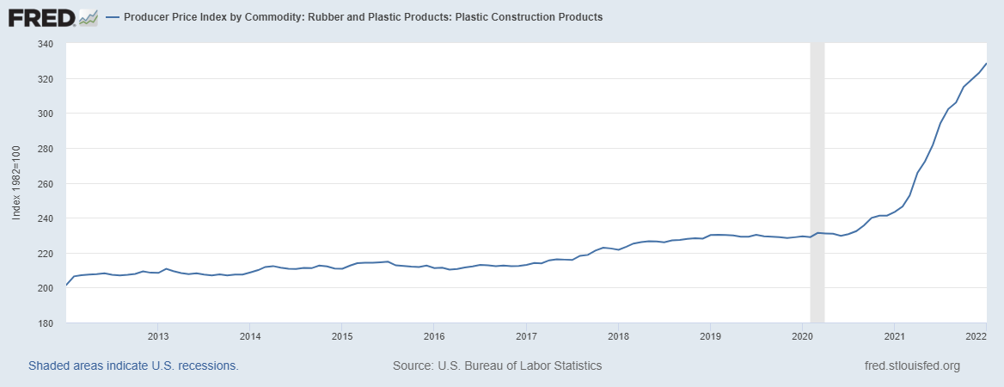
Producer Price Index Commodities
Nationwide Plastic Construction Products (10 years)
Notes:
On a side note, Plastic Construction Products has a similar trend as steel. We have noticed that PVC for sanitary and water have increased, and prices for these are extremely high if pipes are deep, in or near rock, or being done half at a time.

Slide 8
No. 2 Diesel Price per Gallon
Wisconsin Average (10 years)
Notes:
Here is a graph for the average price of No. 2 Diesel in Wisconsin for the past 10 years. The prices shown on this graph do not include gas taxes. In the last month, No. 2 Diesel increased to 2014 prices. Prices did increase a lot in a short amount of time, but prices have been this high before. Crude oil, asphalt and No. 2 Diesel all have similar trends. However, the nationwide increases are a little higher than 2012 to 2014 instead of a little below. Recent increases are not unprecedented and continue to increase.
Asphalt and any item sensitive to haul distances and fuel use will be affected. Items include earthwork, aggregate, concrete, and more. A larger factor for some price increases due to haul distance may be the growing trucking shortage in Wisconsin and nationwide. Across the state, various shortages of commercially licensed drivers exist for garbage trucks, snowplows, buses, and lower attendance at trucking schools. Compensation packages have been increasing which would lead to higher prices. Projects that are remote, have limited site storage, or are more difficult to travel to such as an urban areas or bridge replacements with limited right-of-way, prices are going to be higher, and average prices should not be used.

Slide 9
Commodity Links
PPI Iron and Steel (WPU101)
  PPI Steel Mill Products (WPU1017)
  PPI Concrete Reinforcing Bars (WPU1074051)
PPI Cement, Hydraulic (WPU1322)
  PPI Construction Sand, Gravel, and Crushed Stone (WPU1321)
  PPI Construction Machinery and Equipment (WPU112)
PPI Concrete Pipe (WPU1332)
PPI Plastic Construction Products (WPU072106)
Wisconsin’s Fuel Cost Adjustment
  PPI No. 2 Diesel Fuel (WPU057303)
  PPI Asphalt (WPU05810212)
  Crude Oil Prices
Notes:
Here is a list of the commodities shown and mentioned. Links are provided in the file.
Commodities in bold are commodities that have increased much faster to unprecedented amounts since January 2021. Again, these include Iron and Steel, and Plastic Construction Products. And again, we believe the rising commodity costs affect rebar, piling, steel railing, guardrail and plastic pipes. Prices for these items are currently at the upper range of historic values.

Slide 10
Item Trends
Asphalt Pavement Items
Asphalt Pricing GIS Application
  Price ranges may be used in preliminary estimates
  Final Prices should use Bid Express
Laying more asphalt this year
Quantities below 20,000 TONS are higher
Recent competition in Jefferson, Dane, Rock, Walworth and western Waukesha Counties.
Notes:
Next, I am going to share what I have seen with some other estimating item trends.
The Asphalt Pricing GIS Application may not be as accurate. Current trends vary depending on what part of the state the project is located, and prices vary depending upon the mix design. Asphalt Pricing does a good job of showing where competition between asphalt producers exist. In general, areas with competition have low prices. Final Prices should use Bid Express.
Here are some other factors that will influence asphalt prices:
Wisconsin is laying more asphalt this year than recent years. Contracts with a lot of constraints, such as time to pave after milling or lower layer asphalt has been laid, will see higher than normal prices. If possible, I recommend addenda or adjust PS&E documents to allow more flexibility in paving operations.
Asphalt contracts with less than 20,000 TONs of asphalt or higher grades are higher. The Similar Projects Tool can be used to find projects with more or less than 20,000 TONs by looking at the Total HMA pavement Column of the Data Sheet.
Statewide, prices fluctuate, asphalt projects in south-central Wisconsin are seeing lower bid prices because of more, competition in Jefferson, Dane, Rock, Walworth and western Waukesha Counties since Dec. 2019. Average asphalt prices have gone down in these areas with recent unit prices as low as $48 per TON.

Slide 11
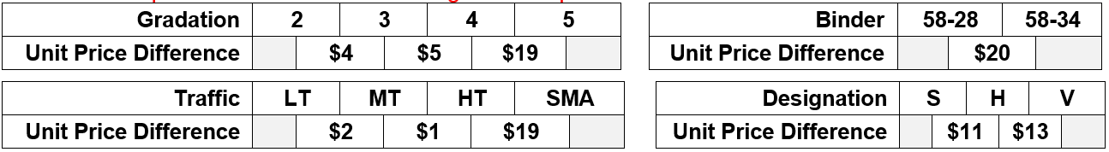
Item Trends
Asphalt Pavement Items
Average prices for the past year are shown
Gradation 5, Binder 58-34 or SMA asphalt mixes cost more
Notes:
Asphalt prices vary based upon mix design too. Statewide averages for the past year are shown in the table below. This is updated in the recent trends document. HMA pavement has about 80 items. Some mix designs do not have a large difference in unit prices between each other, and broader searches may be used. Bid prices for the past year have been similar between Gradation 2 and 3 mixtures, Light, Medium and Heavy Traffic. Estimates may be adjusted with more common items, but only one characteristic price difference or an average of multiple characteristics should be used. As shown below, Gradation 5, Binder 58-34 or SMA asphalt mixes cost more than other mix designs. If you can only find bid information for cheaper mixes, your estimate should be increased if your asphalt mixture contains one of the expensive characteristics. For instance, if you have a Gradation 5 and 58-34 Binder using bid data for cheaper mixes, then a unit price difference range is from $19 to $20 higher, not $39.

Slide 12
Item Trends
Removing Asphaltic Surface Milling
Guidance is in FDM 19-5-5.6.3 pg. 18
Average prices should not be used
  If the millings can be reused, prices are lower
    Prices are very low in competitive areas
  If the millings cannot be reused, prices are higher
    Sealcoats, chip seal, long haul distances, urban area or staging
Notes:
Removing Asphaltic Surface Milling is commonly an item of concern when comparing bids and estimates. Guidance is already in FDM 19-5-5.6.3 pg. 18.
Average prices should not be used. Prices vary depending upon if the milling can be reused or not. If they can be reused, prices are lower than average, especially in competitive areas.
If the millings cannot easily be reused due to a sealcoat, chip seal, long haul distances, in an urban area, or the construction schedule or staging is constrained, prices are higher than average. Since December, we have seen bid prices come in much higher with these characteristics.

Slide 13
Item Trends
Concrete Masonry Bridges
Regression prices should not be used
  Prices vary for slab-spans, girder and rehabilitated bridges
  Concrete Masonry Bridges, Removing Structure and Excavation for Structures should be estimated at the same time
    Each contractor will bid these items differently
Notes:
Concrete Masonry Bridges is commonly an item of concern when comparing bids and estimates. Prices seem to have increased since the December Letting.
Prices vary depending upon the bridge. Bid prices are higher with lower production rates. Prices will be higher if formwork is more difficult to complete, especially if there is only work on the superstructure.
- Concrete slab-span bridges typically receive bids lower than average.
- Girder bridges typically receive bids at about the average price.
- Rehabilitated bridges typically receive bids higher than average
Each contractor will balance their bid differently between Concrete Masonry Bridges, Removing Structure and Excavation for Structures items. All three items should be estimated at the same time with the same bid data.
The Recent Trends Document provides some basic steps to find similar bridges using the Highway Structure Information System or HSI.

Slide 14
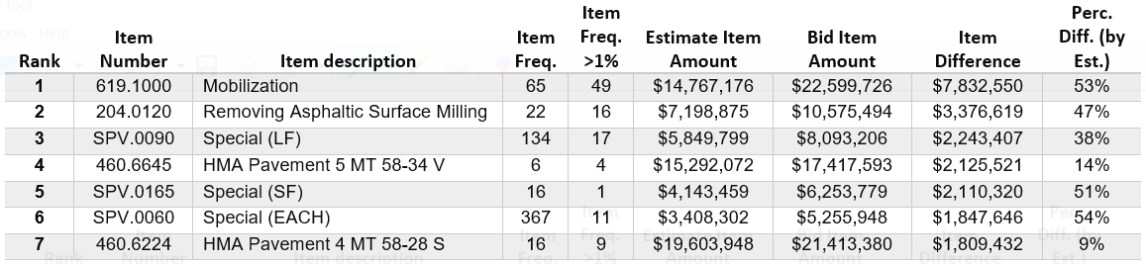
Item Trends
Top Items Bid Above Estimate
Notes:
From the recent trends document, here is the current table for Top Items Bid Above Estimate. The Top Items Tables are found on the second page of the Recent Trends Document.
I am going to walk through what these columns mean, and hopefully you can get more use out of these tables. These totals are statewide for the last three months.
Rank is in order by the item difference between the bid and estimate amounts. The item difference column is the second column from the right.
Item Number and Description are obvious.
Item Frequency is the number of times the bid items were bid above the estimate. The number of times the bid was below the estimate is included in the next table.
Item Frequency greater than 1% is the number of times the bid item was bid significantly higher than the estimate. The difference between the total cost of the item bid and estimate, expressed as a percent of the total estimate, is greater than 1%.
If the items has a low item frequency greater than 1%, that means there were only one or a few large contracts, then this item is likely not of concern for most medium or small contracts. If you see the square foot SPV, there is only one occurrence for item frequency greater than 1%, so most of that item difference amount is coming from one contract.
And the opposite is true, so Mobilization, Removing Asphaltic Surface Milling, and 2 HMA mixes have higher item frequency greater than 1%, and they are of concern for most medium to small contracts.
Milling and asphalt items are likely on this list for reasons I shared earlier. I will discuss Mobilization in the next slide.
Estimate and Bid amounts include statewide totals for item amounts, and the difference between these values is in the item difference column.
And Percent difference is the item difference divided into the estimate amount.
SPVs will be discussed in the next slide.

Slide 15
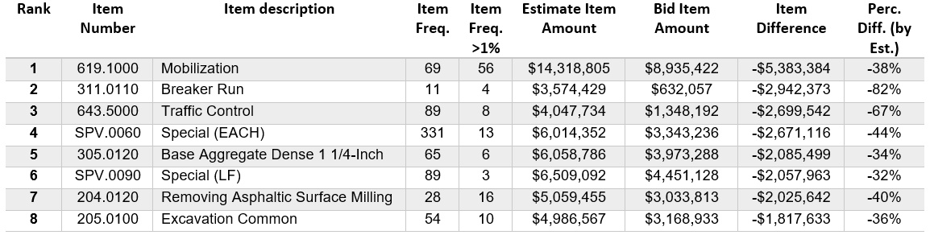
Item Trends
Top Items Bid Below Estimate
Notes:
Here is the current table for Top Items Bid Below Estimate.
The columns are the same.
Item frequency is the number times the bid was below estimate.
And Item frequency greater than 1% is the number of times the bid item was bid significantly lower than the estimate.
The items difference and precent difference columns are negative since bid prices are lower.
SPVs are commonly on both top item lists and are more difficult to estimate. If possible, I would use a modified special instead of an SPV if there is only a minor change for the item. These are very common in large contracts.
You are likely surprised to see Base Aggregate Dense, Breaker Run and Excavation Common items on this list. In large contracts, the items often receive unbalanced bids and are bid a penny. This is frustrating, but a mathematically unbalanced bid is legal. It still does not hurt to check to see if prices in your area have been lower than expected if you increased your estimate too much for these items, especially since there are more than a few times of item frequency greater than 1%.
The last item I want to talk about is Mobilization. The top item on both lists is Mobilization, which is a difficult item to estimate. Mobilization costs make up a larger percentage of the work in small and large proposals. The Similar Projects Tool does a good job at helping you figure out what percentage you should use. Be sure to use the correct formula for calculating mobilization amounts using percentages. Page 20 of FDM 19-5 under Unit Price Guidance explains how to calculate percentage items. The estimate total needs to be calculated before the mobilization amount. Otherwise, your mobilization estimate is going to be too small.
That is everything I want to share today about item trends.

Slide 16
Similar Project Tool Updates
Copy Proposal IDs for BidX Button has been added
Proposal IDs may be filtered
  Bridge Replacement or Rehabilitations for structure items
  Reconstruction or resurfacing/pavement replacements for sidewalk, earthwork and aggregates
  Broad filters recommended
Notes:
The Similar Projects tool file was recently updated with a new feature. A Copy Proposal IDs for Bid Express Button has been added. Honestly, I am very excited about this new feature, and a special thanks to Tou Yang in the NW Region for creating this macro. The Copy Proposal IDs for BidX Button allows you to copy the filtered proposal IDs into your clipboard. After pressing this button, the list of filtered proposals is copied into your clipboard, and you can paste the proposal IDs in the Proposal Items Field of Bid Tab Analysis in Bid Express.
You can now separate Bid Express search results between Bridge Replacements and Bridge Rehabilitations for structure items after filtering between these projects in the Similar Projects Tool.
You can now separate reconstruction or resurfacing and pavement replacements for sidewalk, earthwork and aggregates.
Broad filters are recommended, but in some instances, you may want to use a short proposal list but then use broad item description searches in Bid Express. There are a lot of characteristics to filter projects in Similar Projects Tool, especially in the Data Sheet. I am really sure I am only scratching the surface for this feature, so please check it out and let me know if you find innovative ways to use this feature or if there are any issues.
The Copy Proposal IDs for Bid Express Button has been added to the Filters, Results and Data Sheets. And using any of the buttons will yield the same proposal list currently filtered.

Slide 17
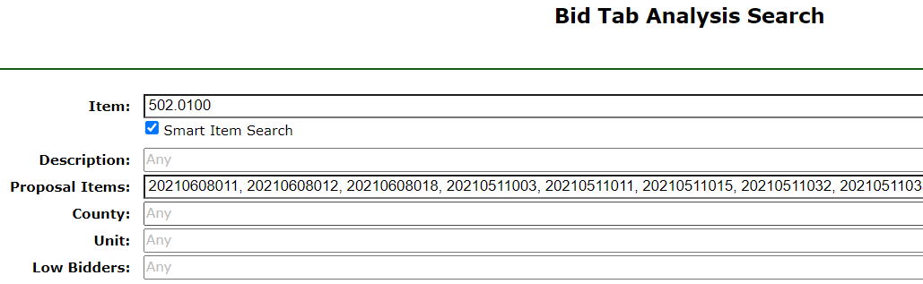
Similar Project Tool Updates
Notes:
Here is a screen capture for where to paste the proposal IDs in the Proposal Items Field. It’s where the red arrow is pointing. The proposal IDs are pasted and separated by commas.
Unfortunately, you must enter an item number or a portion of an item number for searches to obtain results, when using the Proposal Items Field. You may enter information in the Item and Description Field, but you must enter something in the Item Field at the blue arrow. If you only enter information in the Description Field, the search results will not work. InfoTech who maintains Bid Express is aware of the issue. They can replicate the problem, and they are working on it.

Slide 18

Bid Express User Guide
Linked in FDM 19-5-5.5.1 Primary Tools pg. 13
  Linked in the Estimating Tools Pages
Introduction – pg. 2-3
  Start up
  Bid Express Overview
Looking up bid history and bid tabulations – pg. 4-7
  Guidance for what to enter in bid history fields
  Steps to review and obtain results
Notes:
The Bid Express User Guide has been updated. It is linked under Bid Express in the Primary Tools Section in page 13 of FDM 19-5.
It is also linked in the Estimating Tools Page, but it makes the most sense to find it in the FDM, since that is where we should be looking for construction estimate guidance.
The Bid Express User Guide currently has 29 pages but hold on. It’s not as overwhelming as it seems. The first page is the table of contents. If you’re new to Bid Express or would like a refresher, Start Up and Bid Express Overview information is provided in pages two and three.
Pages four through seven contains guidance for looking up up bid history and bid tabulations. Guidance for what to enter in bid history fields in Bid Tab Analysis and steps to review and obtain bid tabulation results.
I strongly recommend everyone who develops construction estimates review these pages to ensure we are all using Bid Express properly and efficiently. I know a lot of us developed our own ways of reviewing bid tabs in Bid Express. I have seen some… creative ways people search for results in Estimate Documentation from experienced and new design engineers. So please review at least this portion of the Bid Express User Guide. Spending 15 minutes or less reviewing this portion of the guide is very beneficial.

Slide 19
Bid Express User Guide
Tips and Tricks – pg. 8-24
  Step-by-step guides with screen captures
  Finding proposal, project or bid information with any project or structure ID
  Finding structure information
  Filter and graph Bid Tab Analysis results in Excel
Appendices – pg. 25-29
  County and region map
  County and region codes
Notes:
Pages eight through 24 contain tips and tricks for using Bid Express. The reason this portion of the guide is so big is because it contains step-by-step guides with screen captures.
Depending on what you need, we have three step-by-step guides to find proposal, project or bid information with any project or structure ID; A guide to find structure information; and a guide to filter and graph Bid Tab Analysis results in Excel.
For filtering and graphing Bid Tab Analysis results in Excel, a regression curve is created in Excel. Additional effort is required to use Excel. This method is recommended for quantifiable significant items and is not worthwhile for non-significant items. It is very beneficial for broad searches in Bid Express and aggregating the results in Excel. I think it would be beneficial instead of performing multiple searches for the same item or reviewing major items of multiple projects. Broad searches could be done for all HMA mixes, same items with multiple units such as CY aggregate items often used in freeway contracts. Then, Excel can be used to aggregate the results or convert the items. An Excel example file is available, which is linked in the guide.
Pages 25 through 29 contains appendices for county and region map, and county and region codes that are referenced throughout the guide.
That’s everything I wanted to share for item trends and tool updates. Now Jill will speak for the rest the presentation starting with estimate accuracy.

Slide 20
Estimate Accuracy
Statewide – By Proposal
Notes:
Next, I would like to talk about estimate accuracy. This graph illustrates the estimate accuracy by proposal. The orange line shows the estimate accuracy for each letting, and the blue line shows the cumulative estimate accuracy for the fiscal year. So far in FY22, we have achieved an estimate accuracy of 60% when evaluating the lettings by proposal. Considering all the drastic price changes, this is very good. Good job everyone.

Slide 21
Estimate Accuracy
Statewide – By Dollar Amounts
Notes:
We also track estimate accuracy by proposals dollars estimated within 10% of the low bid. It’s currently not a performance measure, but it may be considered in the future since it can be a more reliable indicator of program stability.
So far in FY22, 47% of proposal dollar amounts were estimated within 10% of the low bid. When compared to the previous values, it means that larger projects are not estimated as accurately as small ones. The entire state is struggling with estimating these large projects.

Slide 22
Estimate Accuracy
Statewide by Program
Notes:
Here are estimate accuracy graphs by program so far for this fiscal year and for the last five complete fiscal years. On the left is Local Program, center is State Highway Rehabilitation and Majors on the right.
So far in FY 2022, Local Program has the best estimate accuracy at 68% by proposal and 75% by dollar amounts. SHR also has a good estimate accuracy at 55% by proposal and 54% by dollars. Proposals in the Majors program have been struggling with estimate accuracy at 25% by proposal and 2% by dollars. Local program contracts are typically smaller, and larger contracts are typically in the Majors Program.
These trends are consistent for small, medium and large contracts. As the projects get larger, in FY 22, estimate accuracy decreases, and there has been significant issues estimating projects more than $20 million. I would recommend that any large projects, especially those that are more than $20 million, go through a more thorough estimate review.

Slide 23
Start of FDM 19-5-5
Importance of Reliable Estimates
Estimate based on current costs
Program and budget stability
  Balance workloads and spending by region, contract type and funding sources
Low and High estimates impact program stability and are not beneficial
  Low estimates impact local agency funding
  High estimates impact advanceable projects being let in unfavorable months
Notes:
The start of FDM 19-5-5, Guidance for Construction Estimates, explains the importance of reliable estimates.
Your estimate should be based upon current construction costs and requirements of the project, not on how much the department feels would be appropriate to pay based upon past or original estimates.
WisDOT’s program stability depends on reliable estimates. Project programming is based on the estimated cost of a project. WisDOT also balances project attributes, such as Concrete, Asphalt and Structures, to ensure optimum workload distribution between regions during the fiscal year A reliable estimate allows WisDOT to make the best decisions with available funding.
If estimates are below the low bid extra funding will be required. If the funding is not available, it may result in the proposal being rejected or requiring the department to delay work on other needed projects. Local municipalities or counties with smaller budgets are more sensitive unanticipated cost increases, which increases the likelihood of the contract being rejected.
If estimates are above the low bid, it also create issues. The let savings may be fine for YOUR project. However, the state has budgeted a certain amount for the project, and if the project is bid much lower, more projects will need to be advanced to ensure the budgeted state program is spent. The advanced projects likely will be moved to unfavorable lettings at the end if the FY in late spring or early summer. If you look at FDM 19-5 Attachment 5.1, you will see that is typically the worst time to let projects.

Slide 24
Start of FDM 19-5-5
Importance of Estimates
May not spend a lot of time on them
Very critical when trying to schedule, let and award
Notes:
I know you will not spend as much time developing your estimates compared to other deliverables such as the DSR, plans and specials. But a reliable and consistent construction estimate is very critical when you are trying to schedule your project, letting your project, and successfully awarding your project to a contractor for construction.

Slide 25
FDM 19-5-5
May 2021 Updates
Better flow and new content for new designers
  Decrease additional guidance for new designers
Additional Estimating Webpage content copied to FDM 19-5
  Estimates are Confidential
    Link to Confidentiality Memo
  Estimating Users Group
Notes:
The FDM 19-5-5 was completely overhauled as part of the May 2021 updates. The overall guidance remained the same. However, 19-5-5 has a much better flow which makes it easier for new designers to successfully develop estimates with minimal additional guidance.
The additional content that can be found on the estimating webpages was added to FDM 19-5-5. This includes the confidentiality memo and information about the estimating user group.
The confidentiality memo explains that a construction estimate is always confidential, the contractor's bid tab information is confidential until the proposal is awarded. The memo also provides insight on why confidentiality of this information is important to the bidding process.
The objective of The Estimating Users Group is to review, develop and recommend WisDOT procedures and best practices on cost estimating for projects. Under the leadership of the Proposal Management Section in the Bureau of Project Development, members from each region work together to develop construction estimate training, maintain the Estimating Webpages and maintain most of FDM 19-5.

Slide 26
FDM 19-5-5
Estimate Types and Components
Bid-based estimating primarily used
Cost-based estimating for new or SPV items
  Labor + equipment + materials + overhead + profit
Item types listed with relevant links
Allowance items - known unknowns
Contingency items - unknown unknowns
Notes:
Following the section on the Estimating Users Group, the next new section of the FDM is the Estimate Types and Components Section. This section explains that the Department primarily uses bid-based estimating’ which uses historical bid data to develop estimates.
The Department also uses Cost-based estimating, which creates an estimate like a contractor would. Cost-based estimates are usually done for items with little or no bid history and very few similar items. The Cost-based estimate guidance has been greatly expanded using AASHTO’s Practical Guide to Cost Estimating and experience from construction staff. Cost-based estimating elements include labor, equipment, materials, overhead and profit. Each element of the guidance contains basic information on the process and where to find more information.
Estimate components include the various types of bid items including Standard Items, STSP Items and SPV items. Links to the relevant FDM sections and webpages are provided.
Allowance and Contingency items are defined from AASHTO’s Practical Guide to Cost Estimating.
An allowance item is a known part of the construction estimate, but standard items have not been quantified. Otherwise revered too as a known, unknowns.
A contingency item is an estimated cost associated with identified uncertainties. The uncertainties are usually identified through a risk assessment. Otherwise referred to as an unknown, unknowns.

Slide 27
FDM 19-5-5.5
Tools and Resources
Descriptions updated
  Who created and update the tools
  Type of application
  Credentials to use tools
  Link to tool guidance
Primary tools
  Table showing what tools are recommended for each item type
Other tools and resources
Notes:
After estimate and item types are defined, estimating tool resources are listed.
Descriptions for each tool have been updated. The description for each tool explains who created and updated the tool, what type of application is needed for each tool, credentials required to use each tool, and additional guidance or links to additional guidance for each tool.
The estimating tools section is now divided into two main sections, primary tools, and other tools and resources.
Primary tools list the main tools used by the department for developing construction estimates. Table 5.1 has been added, and it shows what estimating tools are most applicable for each item type defined in the previous section.
Other tools and resources provide additional resources that can be helpful in estimate development.

Slide 28
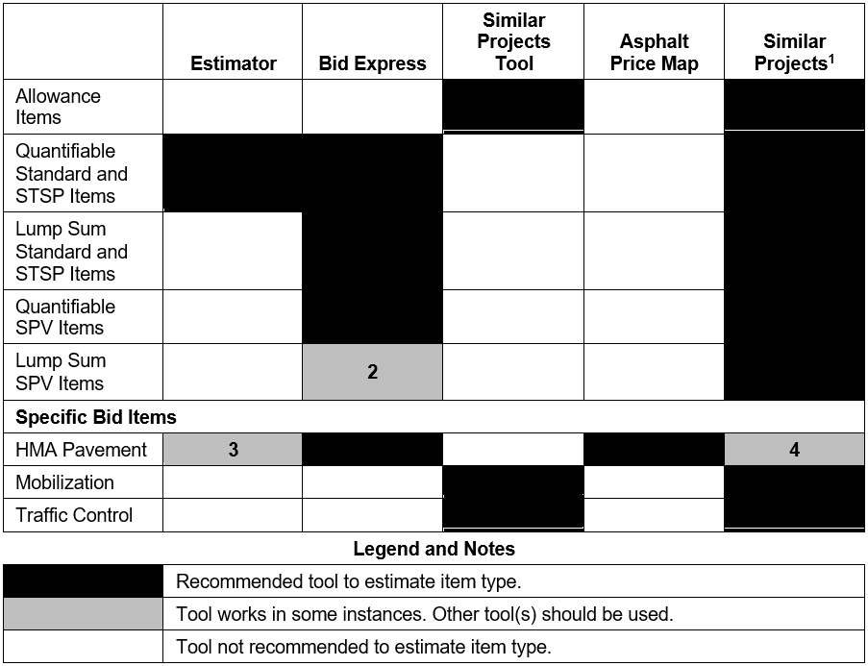
Tools to Estimate Each Item Type
Not an estimating tool.
Not similarly scoped. Find similar projects.
Only in NW and SE Regions
May not be in a similarly priced, geographic area.
Notes:
Here is the new table in FDM 19-5-5. This table shows what primary tool should be used for each type of bid item.
The various items are listed on the left, including allowance items, quantifiable items, lump sum items, and specific bid items.
The primary tools with similar projects are listed across the top.
The matrix below shows what estimating tools should be used with each item type.
Black squares are recommended tools for each item type.
Gray squares are tools that work in some instances which are defined on the right.
These notes are expanded in the FDM.
Note one explains that similar projects are not an estimating tool but are used in estimate development.
Note two says Bid Express results may not be similarly scoped if there are similar SPV item descriptions. Similar projects likely are needed to find similarly scoped items.
Note three says Estimator should only be used in the NW and SE Regions, where bid prices are consistent throughout the region. Prices can vary significantly throughout the other regions.
Note four says similar project may not be in a similarly priced, geographic area with HMA pavement items.

Slide 29
FDM 19-5-5.5.2
Training Videos
Estimate Documentation
Quantities 2 Plans
Estimating Webpages
Future Training Videos
  Estimate Development based on FDM 19-5-5 and FDM 19-5-7
  Bid Express
Notes:
The Estimating Webpages are the first of the “Other Tools and Resources” listed in FDM 19-5-5.5.2. People from the Estimate Initiative and the Estimating Users Group worked together to develop training videos to guide people in estimate development. The Estimate Training Webpage provides links to the videos. The training videos address the following topics: Estimate Documentation, Quantities 2 Plans and Estimating Webpages. Currently, Fred is working on a training video based upon FDM 19-5-5 and FDM 19-5-7 that will address estimate development. Once that is completed, he work on the Bid Express training video based upon the Bid Express User Guide.

Slide 30
FDM 19-5-5.6
Construction Estimate Development
Estimate Development reorganized to match Estimate Documentation
  Similar projects guidance
  Project characteristics greatly expanded
    Subheadings matching Estimate Documentation
    Content from past presentations
  Bid Item Estimating Guidance
  Unit Price Guidance
Notes:
After Tools and Resources, the Construction Estimate Development Section has been reorganized to better match the Estimate Documentation Report. The subsections within the Construction Estimate Development Section include similar projects guidance, project characteristics, bid item estimating guidance, and unit price guidance.
It includes relevant content from past presentations, such as the attachment that shows recommended letting months by Improvement Strategy.
Bid item estimating guidance includes additional guidance for specific bid items such as Mobilization, milling and asphalt pavement items.
Unit price guidance includes rounding unit prices, regression price guidance, calculating percentage items such as allowance and mobilization items, blending unit prices, and adjusting unit prices using the Wisconsin DOT Chained Fisher Construction Cost Index.

Slide 31
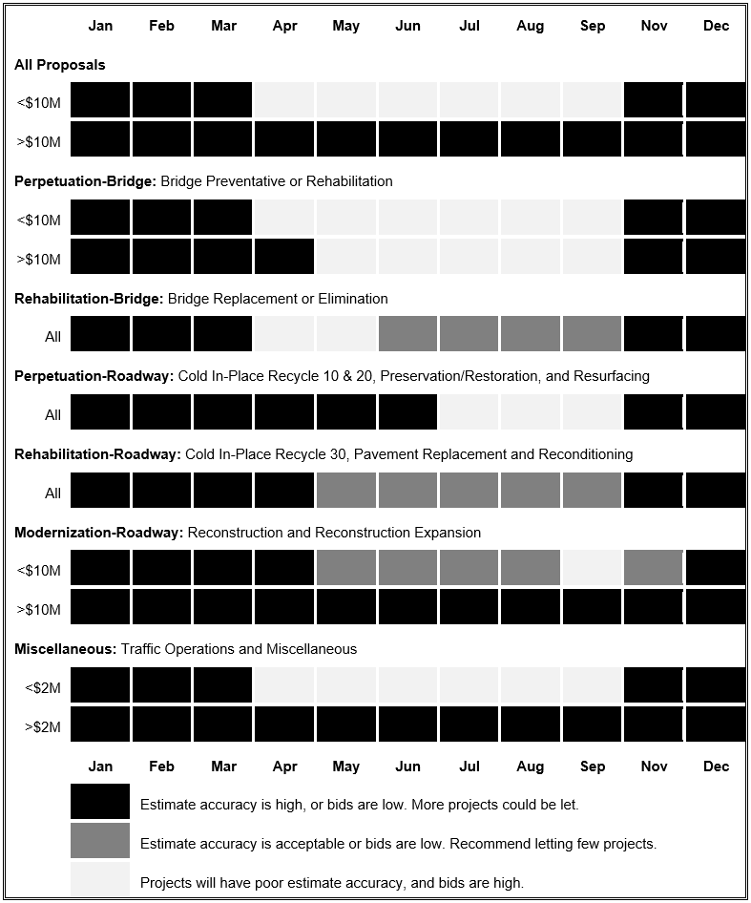
Tools to Estimate Each Item Type
Notes:
Here is attachment 5.1 of 19-5. This is only a portion of the table, but what is shown includes recommended letting months by Improvement Strategy for all proposals and bridge related contracts. If the letting date can be moved and the letting still has capacity, I would recommend to move the project’s letting into a more favorable letting. Estimate prices will need to be increased if a project is let in a less favorable month. Estimator already adjusts regression prices by season and do not need to be increased.
The letting date does influence bid prices. Bids are typically higher in the spring and summer months. Contracts let closer to when work is scheduled to begin will see higher bid prices, and contractors are focused on their on-hand work. Competition decreases as contractors fill up with work before a construction season in April and May lettings, which leads to higher prices.
For contracts less than $10 million, November through March letting months have higher estimate accuracy or the bids are low. Contractors are concentrating on bidding for work in the next construction season and bid aggressively.
A contract more than $10 million usually can be in any letting month. Larger contractors who bid on larger contracts likely have dedicated staff for developing bids.

Slide 32
FDM 19-5-7
May 2021 Updates
Updating construction estimates after PS&E
How to reach out to contractors after a letting
  Only reach out to contractors through BPD
  Consistent with FDM 11-5-1.2
Link to Unbalanced Bid Analysis in CMM 210.2.1
Notes:
More guidance was added for updating construction estimates after PS&E. The Recent Trends Document is linked again in this section. Update your estimate prior to submittal of the PS&E. Unit prices and quantities can also be updated when addressing comments from the plan reviewers. Any updates to estimates after advertisement will require an addenda.
Guidance was revised concerning reaching out to contractor after the bid opening. Any outreach to contractors or industry should be completed through Bureau of Project Development, or BPD. BPD will work with the contracting associations to obtain information on biddability and constructability information for a proposal. This is consistent with FDM 11-5-1.2 for collaboration with industry during the design process.
A link to information concerning WisDOT’s Unbalanced Bid Analysis in the Construction and Materials Manual has been added.
Those are the major updates last year to FDM 19-5 Construction Estimates.

Slide 33
Bid Express Questions and Answers
Project staff to provide answers within 5 business days
  See FDM 19-22-5
Recommend that all questions go through Bid Express
If a contractor calls, send a summary of questions and answers to DOTBidxQA@dot.wi.gov
  All contractors need to be aware of questions and answers received
    Otherwise, contractors who call receive a bid advantage
Notes:
Next, I want to share some information about the Bid Express Questions and Answers.
Once a question has been submitted and published, the question will be forwarded by BPD staff to the appropriate Project Manager, Project Designer, and Supervisor as listed within the plan letter and FIIPs. The Project Staff will provide the answer within 5 business days or less to the Bid QA mailbox. See FDM 19-22-5.
Bureau staff are copied on questions, as needed, to ensure answers are consistent with state policy and common practice. Discussions and analysis may occur, but we still need the answer within 5 business days. Please be mindful of the timeframe we will reach out to you again if time permits, however, it is in the best interest of the project to provide answers to the questions or issue and addendum if needed.
We recommend that all contractor questions go through Bid Express. If a contractor calls you refer them to the Bid Express site. Contractors can ask questions whether or not they have an account with BidX.com.
All contractors need to be aware of questions and answers from other contractors. The contractor that calls you, has no incentive to submit a question to Bid Express, and has a bid advantage if other contractors are not made aware of the question and response.

Slide 34
Justifications
Why was the bid significantly different than the estimate?
  Did you omit the labor for a cost-based approach?
  Did something change between PSE and the Letting?
  Designers are aware of location, staging, environmental constraints.
    These characteristics should be considered in the estimate.
What safety issues will the project address (HSIP)?
  Identify what is being done to address the safety concern.
  Provide a crash rate comparison to the statewide average crash rates.
Notes:
What is important to explain in the Justification? Why was the low bid significantly different that the project estimate? Did you estimate one or more of the items using a cost based estimating process and forget to add the labor? Did something change between PSE and the Letting? For example, did a competitor buy out a potential second bidder or an aggregate supply. You know the various aspects of the project when you are developing the estimate, for example, location, staging, environmental constraints, Railroad issues, Utility concerns. These should be factored into the estimate. Be careful when using regression prices. They do not necessarily consider cost impacts for the characteristics of your projects.
Safety. We are looking for information on a documented safety concern that will be addressed with this project. Please provide data such as a crash rate comparison to the statewide crash rate for similar roadways.

Slide 35
Justifications
Environmental restrictions or commitments that impact schedule.
  Stream disturbance - Fish spawning and Cricket Frog windows.
Impacting schedules of other area projects.
  The roadway is being used as a detour the following construction year.
  Municipal utilities are being relocated as part of the project.
Maintenance concerns.
  Will maintenance need to complete work on the corridor to keep the route viable for another year? If so, how much will it cost.
Notes:
If the project is rejected and relet, even 2 months later, what are the project impacts. Are there environmental restrictions such as fish spawning and Cricket Frog windows that will require the project to be pushed an entire year. If that occurs what coordination would need to be revisited?
Are there other projects in the area that will be impacted by a delay in the construction of this project? Is the corridor being used as a detour for another project the following year? Are municipal utilities being relocated as part of the project? What are the impacts to the municipality if the project is delayed. Was utility work completed earlier in anticipation of the surface being replaced in a specific timeframe?
Are there maintenance concerns along the project? Will maintenance need to be completed on this corridor if the project does not move forward? If so, what will be done and how much will it cost.

Slide 36

Contact Information
Jill Fehrman
Proposal Management Chief DTSD-BPD
Jillene.Fehrman@dot.wi.gov
(608) 266-3721
Fred Schunke
Estimating Engineer, DTSD-BPD
fred.schunke@dot.wi.gov
(608) 266-9626
Notes:
That is everything I wanted to cover today. If you have any questions or comments, feel free to ask now, email or call us using the contact information provided on the screen.
Thank you.

