Slide 1

Estimating Costs
on WisDOT Projects
Jill Fehrman
Proposal Management Chief
and
Fred Schunke
NC Region QA Engineer
Transportation Improvement Conference
March 8, 2023
Notes:
Hello. My name is Fred Schunke. I now am the North Central Region Design QA Engineer, but until last year I was the statewide estimating engineer for the Proposal Management Section in the Bureau of Project Development.

Slide 2
What are we going to talk about today?
Learning Objectives
Examine recent trends in unit bid prices.
Learn the latest estimating guidance and tool updates.
Understand central office expectations and guidance when responding to justification emails.
Notes:
The learning objectives we are going to discuss today include the following:
Examine recent trends in unit bid prices.
Learn the latest estimating guidance and tool updates.
Understand central office expectations and guidance when responding to justification emails.

Slide 3
Item Trends
Recent Trends Document
  FDM 19-5-5.6.2 pg. 19 & FDM 19-5-7.3.1 pg. 25
  Updated almost monthly
  Contains latest item estimating guidance
  Latest bidding trends
Bid Item Estimating Guidance
  FDM 19-5-5.6.3 pg. 19
  Contains more permanent estimating guidance
Notes:
First, lets talk about items trends.
A significant portion of what we will be discussing for items is in the Recent Trends Document. Recent Trends is linked in two places in the FDM, under Other Considerations of Project Characteristics on pg. 19 of FDM 19-5 and under Updating the estimate after PS&E on pg. 25 of FDM 19-5.
It is updated almost monthly, it contains the latest estimating guidance, and the latest bidding trends.
Lasting guidance is eventually moved to FDM 19-5, when the guidance is remains consistent and not for temporary trends.
For item trends, the first thing I am going to show are commodity trends along with recent item trends.

Slide 4
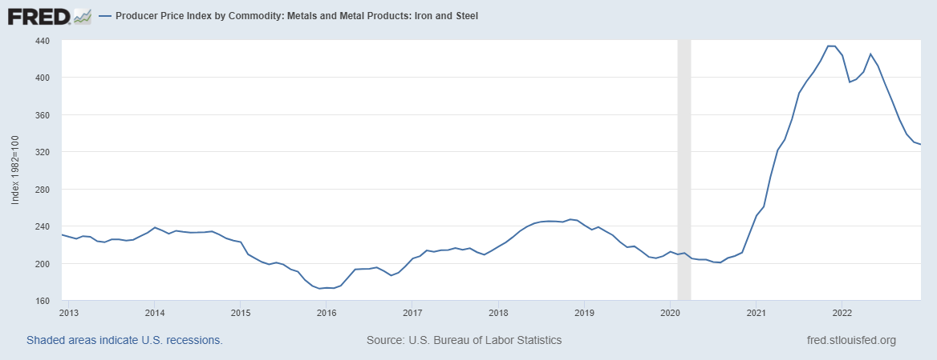
Producer Price Index Commodities
Nationwide Iron and Steel (10 years)
Notes:
First is iron and steel. National steel commodities have decreased down to about half of the unprecedented peak in January last year. The vertical, dashed line is where the graph was when I shared it last year.
Bid prices for piling, rebar and steel railing significantly vary between contractors. We believe some contractors still have materials they purchased at higher prices, or some steel suppliers still have higher prices.
Prices for monotubes and cast-iron pipes remain high.
The Producer Price Index for Nationwide Iron and Steel for the past 10 years is shown. These trends are consistent in Steel Mill Products and Concrete Reinforcing Bars Producer Price Indices. The Producer Price Index Graphs are from FRED Economic Data Webpages and the data comes from the U.S. Bureau of Labor Statistics.

Slide 5
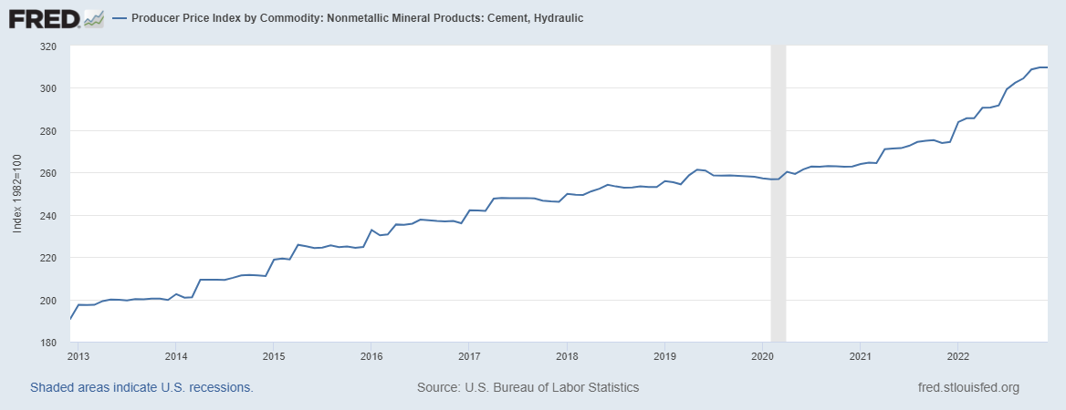
Producer Price Index Commodities
Nationwide Cement (10 years)
Notes:
Here is the Producer Price Index of Cement for the last 10 years. There are similar trends with sand and gravel. As you can see there is a consistent increase each year and this past year has been increasing more, but nothing as drastic as steel.
On a side note, the Nationwide Producer Price Index for Construction Machinery and Equipment have similar trends.

Slide 6
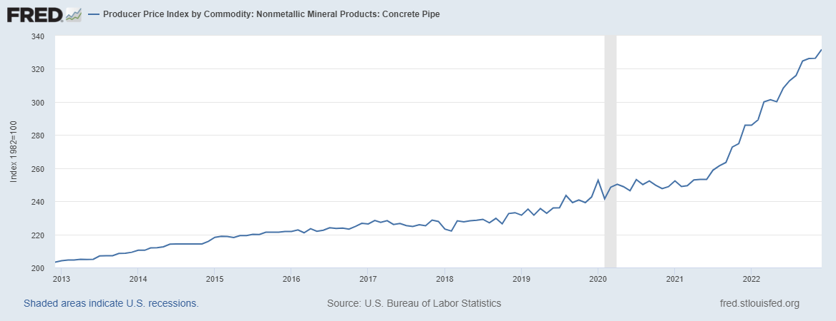
Producer Price Index Commodities
Nationwide Concrete Pipe (10 years)
Notes:
A common item we use that contains cement and steel is concrete pipes. The Producer Price Index for Nationwide Concrete Pipe has increased at a higher rate last year, but not as drastic as steel. We have seen higher prices for concrete pipes, but the highest increases are usually due to deep pipes or pipes being completed a half at a time. So it’s something we should be aware of when developing estimates.

Slide 7
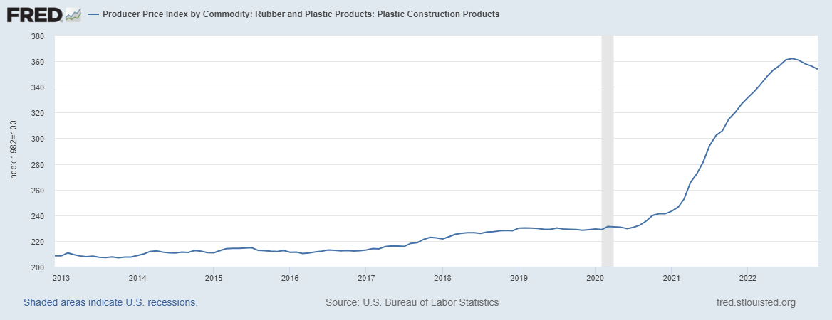
Producer Price Index Commodities
Nationwide Plastic Construction Products (10 years)
Notes:
Plastic Construction Products has a similar trend as steel. We have noticed that PVC for sanitary and water have increased, and prices for these are extremely high especially if pipes are deep, require rock excavation, or work is staged in an urban environment.

Slide 8
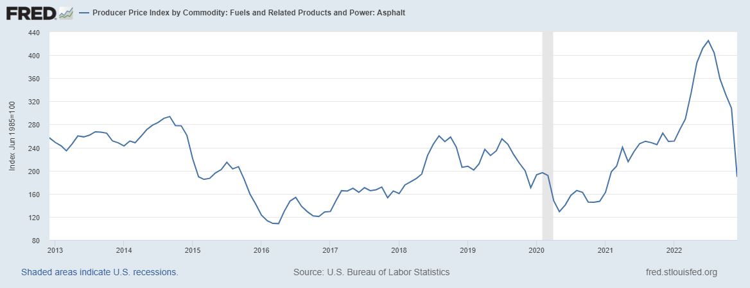
Producer Price Index Commodities
Nationwide Asphalt (10 years)
Notes:
Until recently, worldwide crude oil, nationwide diesel, Wisconsin’s diesel, and national asphalt indices have all had very similar trends. Since November 2022, nationwide asphalt continues to decrease close to previous low index values experienced during the height of the pandemic when prices were very low. None of the other indices continue to decrease as low. We have seen contractor pass on this savings in competitive asphalt market areas.

Slide 9
No. 2 Diesel Price per Gallon
Wisconsin Average (10 years)
Notes:
Here is a graph for the average price of No. 2 Diesel in Wisconsin for the past 10 years. The prices shown on this graph do not include gas taxes. Average prices have dropped but remain at 2014 prices. In the last year, prices did increase to unprecedented amounts and have recently come below previous high prices from 2012 to 2014.
Asphalt pavement and any item sensitive to haul distances and fuel use will be affected. Items include earthwork, aggregate, concrete, and more.

Slide 10
Commodity Links
PPI Iron and Steel (WPU101)
  PPI Steel Mill Products (WPU1017)
  PPI Concrete Reinforcing Bars (WPU1074051)
PPI Cement, Hydraulic (WPU1322)
  PPI Construction Sand, Gravel, and Crushed Stone (WPU1321)
  PPI Construction Machinery and Equipment (WPU112)
PPI Concrete Pipe (WPU1332)
PPI Plastic Construction Products (WPU072106)
Wisconsin’s Fuel Cost Adjustment
  PPI No. 2 Diesel Fuel (WPU057303)
  PPI Asphalt (WPU05810212)
  Crude Oil Prices
Notes:
Here is a list of the commodities shown and mentioned. Links are provided in the file.
Jill?

Slide 11
Future Impacts
Husky Energy’s Superior Refinery
The Refinery is expected to resume operations in 2023
Capacity will be 50,000 barrels per day
  Products include asphalt, gasoline, diesel and fuel oils.
https://huskyenergy.com/superior/general-faqs.asp
Hopefully, diesel and asphalt prices decrease
Notes:
Husky Energy’s Superior Refinery is expected to resume operations in the second quarter of 2023, subject to regulatory approvals. This is where that refinery explosion occurred in 2018.
The refinery’s capacity will remain the same as before at 50,000 barrels/day. It will be able to produce asphalt, gasoline, diesel and fuel oils.
This information is found right on the General FAQ Page for the Superior Refinery on Husky Energy’s Website. A link is shown on the screen.
The Asphalt Construction Cost Index did increase 14% in 2018. We hope that diesel and asphalt prices continue to decrease in area when this refinery is operating again.

Slide 12
Construction Cost Index
Asphalt Pavement Items
Notes:
The WisDOT CF CCI has increased about 20% in the last year. The Asphalt, Concrete Pavement and Structure Indices increased about the same amount in the last year. Many of the commodity indexes have been falling. Hopefully, we will stop seeing drastic price increases and they possibly could decrease in the next year. Other major factors exists for rising costs such as labor shortages, wage increases, supply chain issues, increased program nationwide due to BIL funding to name a few. We still have a lot of unknowns that impact costs.
That was everything we wanted share about updated item trends.

Slide 13
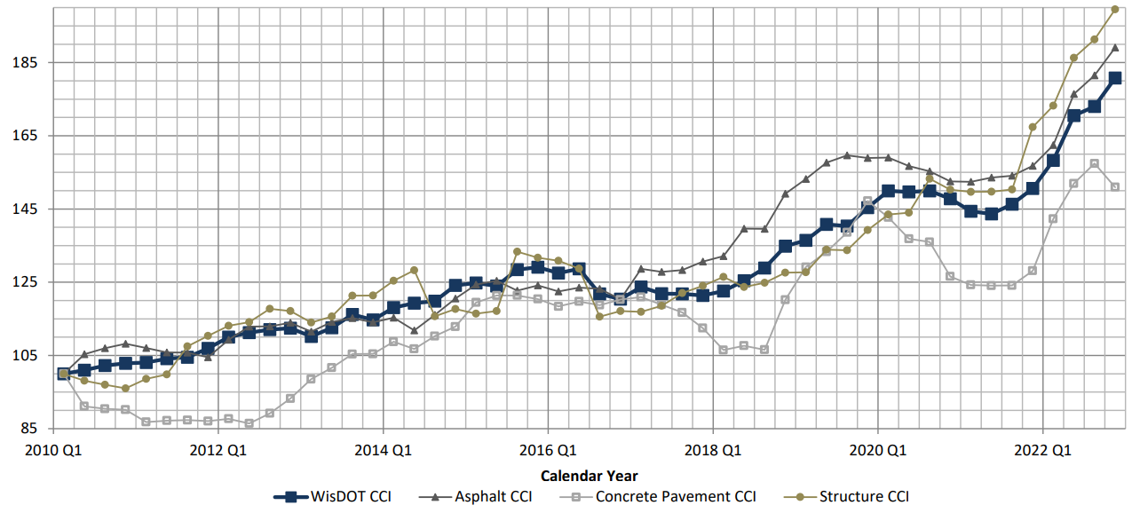
Construction Cost Index
Asphalt Pavement Items
Notes:
The third and forth pages of the WisDOT’s Chained Fisher Construction Cost Index contains Construction Cost Indices for Asphalt, Concrete Pavement and Structures. The individual values for each index are listed on page 4. This information can be used to adjust historic prices into current dollars for specific item types or classes.
Jill?

Slide 14
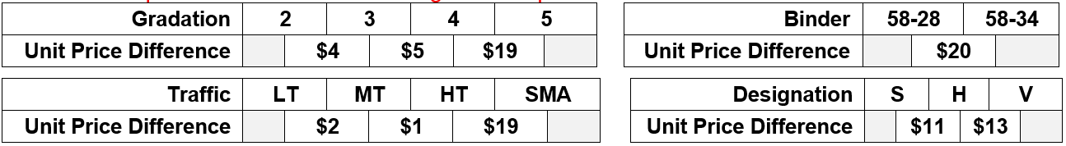
Item Trends
Asphalt Pavement Items
Average prices for the past year are shown
Gradation 5, Binder 58-34 or SMA asphalt mixes cost more
Notes:
Asphalt prices vary based upon mix design too. Statewide averages for the past year are shown in the table below. This is updated in the recent trends document. HMA pavement has about 80 items. Some mix designs do not have a large difference in unit prices between each other, and broader searches may be used. Bid prices for the past year have been similar between Gradation 2 and 3 mixtures, Light, Medium and Heavy Traffic. Estimates may be adjusted with more common items, but only one characteristic price difference or an average of multiple characteristics should be used. As shown below, Gradation 5, Binder 58-34 or SMA asphalt mixes cost more than other mix designs. If you can only find bid information for cheaper mixes, your estimate should be increased if your asphalt mixture contains one of the expensive characteristics. For instance, if you have a Gradation 5 and 58-34 Binder using bid data for cheaper mixes, then a unit price difference range is from $19 to $20 higher, not $39.

Slide 15
Item Trends
Removing Asphaltic Surface Milling
Guidance is in FDM 19-5-5.6.3 pg. 18
Average prices should not be used
  If the millings can be reused, prices are lower
    Prices are very low in competitive areas
  If the millings cannot be reused, prices are higher
    Sealcoats, chip seal, long haul distances, urban area or staging
Notes:
Removing Asphaltic Surface Milling is commonly an item of concern when comparing bids and estimates. Guidance is already in FDM 19-5-5.6.3 pg. 18.
Average prices should not be used. Prices vary depending upon if the milling can be reused or not. If they can be reused, prices are lower than average, especially in competitive areas.
If the millings cannot easily be reused due to a sealcoat, chip seal, long haul distances, in an urban area, or the construction schedule or staging is constrained, prices are higher than average. Since December, we have seen bid prices come in much higher with these characteristics.

Slide 16
Item Trends
Concrete Masonry Bridges
Regression prices should not be used
  Prices vary for slab-spans, girder and rehabilitated bridges
  Concrete Masonry Bridges, Removing Structure and Excavation for Structures should be estimated at the same time
    Each contractor will bid these items differently
Notes:
Concrete Masonry Bridges is commonly an item of concern when comparing bids and estimates. Prices seem to have increased since the December Letting.
Prices vary depending upon the bridge. Bid prices are higher with lower production rates. Prices will be higher if formwork is more difficult to complete, especially if there is only work on the superstructure.
- Concrete slab-span bridges typically receive bids lower than average.
- Girder bridges typically receive bids at about the average price.
- Rehabilitated bridges typically receive bids higher than average
Each contractor will balance their bid differently between Concrete Masonry Bridges, Removing Structure and Excavation for Structures items. All three items should be estimated at the same time with the same bid data.
The Recent Trends Document provides some basic steps to find similar bridges using the Highway Structure Information System or HSI.

Slide 17
FDM 19-5-5
Major update in May 2021
  Additional updates in November 2022
Better flow and new content for new designers
  Decrease additional guidance for new designers
All Estimating Webpage Content in FDM
Notes:
The FDM 19-5-5 was completely overhauled as part of the May 2021 updates, and other updates were made in November 2022. The overall guidance remained the same. However, 19-5-5 has a much better flow which makes it easier for new designers to successfully develop estimates with minimal additional guidance.
In both updates, all Estimating Webpage content has been copied to the various sections of FDM 19-5. This means that all estimating guidance or links to supplemental guidance are found in the FDM. The Estimating Webpages still exist, but they act as more of a location where tools and guidance that are regularly updated can be posted and maintained. Links to these tools and guidance is found in the FDM.
If you’re looking for estimate guidance or tool, go to the FDM.

Slide 18
FDM 19-5-5.5
Tools and Resources
Descriptions updated
  Who created and update the tools
  Type of application
  Credentials to use tools
  Link to tool guidance
Primary tools
  Table showing what tools are recommended for each item type
Other tools and resources
Notes:
Any tools and resources updated or created are listed in page 13 of FDM 19-5.
Descriptions for each tool are provided. The description for each tool explains who created and updated the tool, what type of application is needed for each tool, credentials required to use each tool, and additional guidance or links to specific tool guidance.
The estimating tools section is divided into two main sections, primary tools, and other tools and resources.
Primary tools list the main tools used by the department for developing construction estimates. Table 5.1 has been added, and it shows what estimating tools are most applicable for each item type.
Other tools and resources provide additional resources that can be helpful in estimate development. There is a lot of good information in here.

Slide 19
Estimating Tool Updates
Similar Projects Tool Update
  Cost per Mile
Bid Item List
  Standard, STSP and SPV items
  Current and obsolete items
  Copied from AWP Item Overview
    https://wisdot-pr-prod.infotechfl.com/#/RefItem/Overview
Notes:
The Similar Projects Tool had a minor update. The results sheet now has an average cost per mile calculation. Calculations only include filtered projects with numerical values for Proposal Length in the Data Sheet. Proposal mile lengths use centerline length, not lane mile, and divided highways are not doubled. This information is in the Similar Projects Tool Instruction within the Excel file and is linked as a separate PDF in FDM 19-5. Cost per mile may be used as a check to see how your estimate cost per mile compare to recent contracts from the scoping to final estimate.
A new resource we have is the bid item list. The bid item list contains a list of all standard, STSP and SPV bid items in the Item List Sheet. This list contains current and obsolete bid items. It can be used to find recently obsoleted item numbers that new items have replaced. Obsolete bid items shall not be used. Obsolete bid items have red, italic font. The bid item list has the item classification for each bid item that is used in the item classification calculations of the Similar Projects Tool.
The bid item list is copied from the AASHTOWare Projects Item Overview currently found in construction.
Designers may copy the link below after signing into AWP.

Slide 20
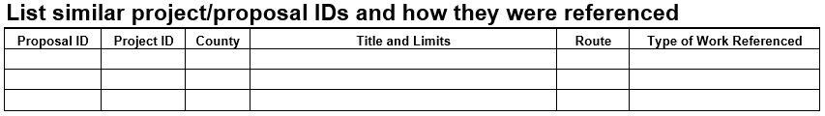
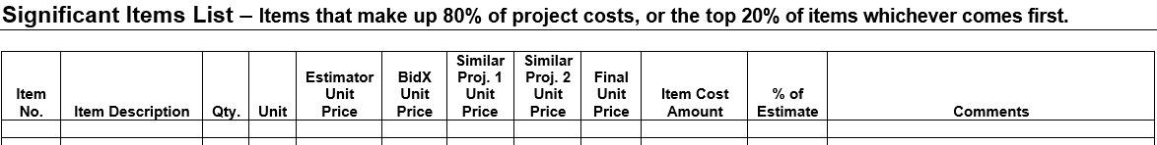
Estimate Documentation Updates
Similar Projects Table added
Significant Items Table added
Notes:
The Estimate Documentation Report Template was updated September, last year. Estimate Documentation Report Guidance is found FDM 19-5-6 with links to the guidance document and template.
A standard table was added for similar projects and significant items. The standard tables were added so that reviewers can easily find historic projects by proposal ID or project ID, and have project and item information in a consistent format.
In the Similar Project Table, we’re asking for the Proposal ID, Project ID, County, Title and Limits, Route and Type of Work Referenced. Nearly all of this information is found right in the Data Sheet of the Similar Projects Tool.
The Significant Items Table asks for item number, description, quantity, unit, estimator price, BidX Price, 2 similar project prices, Final Unit Price, Item Cost Amount, % of estimate and comments. Again, Significant items make up 80% of the project costs; or the top 20% of items whichever comes first.
Those were all the tool updates I wanted to share with you today.
Jill?

Slide 21
Criteria to Send Justification Emails
Low bid > 5% overestimate
Low bid > 10% below estimate
Items with bid flip concern
Sent to:
  Design team
  Region QA Engineer(s),
  Supervisor
  Design and planning chiefs
Notes:
Next, I am going to share justification guidance and expectations. We have updated FDM 19-5-7 and provide a justification guidance document, but we still get a lot of justifications that don’t quite me our expectations, and many times, you’re doing WAY more work than you need to, or not nearly enough. Hopefully after sharing our expectations, we get what we need, and you spend less time getting it to us, and everyone is happy… er.
An estimate is required to be justified by the designer if the low bid is more than 10% lower than your estimate or if the low bid more than 5% higher than your estimate. Emails also may be sent asking to check quantities in unbalanced bids where a change in 100% of the plan quantity would result in a different low bidder. About 2/3 of all proposals will need a justification email.
Emails will be sent to the following individuals when a bid justification is required:
Design Engineer
Project Manager or Local Program Project Manager
Region Design QA Engineer
Supervisor
Design Chief and Planning Chief
Justification emails use contact information from the plan letter. If the wrong individual is emailed, please forward the justification email to the correct contact and CC everyone else in the original email. A lot of projects are moving around in the regions and BPD will make mistakes for who receives the justification emails.

Slide 22
Timeline for Letting Review
Wed.
Generate Reports
Send justification emails
Thu.
Begin letting review
Letting review
Fri. to Mon.
Letting review
Review justification responses
Review justification responses
Letting review meeting
Tue.
Finalize letting review
Awards Meeting
Review unbalanced bid items
Notes:
You and your team may have been dealing with the project for years, but the letting review team has only begun looking at your project, and most of us will only be touching it until it is awarded.
Jill Fehrman is the proposal management chief of BPD who oversees the letting review process, ensures each project is ready for award and completes the award of each project.
The statewide estimating engineer and Mike Coleman review each proposal, justification email, create notes for each proposal and provide Jill with recommendations to award or outstanding issues.
Before the letting week starts, we will create a summary of each contract and review justification email contacts received from the plan letter and compare them against the DOT organization charts.
From noon on Wednesday until the next Tuesday morning, nearly all the letting review occurs for 30-50 contracts. Or an average of less than one hour per contract if we only devote our time towards this letting for the week. We do have other tasks to complete.
On Wednesday afternoon, reports are generated, unbalanced bid items are reviewed. This includes items where a change in 100% of the total quantity results in the low bidder changing. Quantities for these items need to be checked. When quantities need to be checked due to bid flip concern, a separate email may be sent, or a question added in the justification email to check these item quantities.
Otherwise, projects bid 5% over or 10% underestimate will have justification emails sent out.
If there are no issues with those processes and there is time, we will begin the letting review Wednesday afternoon until the awards meeting. On Thursday, Friday and Monday, we will review justification emails as they come in, and ask when we will receive missing emails before the awards meeting on Tuesday morning.
Please send the justification response before noon on Friday. You do not need to wait for concurrence responses from the region chiefs or local agency before sending the justification. Many local agencies cannot provide concurrence until they’ve had a meeting later that month. This is fine, but we still would like you to respond to the first set of questions in the justification. Bureau of Project Development can ensure no additional information is needed for the justification before the letting review and the proposal may be awarded as soon as the concurrences are received
On Friday and sometimes Monday, we will have a letting review meeting. Here, we review each contract or proposal and note anything else we need before awarding the project.

Slide 23
Letting Review Tasks
Proposal Description
  Project location and length
  Main work and items
  Coordination with others (utilities, RR, etc.)
  Hazardous materials
  Schedule constraints (stream limits, etc.)
  Staging
  Completion time requirements
Notes:
The first thing added to our letting review is the proposal description. The proposal description is a concise paragraph that includes the following information:
The project’s location or locations, how long segments are, and distance between multiple locations.
Next, the main bid items are listed. If needed, the main work will be described such as a new roundabout, or new bridge type. This gives us an idea for what crews and equipment are needed and how many crews.
Then, required coordination during construction is listed such as coordination with utility or railroads. Coordination with others can significantly impact the schedule, especially if they are not cleared yet.
Next, we will note any hazardous materials likely to be run into during construction including asbestos abatement or disposal of petroleum contaminated soils. Specialty crews may be needed, or the schedule impacted when the contractor pays special attention to these hazards.
Stream impact limitations and other schedule constraints are listed. Can the contractor complete the project within the construction schedule with these constraints?
Next, the project’s traffic control staging is described. Costs are typically much cheaper with mainline closures. While, multi-staged, tight urban projects are more expensive.
And finally, the completion time requirements are described. The number of interim completion times are listed, and we will note the completion date or number of working days.
Knowing this list of characteristics is helpful to understand why most bid results come in much higher or lower than estimate and seem to have the greatest impact on projects costs. This is one reason we ask you to share this information in the first two pages of the Estimate Documentation Report for your and our benefits.

Slide 24
Letting Review Tasks
Difference between bid and estimate
Number of competitive bids
List items much higher or lower than estimate
  Review their bid history
Review justification email responses
  Copy item notes
  Why bid was above or below estimate
  Reasons this contract should not be relet
Notes:
For each proposal, we will note the bid and estimate difference and the number of competitive bids.
Then, we will list items bid much higher or lower than the estimate and highlight the ones with the highest dollar amounts that caused the project to require a justification. We will use letting review tools to see if bid prices are consistent with trends statewide, for this letting, and for this contractor.
As we review justification email responses, we will add notes for the individual items under review, why the overall bid was above or below estimate, and reasons the contract should not be relet. If you have HSIP funding, it would be a good idea to include information about the safety issues there are in this contract and how this contract resolves them. A contract is rarely rejected that is bid much higher than estimate, when a lot of detailed safety information is provided.

Slide 25
Letting Review Tasks
Review bid flip concern items
Contractor capacity
Ensure no holds exist (DNR, real estate, RR, etc.)
When the bid is more than 5% overestimate:
  Region and local agency concurrence
  If needed, AO and SO concurrence
Notes:
Then, We will note items of bid flip concern, and verify those quantities have been checked.
Before the awards meeting,
We will review the contractor’s capacity.
Ensure no hold exist for DNR or railroad coordination and real estate.
When the bid is more than 5%, verify that we have local agency and region concurrences.
And if needed, note if the contract needs an administrator’s or secretary’s office review and concurrence before award.
The contractor’s capacity is checked by adding their current outstanding work, the low bid amounts of any contract they are the low bidder in this letting. This total will be checked against the maximum rating. The maximum capacity rating will establish the combined value of all work including subcontracts of all classes which a bidder may be awarded and have under contract and incomplete at anyone time.
An administrator’s or secretary’s office review is needed when the bid is more than 15% overestimate with multiple bids, more than 10% overestimate with single bids, or more than a million dollars overestimate. These parameters are listed in Justification Guidance.
These notes and tasks are completed for each contract, every letting.
Jill?

Slide 26
Justification Attachments
Justification Guidance
  Found in FDM and Estimate Development Page
Engineers Estimate Report
  Bid tabulations for two low bids and estimate
Significant Items Report
  Bid summary and items bid significantly different from estimate
Final Detail Cost Estimate Report
  Low bid summary includes project, funding and category totals
Notes:
Each justification email includes 3 or 4 attachments. The Justification guidance, Engineer’s Estimate and Significant Items Report are attached to every justification email. If a contract has local agency funding, the Final Detail Cost Estimate is Report is included.
Justification Guidance is attached and is in the in FDM 19-5 and Estimate Development Page.
Engineers Estimate Report contains bid tabulations for all items at the proposal level. It has unit costs in the two low bids and estimate.
Significant Items Report has a bid summary and items bid significantly different from estimate.
The significant items listed in this report are not the same significant items listed in the estimate documentation report. This report only looks at items bid significantly different from the estimate and that difference makes up more than 0.25% or 0.5% of the estimate. A lot of the items are the same, but the criteria to get the list of items is completely different from the estimate documentation.
The Final Detail Cost Estimate report gives a low bid summary of project, funding and category totals.

Slide 27
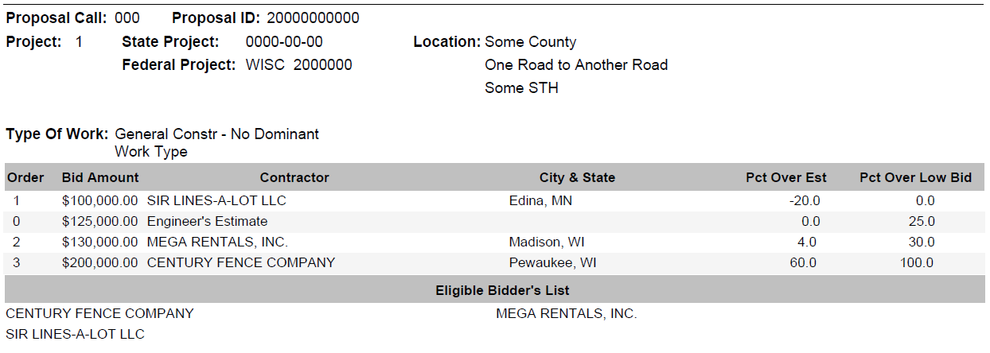
Justification Attachments
Notes:
In the last year and a half, the significant items report got a bid summary as the first page of the significant items report. A made up example is shown on the screen. On the top of the page we have your standard project and proposal information. The middle compares total bids and estimates along with contractor location, percent over estimate and percent over low bid.
On the bottom, we have the eligible bidder’s list. Knowing who the approved bidders are may help you understand why the bid was below or above the estimate. These are contractors that meet the prequalification requirements, asked to bid this contract and were approved to bid.
There are questions we try to understand when there is a single bidder and there are multiple eligible bidders who requested to bid.
When the bid is below estimate,
Did the contractor think there would be competition?
When the bid is above estimate,
Is the single bidder the only contractor able to complete this work?
Is the contract desirable to the contractor? Other contractors may not have bid likely because they feel they could not compete, the schedule is limited they have no crews available, or the contract is not desirable and they have enough work already.
Some contractors bid because they technically could bid the contract, but there is more work in another work type that someone else has requested to bid. For instance, if there is general contract with asphalt and bridgework, and there is more asphalt work, the bridge contractor will often just become the asphalt contractor’s sub.
These are some additional considerations to think about when submitting your justification email responses.
Jill?

Slide 28
Justification Guidance and Expectations
Macroeconomic trends impact all proposals
  Adjust historic prices into current dollars
    See FDM 19-5-5.6.4 Page 22
    Asphalt CCI
    Concrete Pavement CCI
    Structure CCI
  Do not need a large paragraph that mimics recent trends document
    Only a short summary needed
  Usually not the only reason for high bid prices
Notes:
Now that we’re aware of central offices letting review process and attachments received, lets go through some justification guidance and expectations.
The macroeconomic trends of rising material and labor costs and difficulty finding adequate materials and labor affects all contracts. Many justifications only discuss these trends as the only reason they believe the bid is high.
FDM 19-5, page 22 contains guidance to Adjust Unit Prices into current dollars using the Wisconsin DOT Chained Fisher Construction Cost Index. Pages have been added that include HMA pavement, concrete pavement, structures indices that make up the combined construction cost index. These item class indices may be used to adjust historic prices into current dollars.
You do not need a paragraph of information that essentially mimics what is in the Recent Trends Document. We also are the ones putting the recent trends document together from bid and commodity trends, and are aware of these trends. We do encourage designers to share additional information that is not discussed in the recent trends document.
If your project is more than 20% overestimate, usually more is going on than simply high inflation for materials and labor.
Is there staging, spot location work, or other contract requirements that would decrease productions rates, restrict contractor means and methods and get higher prices.
Did your similar, historic projects have lighter restrictions?
Was there a bid item with very limited bid history and has not been used recently?

Slide 29
Justification Guidance and Expectations
Need more thought-out reasons than
  “Bid is higher or lower than expected”
  Listing items and difference amounts
Focus on bid items differences that caused justification
  Do not justify price differences for all Significant Item Report Items
Most justifications do not need an attached document
  Separate justification attachment may be needed for AO/SO review contracts
Do not repeat yourself
Notes:
Simply saying that a bid is higher or lower than expected, or listing items with their difference amounts is not enough. Differences between the estimate and bid need more thought-out reasons in the justification.
Focus on bid item differences that caused the justification to be required. You do not need to list reasons why prices are different for all items listed in the significant items report. We will go through an example in little bit.
Most justification responses do not require a separate, attached document. We recommend you simply embed the responses in different colored test within the original email. Otherwise, justification attachments can become lost in replies.
You do not have to repeat yourself either. If you’ve answered multiple questions in one response, simply say “see answer in this question number” and be sure that response applies to both questions.
In summary, please do not send five to seven page justification attachments when the bid is less than 15% over estimate. They usually do not have to be that long.
And conversely, if the bid is more than 20% overestimate, rarely is a paragraph of information adequate to ensure we have the information we need to relay to the administrator’s and secretary’s office to award the contract.

Slide 30
Justification Guidance and Expectations
Lump similar items or work together
  Culvert pipe example
  Curb ramp example
Lump unbalanced items together
  More consistent with bid order and estimate
  Review characteristics for all unbalanced items
Notes:
You may lump similar items together, instead of repeating the same information for each significant item.
Culvert pipes are often listed and many times there are multiple sizes that show up in the significant items report. Feel free list all culvert items bid significantly different from the estimate and provide one explanation for why all culvert pipes were bid overestimate. Culvert pipes are often higher in resurfacing contracts for multiple reasons.
Work is scattered throughout the project length, multiple mobilizations may be required, especially if work is being completed half at a time.
You also may lump a group of items together that are required for the same work. Items for grading and shaping curb ramps, sidewalk and curb and gutter may be lumped together. Curb ramp work is completed at spot locations and is completed by hand. Production rates are low, and bid prices are typically much higher compared to long runs of earthwork, sidewalk and curb and gutter.
Unbalanced items are recommended to be lumped together. This is when the contractor has shifted funds from one item into another. Unbalanced items, added together, are more consistent with bid order and estimate. Characteristics for all items need to be looked at the same time for why bids were above or below estimate. We will go through more in our example.

Slide 31
Justification Guidance and Expectations
Bridge Replacement Contract
  15% or $150,000 overestimate
    Need $100,000 of items bid overestimate
  Removing Structure $105,000 overestimate
Notes:
Lets go through a quick and common example to decide what items to discuss in the justification. Bid and estimate difference totals by items are listed in the Significant Items Report.
You have a bridge replacement contract that was bid 15% or 150,000 overestimate. You need to find items that were together bid a $100,000 overestimate. If the bid was less than $50,000 overestimate, you wouldn’t be filling out this justification response because the bid would have been less than 5% overestimate.
The item with the highest dollar amount over is $105,000 overestimate, Removing Structure. Now, you may think this is very straight forward, and you’re done. However…

Slide 32
Justification Guidance and Expectations
Bridge Replacement Contract
  15% or $150,000 overestimate
    Need $100,000 of items bid overestimate
  Removing Structure and Concrete Masonry Bridges $25,000 overestimate
    Removing Structure $105,000 overestimate
    Concrete Masonry Bridges $80,000 underestimate
Notes:
Concrete Masonry Bridges was bid $80,000 underestimate. If you read estimating guidance in FDM 19-5, you will see that each contractor will balance their bid differently between Concrete Masonry Bridges, Removing Structure and Excavation for Structure Items. Removing Structure and Concrete Masonry Bridges together is only $25,0000 overestimate. You may discuss why the individual items were bid differently, but you should focus on why the items together were bid above estimate. The concrete masonry work may be more difficult than a typical contract that was not fully accounted for in the estimate, and the bridge removal may be straightforward. In this example, the low bidder likely had higher costs for concrete masonry bridges but shifted some of the costs to the Removing Structure Item. This is called a mathematically unbalanced bid, but the total cost of the contract is not going to change, and this unbalanced bid is legal.
Unbalanced items added together are more consistent with bid order and estimate. Characteristics for all items need to be looked at the same time for why bids were above or below estimate.
Ok, so we still need to find more items bid much higher than the estimate, since we’re only at $25,000 of $100,000.

Slide 33
Justification Guidance and Expectations
Bridge Replacement Contract
  15% or $150,000 overestimate
    Need $100,000 of items bid overestimate
  Removing Structure and Concrete Masonry Bridges $25,000 overestimate
    Removing Structure $105,000 overestimate
    Concrete Masonry Bridges $80,000 underestimate
  Cofferdams $50,000 overestimate
  Mobilization $35,000 overestimate
Notes:
The next highest dollar difference is cofferdams, that was $50,000 overestimate, then Mobilization was $35,000 overestimate. Together, Removing Structure, Concrete masonry Bridges, Cofferdams, and Mobilization were $110,000 overestimate. These are the items we will be reviewing for why the bid was 15% above the estimate.
Jill?

Slide 34
Start of FDM 19-5-5
Importance of Reliable Estimates
Estimate based on current costs
Program and budget stability
  Balance workloads and spending by region, contract type and funding sources
Low and High estimates impact program stability and are not beneficial
  Low estimates impact local agency funding
  High estimates impact advanceable projects being let in unfavorable months
Notes:
The start of FDM 19-5-5, Guidance for Construction Estimates, explains the importance of reliable estimates.
Your estimate should be based upon current construction costs and requirements of the project, not on how much the department feels would be appropriate to pay based upon past or original estimates.
WisDOT’s program stability depends on reliable estimates. Project programming is based on the estimated cost of a project. WisDOT also balances project attributes, such as Concrete, Asphalt and Structures, to ensure optimum workload distribution between regions during the fiscal year A reliable estimate allows WisDOT to make the best decisions with available funding.
If estimates are below the low bid extra funding will be required. If the funding is not available, it may result in the proposal being rejected or requiring the department to delay work on other needed projects. Local municipalities or counties with smaller budgets are more sensitive unanticipated cost increases, which increases the likelihood of the contract being rejected.
If estimates are above the low bid, it also create issues. The let savings may be fine for YOUR project. However, the state has budgeted a certain amount for the project, and if the project is bid much lower, more projects will need to be advanced to ensure the budgeted state program is spent. The advanced projects likely will be moved to unfavorable lettings at the end if the FY in late spring or early summer. If you look at FDM 19-5 Attachment 5.1, you will see that is typically the worst time to let projects.

Slide 35
Start of FDM 19-5-5
Importance of Estimates
May not spend a lot of time on them
Very critical when trying to schedule, let and award
Notes:
I know you will not spend as much time developing your estimates compared to other deliverables such as the DSR, plans and specials. But a reliable and consistent construction estimate is very critical when you are trying to schedule your project, letting your project, and successfully awarding your project to a contractor for construction.

Slide 36
FDM 19-5-5
May 2021 Updates
Better flow and new content for new designers
  Decrease additional guidance for new designers
Additional Estimating Webpage content copied to FDM 19-5
  Estimates are Confidential
    Link to Confidentiality Memo
  Estimating Users Group
Notes:
The FDM 19-5-5 was completely overhauled as part of the May 2021 updates, and other updates were made in November 2022. The overall guidance remained the same. However, 19-5-5 has a much better flow which makes it easier for new designers to successfully develop estimates with minimal additional guidance.
All Estimating Webpage content has been copied to the various sections of FDM 19-5. This means that all estimating guidance or links to supplemental guidance are found in the FDM. The Estimating Webpages still exist, but they act as more of a location where tools and guidance that are regularly updated can be posted and maintained. Links to these tools and guidance is found in the FDM.
If you’re looking for estimate guidance or a tool, go to the FDM.
The additional content that can be found on the estimating webpages was added to FDM 19-5-5. This includes the confidentiality memo and information about the estimating user group.
The confidentiality memo explains that a construction estimate is always confidential, the contractor's bid tab information is confidential until the proposal is awarded. The memo also provides insight on why confidentiality of this information is important to the bidding process.
The objective of The Estimating Users Group is to review, develop and recommend WisDOT procedures and best practices on cost estimating for projects. Under the leadership of the Proposal Management Section in the Bureau of Project Development, members from each region work together to develop construction estimate training, maintain the Estimating Webpages and maintain most of FDM 19-5.

Slide 37
FDM 19-5-5
Estimate Types and Components
Bid-based estimating primarily used
Cost-based estimating for new or SPV items
  Labor + equipment + materials + overhead + profit
Item types listed with relevant links
Allowance items - known unknowns
Contingency items - unknown unknowns
Notes:
Following the section on the Estimating Users Group, the next new section of the FDM is the Estimate Types and Components Section. This section explains that the Department primarily uses bid-based estimating’ which uses historical bid data to develop estimates.
The Department also uses Cost-based estimating, which creates an estimate like a contractor would. Cost-based estimates are usually done for items with little or no bid history and very few similar items. The Cost-based estimate guidance has been greatly expanded using AASHTO’s Practical Guide to Cost Estimating and experience from construction staff. Cost-based estimating elements include labor, equipment, materials, overhead and profit. Each element of the guidance contains basic information on the process and where to find more information.
Estimate components include the various types of bid items including Standard Items, STSP Items and SPV items. Links to the relevant FDM sections and webpages are provided.
Allowance and Contingency items are defined from AASHTO’s Practical Guide to Cost Estimating.
An allowance item is a known part of the construction estimate, but standard items have not been quantified. Otherwise revered too as a known, unknowns.
A contingency item is an estimated cost associated with identified uncertainties. The uncertainties are usually identified through a risk assessment. Otherwise referred to as an unknown, unknowns.

Slide 38
FDM 19-5-5.5
Tools and Resources
Descriptions updated
  Who created and update the tools
  Type of application
  Credentials to use tools
  Link to tool guidance
Primary tools
  Table showing what tools are recommended for each item type
Other tools and resources
Notes:
After estimate and item types are defined, estimating tool resources are listed.
Descriptions for each tool have been updated. The description for each tool explains who created and updated the tool, what type of application is needed for each tool, credentials required to use each tool, and additional guidance or links to additional guidance for each tool.
The estimating tools section is now divided into two main sections, primary tools, and other tools and resources.
Primary tools list the main tools used by the department for developing construction estimates. Table 5.1 has been added, and it shows what estimating tools are most applicable for each item type defined in the previous section.
Other tools and resources provide additional resources that can be helpful in estimate development.

Slide 39
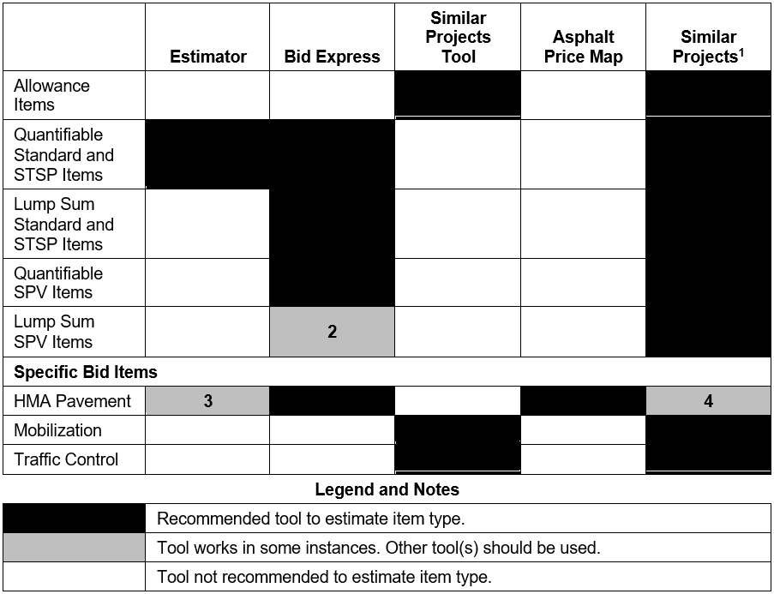
Tools to Estimate Each Item Type
Not an estimating tool.
Not similarly scoped. Find similar projects.
Only in NW and SE Regions
May not be in a similarly priced, geographic area.
Notes:
Here is the new table in FDM 19-5-5. This table shows what primary tool should be used for each type of bid item.
The various items are listed on the left, including allowance items, quantifiable items, lump sum items, and specific bid items.
The primary tools with similar projects are listed across the top.
The matrix below shows what estimating tools should be used with each item type.
Black squares are recommended tools for each item type.
Gray squares are tools that work in some instances which are defined on the right.
These notes are expanded in the FDM.
Note one explains that similar projects are not an estimating tool but are used in estimate development.
Note two says Bid Express results may not be similarly scoped if there are similar SPV item descriptions. Similar projects likely are needed to find similarly scoped items.
Note three says Estimator should only be used in the NW and SE Regions, where bid prices are consistent throughout the region. Prices can vary significantly throughout the other regions.
Note four says similar project may not be in a similarly priced, geographic area with HMA pavement items.

Slide 40
FDM 19-5-5.5.2
Training Videos
Estimate Documentation
Quantities 2 Plans
Estimating Webpages
Future Training Videos
  Estimate Development based on FDM 19-5-5 and FDM 19-5-7
  Bid Express
Notes:
The Estimating Webpages are the first of the “Other Tools and Resources” listed in FDM 19-5-5.5.2. People from the Estimate Initiative and the Estimating Users Group worked together to develop training videos to guide people in estimate development. The Estimate Training Webpage provides links to the videos. The training videos address the following topics: Estimate Documentation, Quantities 2 Plans and Estimating Webpages. Currently, Fred is working on a training video based upon FDM 19-5-5 and FDM 19-5-7 that will address estimate development. Once that is completed, he work on the Bid Express training video based upon the Bid Express User Guide.

Slide 41
FDM 19-5-5.6
Construction Estimate Development
Estimate Development reorganized to match Estimate Documentation
  Similar projects guidance
  Project characteristics greatly expanded
    Subheadings matching Estimate Documentation
    Content from past presentations
  Bid Item Estimating Guidance
  Unit Price Guidance
Notes:
After Tools and Resources, the Construction Estimate Development Section has been reorganized to better match the Estimate Documentation Report. The subsections within the Construction Estimate Development Section include similar projects guidance, project characteristics, bid item estimating guidance, and unit price guidance.
It includes relevant content from past presentations, such as the attachment that shows recommended letting months by Improvement Strategy.
Bid item estimating guidance includes additional guidance for specific bid items such as Mobilization, milling and asphalt pavement items.
Unit price guidance includes rounding unit prices, regression price guidance, calculating percentage items such as allowance and mobilization items, blending unit prices, and adjusting unit prices using the Wisconsin DOT Chained Fisher Construction Cost Index.

Slide 42
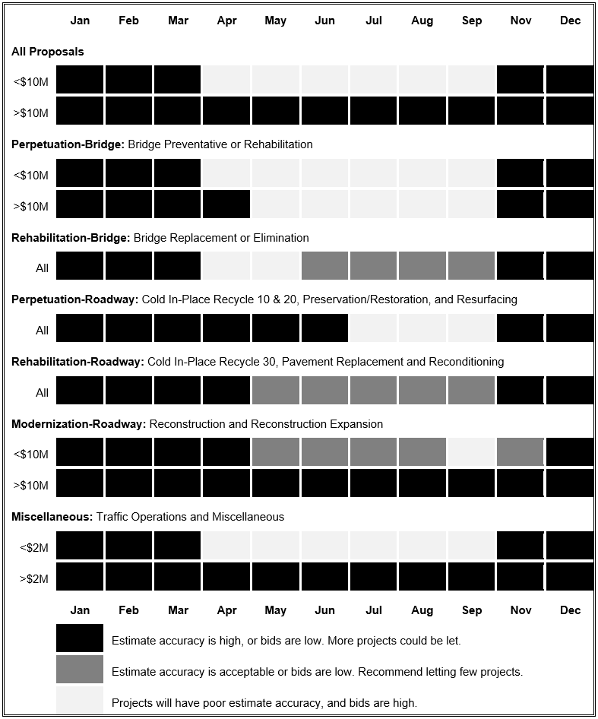
Tools to Estimate Each Item Type
Notes:
Here is attachment 5.1 of 19-5. This is only a portion of the table, but what is shown includes recommended letting months by Improvement Strategy for all proposals and bridge related contracts. If the letting date can be moved and the letting still has capacity, I would recommend to move the project’s letting into a more favorable letting. Estimate prices will need to be increased if a project is let in a less favorable month. Estimator already adjusts regression prices by season and do not need to be increased.
The letting date does influence bid prices. Bids are typically higher in the spring and summer months. Contracts let closer to when work is scheduled to begin will see higher bid prices, and contractors are focused on their on-hand work. Competition decreases as contractors fill up with work before a construction season in April and May lettings, which leads to higher prices.
For contracts less than $10 million, November through March letting months have higher estimate accuracy or the bids are low. Contractors are concentrating on bidding for work in the next construction season and bid aggressively.
A contract more than $10 million usually can be in any letting month. Larger contractors who bid on larger contracts likely have dedicated staff for developing bids.

Slide 43
FDM 19-5-7
May 2021 Updates
Updating construction estimates after PS&E
How to reach out to contractors after a letting
  Only reach out to contractors through BPD
  Consistent with FDM 11-5-1.2
Link to Unbalanced Bid Analysis in CMM 210.2.1
Notes:
More guidance was added for updating construction estimates after PS&E. The Recent Trends Document is linked again in this section. Update your estimate prior to submittal of the PS&E. Unit prices and quantities can also be updated when addressing comments from the plan reviewers. Any updates to estimates after advertisement will require an addenda.
Guidance was revised concerning reaching out to contractor after the bid opening. Any outreach to contractors or industry should be completed through Bureau of Project Development, or BPD. BPD will work with the contracting associations to obtain information on biddability and constructability information for a proposal. This is consistent with FDM 11-5-1.2 for collaboration with industry during the design process.
A link to information concerning WisDOT’s Unbalanced Bid Analysis in the Construction and Materials Manual has been added.
Those are the major updates last year to FDM 19-5 Construction Estimates.

Slide 44
Bid Express Questions and Answers
Project staff to provide answers within 5 business days
  See FDM 19-22-5
Recommend that all questions go through Bid Express
If a contractor calls, send a summary of questions and answers to DOTBidxQA@dot.wi.gov
  All contractors need to be aware of questions and answers received
    Otherwise, contractors who call receive a bid advantage
Notes:
Next, I want to share some information about the Bid Express Questions and Answers.
Once a question has been submitted and published, the question will be forwarded by BPD staff to the appropriate Project Manager, Project Designer, and Supervisor as listed within the plan letter and FIIPs. The Project Staff will provide the answer within 5 business days or less to the Bid QA mailbox. See FDM 19-22-5.
Bureau staff are copied on questions, as needed, to ensure answers are consistent with state policy and common practice. Discussions and analysis may occur, but we still need the answer within 5 business days. Please be mindful of the timeframe we will reach out to you again if time permits, however, it is in the best interest of the project to provide answers to the questions or issue and addendum if needed.
We recommend that all contractor questions go through Bid Express. If a contractor calls you refer them to the Bid Express site. Contractors can ask questions whether or not they have an account with BidX.com.
All contractors need to be aware of questions and answers from other contractors. The contractor that calls you, has no incentive to submit a question to Bid Express, and has a bid advantage if other contractors are not made aware of the question and response.

Slide 45
Justifications
Why was the bid significantly different than the estimate?
  Did you omit the labor for a cost-based approach?
  Did something change between PSE and the Letting?
  Designers are aware of location, staging, environmental constraints.
    These characteristics should be considered in the estimate.
What safety issues will the project address (HSIP)?
  Identify what is being done to address the safety concern.
  Provide a crash rate comparison to the statewide average crash rates.
Notes:
What is important to explain in the Justification? Why was the low bid significantly different that the project estimate? Did you estimate one or more of the items using a cost based estimating process and forget to add the labor? Did something change between PSE and the Letting? For example, did a competitor buy out a potential second bidder or an aggregate supply. You know the various aspects of the project when you are developing the estimate, for example, location, staging, environmental constraints, Railroad issues, Utility concerns. These should be factored into the estimate. Be careful when using regression prices. They do not necessarily consider cost impacts for the characteristics of your projects.
Safety. We are looking for information on a documented safety concern that will be addressed with this project. Please provide data such as a crash rate comparison to the statewide crash rate for similar roadways.

Slide 46
Justifications
Environmental restrictions or commitments that impact schedule.
  Stream disturbance - Fish spawning and Cricket Frog windows.
Impacting schedules of other area projects.
  The roadway is being used as a detour the following construction year.
  Municipal utilities are being relocated as part of the project.
Maintenance concerns.
  Will maintenance need to complete work on the corridor to keep the route viable for another year? If so, how much will it cost.
Notes:
If the project is rejected and relet, even 2 months later, what are the project impacts. Are there environmental restrictions such as fish spawning and Cricket Frog windows that will require the project to be pushed an entire year. If that occurs what coordination would need to be revisited?
Are there other projects in the area that will be impacted by a delay in the construction of this project? Is the corridor being used as a detour for another project the following year? Are municipal utilities being relocated as part of the project? What are the impacts to the municipality if the project is delayed. Was utility work completed earlier in anticipation of the surface being replaced in a specific timeframe?
Are there maintenance concerns along the project? Will maintenance need to be completed on this corridor if the project does not move forward? If so, what will be done and how much will it cost.

Slide 47

Contact Information
Jill Fehrman
Proposal Management Chief DTSD-BPD
Jillene.Fehrman@dot.wi.gov
(608) 266-3721
Fred Schunke
Design QA Engineer NCR
fred.schunke@dot.wi.gov
(715) 421-8359
Notes:
That is everything I wanted to cover today. If you have any questions or comments, feel free to ask now, email or call us using the contact information provided on the screen.
Thank you.

