Slide 1
High Value Research Sweet 16 – RAC Region 3
Diane Gurtner, WisDOT
Research & Library Services
July 25, 2017
National RAC and TRB State Representatives meeting
Louisville, Kentucky

Slide 2
Recycled Materials Resource Center Third Generation TPF-5(270)
Partner DOTs: Georgia – Illinois – Minnesota – Pennsylvania – Virginia – Wisconsin (lead state)
Lead Research Team: College of Engineering, University of Wisconsin–Madison
Objectives: Provide resources and research activities to increase utilization and promote the reliable, efficient, safe and sustainable use of recycled materials and industrial byproducts

Slide 3
RMRC background
The initial RMRC was founded in 1998 at the University of New Hampshire through an agreement with FHWA.
It was renewed as RMRC-2 as a joint venture between the University of New Hampshire and the University of Wisconsin-Madison. TPF-5(199).
RMRC-3, TPF-5(270) started in 2012 and is closing out in 2017.
RMRC-4, TPF-5(352) launched Spring 2017.

Slide 4
RMRC-3 scope
Participate in developing AASHTO and ASTM specifications and guidelines
Recycled Materials Web Map: Connecting Consumers and Producers
Systemwide Life-Cycle Benefits for Recycled Materials
Use of Recycled Materials as MSE Retaining Wall Reinforced Backfills
Notes:
Four major activities of the project.

Slide 5
AASHTO and ASTM International
New standards developed with RMRC input and leadership:
D7760 Standard Test Method for Measurement of Hydraulic Conductivity of Tire Derived Aggregates Using a Rigid Wall Permeameter
D7762 Standard Practice for Design of Stabilization of Soil and Soil-Like Materials with Self-Cementing Fly Ash
D7765 Standard Practices for the Use of Foundry Sand in Structural Fill and Embankments
Dxxxx Standard Practice for Reclamation of Recycled Aggregate Base (RAB) Material (just approved, still to be numbered)
Dxxxx Standard Practice for Reclamation of Scrap and Waste Asphalt Shingles to Produce Reclaimed Asphalt Shingles (RAS) for Use in Transportation Applications (in last stage of approval)
Notes:
RMRC has been actively involved with the AASHTO Subcommittee on Materials and TRB ADC60 Committee on Resource Conservation and Recovery and has contributed to national standards and specs in many areas including:
Coal fly ash
Coal bottom ash
Foundry sand
Roofing shingles
Reclaimed concrete
Flue gas desulfurization scrubber material
More specific contributions can be found at
www.rmrc.wisc.edu

Slide 6
Recycled Materials Web Map Phase 1 – rmwm.caps.ua.edu
Online GIS web application
Connects producers and consumers of material, minimizes transportation costs
Producers: location and contact information
Stockpiles: materials, availability and cost
Specifications and regulations
Case studies of successful projects and documentation
Notes:
This portion of the RMRC-3 TPF project was developed at the University of Alabama.
The research team and project partners joke that this is like the “Craigslist of Recycled Materials.”

Slide 7
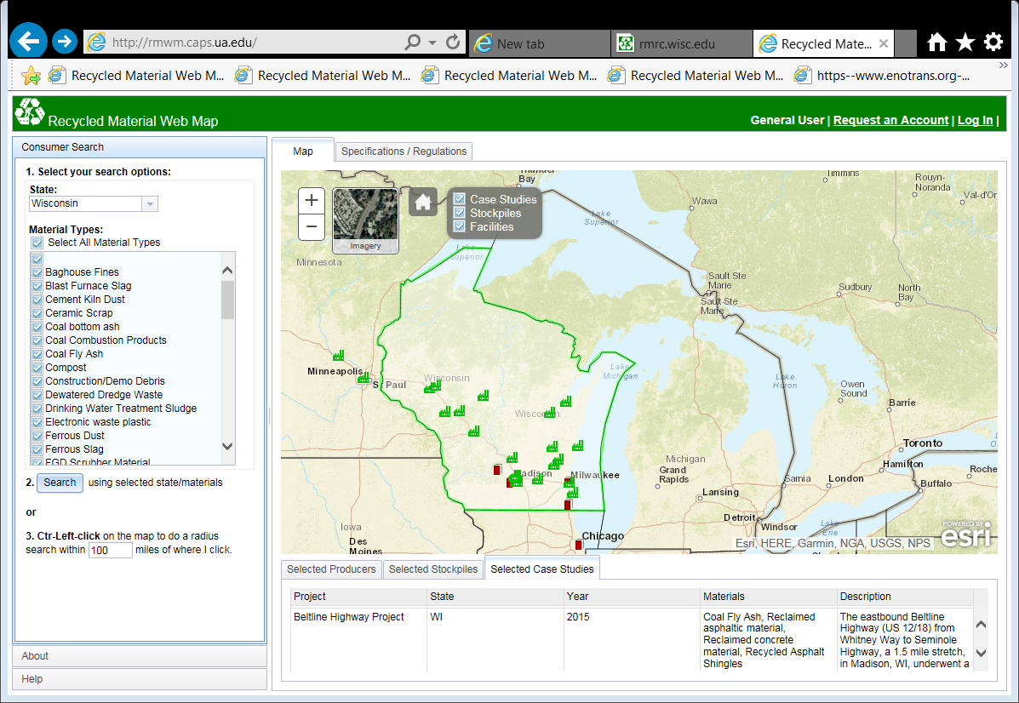
http://rmwm.caps.ua.edu/
Notes:
Shows the search capability of the web map. You can search by state, select specific material types and also choose to see the selected stockpiles, producers and case studies.

Slide 8
Systemwide Life-Cycle Benefits
After researching publicly available tools, PaLATE was used by RMRC to conduct life-cycle assessments and cost analyses for six partner states for the year 2013.
Energy consumption savings ranged from 78-83%
Water consumption was reduced by 94-99%
CO2 emissions were reduced by 92-99%
Solid waste disposal was avoided through reuse by 92-99%
Total economic savings estimated to be $63 million
Notes:
Pavement Life-Cycle Assessment Tool for Environmental and Economic Effects (PaLATE) is a pavement construction LCA model designed by the Consortium on Green Design and Manufacturing from the University of California-Berkeley.
Total economic savings realized from recycled material use in one year (2013) across 6 states estimated to be $63 million.
The range was from $3.3M up to $17.5M, and can be explained by the size of each state’s road improvement program for 2013 (some states like WI and VA had more projects and therefore more opportunities to use recycled materials.)
PA $3.341 million
MN $6.953 million
GA $10.1 million
IL $12.144 million
WI $13 million
VA $17.5 million

Slide 9
Materials Tracking Tool
Provides method to collect direct information and project-specific parameters on sustainability assessment characteristics: emissions, energy and water consumption and life-cycle cost benefits
Conveys the benefits in quantitative and transparent manner using easily understood metrics
Can be downloaded at http://rmrc.wisc.edu/
User manual also available
Notes:
As part of the life-cycle benefits, RMRC developed an Excel based tracking tool.

Slide 10
Use of Recycled Materials as MSE Retaining Wall Reinforced Backfills
Examined suitability of recycled asphalt pavement (RAP) and recycled concrete aggregate (RCA) as economical and environmentally beneficial sources for backfill
Evaluated mechanical and hydraulic properties (direct shear, pull-out, effects of compaction temperature, creep behavior, filtration)
Investigated tufa formation and geosynthetic filter clogging by RCA backfill
RCA and RAP found to be competitive compared to natural granular materials under many conditions; some limitations noted
Notes:
MSE = Mechanically Stabilized Earth
Tufa = a variety of limestone (pronounced Toofa)
See the TPF Website for the detailed final report

Slide 11
Principal Investigators
AASHTO and ASTM Specs; Systemwide Life-Cycle Benefits; and Tracking Tool: Dr. Tuncer Edil and Angela Pakes Ahlman, UW-Madison
Use of Recycled Materials as MSE Retaining Wall Reinforced Backfills: Dr. William Likos, UW-Madison
In collaboration with George Mason University and the University of Maryland-College Park
Web Map: Dr. Andy Graettinger, University of Alabama
Notes:
Researchers from four universities collaborated on the projects

Slide 12
RMRC Fourth Generation TPF-5(352)
New 5-year pooled fund project launched Spring 2017
Partner DOTs: Illinois – Iowa – Minnesota – Pennsylvania – Virginia – Washington – Wisconsin (lead state)
Lead Research Team: College of Engineering, University of Wisconsin–Madison
Will conduct one-year life-cycle assessment and update the Web Map for new partners
Notes:
WisDOT is again leading the project.
RMRC-4 is a $40,000 commitment per year for full participation.
It’s not too late to join!

Slide 13
RMRC- 4 Projects/Proposals Under Consideration
Phase 2 of recycled materials web map
Field and lab analysis of RCA to determine physical and chemical factors controlling leachate chemistry and tufa formation
Effect of inundation of RCA on its coefficient of thermal expansion
Performance of full-scale MSE walls constructed with recycled backfill materials
Use of concrete grinding residue as concrete and soil amendment
Use of waste quarry fines as a binding material in unpaved roads
Use of shredded tires in concrete
Notes:
Partner states are discussing the final scope and RFPs for the potential projects to complete in this iteration.

Slide 14
Contacts and resources
RMRC website: http://rmrc.wisc.edu/
RMRC-3 research results or RMRC-4 research activities: Angela Pakes Ahlman, UW-Madison, angela.pakes@wisc.edu
Information on joining RMRC-4: Lynn Hanus, WisDOT, lynnm.hanus@dot.wi.gov
TPF website: http://www.pooledfund.org/ Links to the final reports for TPF-5(270) and the solicitation and objectives for TPF-5(352)
Notes:
Q&A if time allows.
Thank you for your time and attention.

