Slide 1






WHRP Project 15-04
Analysis and Feasibility of Asphalt Pavement Performance-Based Specifications for WisDOT
WTBA Conference
January 26, 2017

Slide 2
Project Overview
The goal of this research is to aid WisDOT in implementing an asphalt mixture performance based specification. The research team hoped to accomplish this by:
  identifying which properties will be evaluated,
  which tests will be used, and
  how this information is incorporated into WisDot’s mixture design and QMP

Slide 3
Project Objectives
Identify and evaluate asphalt mixture testing procedures that can effectively discriminate the performance of commonly used mixtures in the State of Wisconsin and produce logical trends in the data.
Establish the relationship between these test results with surrogate measures for production testing applications.
Ensure quality of mixtures with high RAP contents through the use of performance based testing.
Develop a criteria-type framework with suggested performance limits for future evaluation

Slide 4
Research Approach (Four Experiments)
Evaluating mixtures that meet current specification,
Evaluating the effects of production variability on mixture performance,
Provide additional guidance for design of high-RAM mixtures, and
In-service field validation of the findings

Slide 5
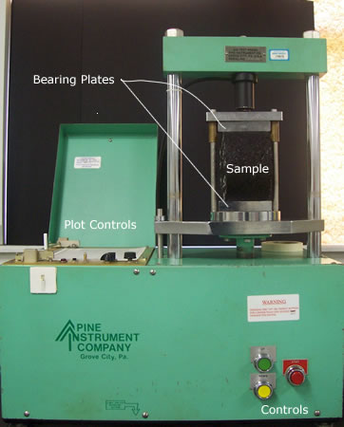
Moisture Damage Sensitivity
Modified Lottman Indirect Tension Test
(AASHTO T283)
Hamburg Wheel Tracking Test
(AASHTO T324)

Slide 6
Moisture Damage Sensitivity
Selection of Test Method:
  Hamburg Wheel Tracking Test
    Additional measure of mixture stability.
    Potential opportunity of cooperation with High RAM Program.
    Being used by neighboring states such as IL and IA.

Slide 7
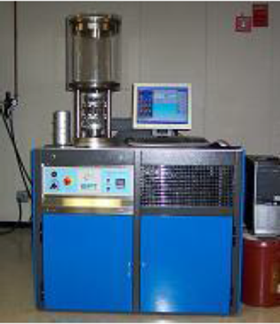
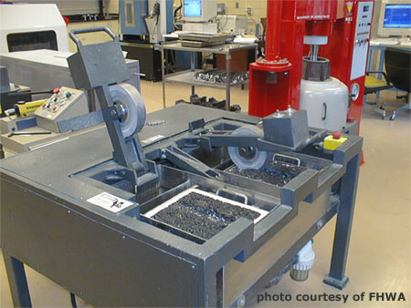
Permanent Deformation
AMPT Flow Number Test (AASHTO TP79)
Loaded Wheel Tracking Test

Slide 8
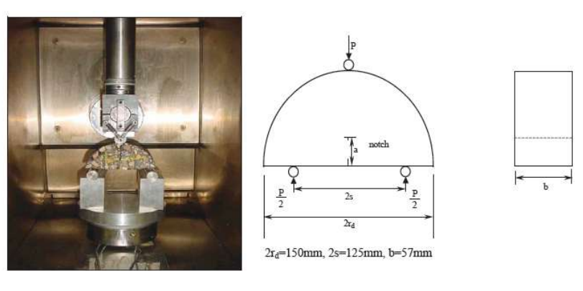
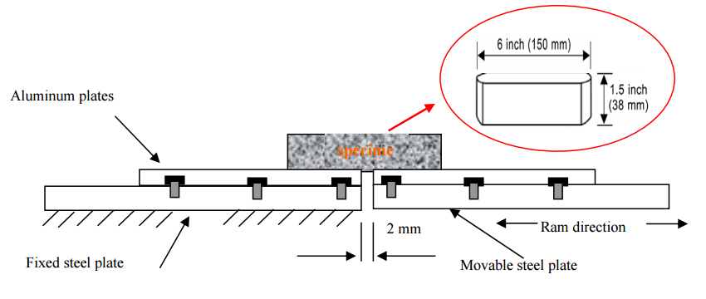
Fatigue Cracking
Crack Propagation Test
Semi-Circular Bending Test (AASHTO TP105 modified by LSU/UIUC)
Overlay Test
(Tex-248-F)

Slide 9
SCB Test Condition and Criteria
SCB Testing @ Intermediate Temperatures
  Changing testing temperature based on LTPP Bind IT grade for different areas of WI
Loading Rate:
  LSU: 0.5 mm/min vertical deformation
  UIUC: 50 mm/min vertical deformation
Test Outputs and Possible Criteria:
  SCB (LSU): Critical Strain Energy Release Rate (Jc) ≥ 0.5 kJ/m²
  SCB (UIUC): Focused on post-peak behavior. Flexibility Index (FI).

Slide 10
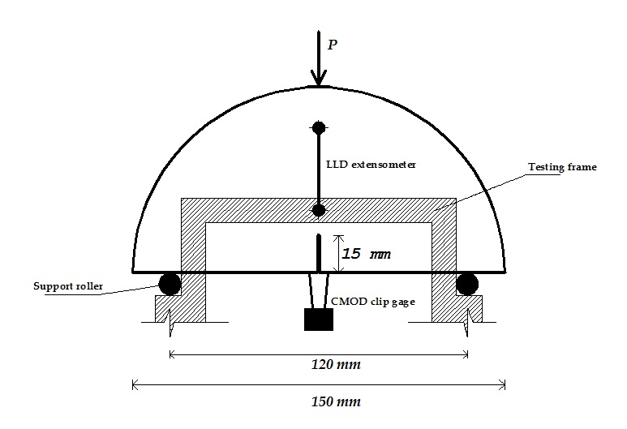
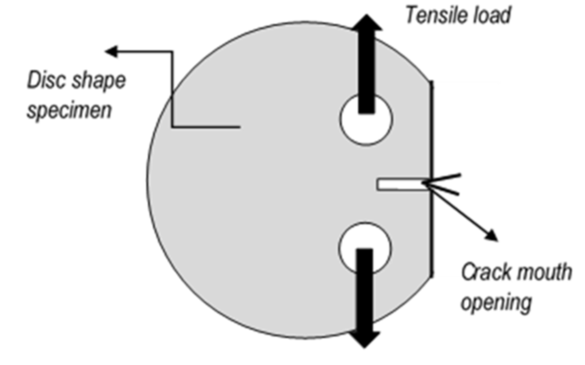
Thermal Cracking
Fracture Procedures
Semi-Circular Bending (SCB) Test
Disc-Shaped Compact Tension (DCT) Test

Slide 11
Summary of Tests Used
Performance Property | Test Method | Reference/Standard
Rutting | 1. Flow Number 2. Hamburg Wheel Tracking | 1. AASHTO TP79 2. AASHTO T324
Moisture Damage | Hamburg Wheel Tracking | AASHTO T324
Stiffness | Dynamic Modulus | AASHTO TP79 with temperatures and frequencies from AASHTO T342
Intermediate Temperature Cracking | 1. SCB-LSU 2. SCB-IFIT | 1. ASTM D8044 2. AASHTO TP124
Low Temperature Cracking | 1. SCB-UMN 2. DCT | 1. AASHTO TP105 2. ASTM D7313

Slide 12
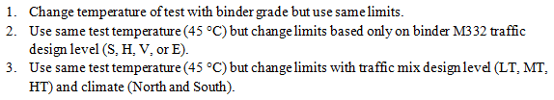
Results – HWT at 45 °C
Development of Draft Specification Concept:
Option 1: Not practical in similar HT climate (N. & S. have PG 58-XX)
Option 2: Similar to WisDOT, does not account for mix design level (LT, MT, HT)
Option 3: Proposed concept based on data collected in this study

Slide 13
Results – HWT at 45 °C
Draft Specification:

Slide 14
Evaluation of Cracking Test Methods Intermediate Temperatures:
SCB (I-FIT, LSU)

Slide 15
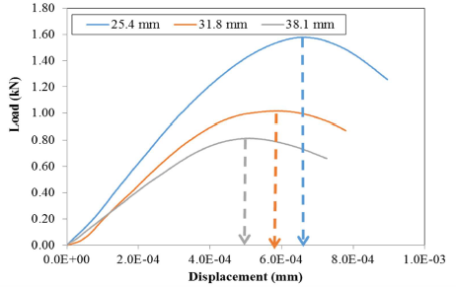
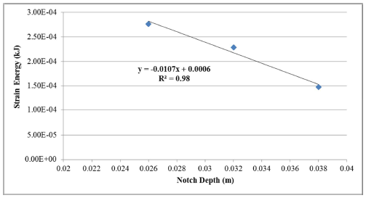
Intermediate Temperature – SCB-LSU
ASTM D8044
Thickness: 57mm
Notch Depth: 25.4, 31.8 and 38.1mm
Loading Rate: 0.5mm/min
Output: Critical Strain Energy Release Rate Jc
  - Determined as the slope of the linear regression from the plot of Strain Energy vs. notch depth

Slide 16
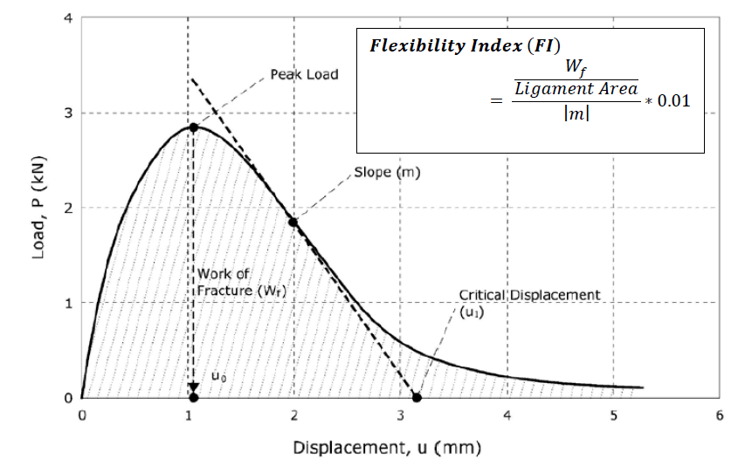
Intermediate Temperature – SCB-IFIT
Tested using TP124
  Fracture Energy & Flexibility Index selected as primary responses
AASHTO TP124
Thickness: 50mm
Notch Depth: 15 mm
Loading Rate: 50mm/min

Slide 17
Intermediate Temperature – LSU-FI
Pros and Cons for Both SCB Procedures
  SCB-LSU
    Jc is a fracture mechanic based parameter; loading rate is much slower; test temperature (IT) is logical.
    No clear trend has been found for Jc among mixtures with different mix design factors.
  SCB-IFIT
    FI is capable of distinguishing mixtures with different variables.
    Loading rate is too rapid; fixed test temperature (25C) is questionable.

Slide 18
Recommended Specification Framework for SCB
Considerations:
Climate, since it is known that PG grades vary across the state and that fatigue is sensitive to temperature of test.
Traffic level (LT, MT, HT), since it is expected that fatigue cracking is dependent on the number of loading passes applied on the pavement, and
The type of construction: whether the project is an overlay or new construction. It is well established that overlay mixtures need to be designed to a higher reliability (in terms of fatigue resistance) to ensure performance.

Slide 19
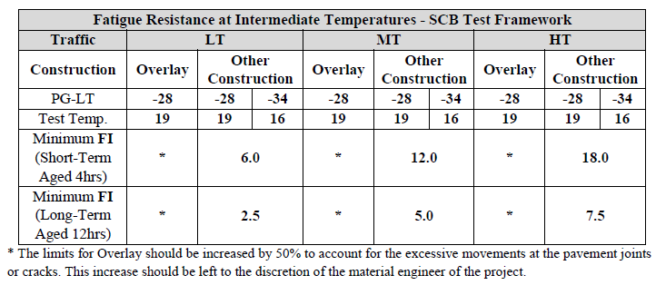
Recommended Specification Framework for SCB
Notes:
Both procedures are found to have deficiencies in terms of producing logical trends in measuring effect of mixture and aging variables included in the experiments. Therefore a modified SCB-LSU procedure recommended in a recent WHRP study is recommended for the specification framework. The main reason for this recommendation is the use of the Post-Peak Slope in the analysis, which appears to be a useful parameter to measure effects of oxidative aging and use of RAP. The following table presents the framework proposed.

Slide 20
Low Temperature – DCT and SCB-UMN

Slide 21
Existing Specifications
State | Aging Condition | Traffic Level | Test Temp (°C) | Test Requirements | Minimum Fracture Energy (J/m²)
WI – High RAM Pilot Project | Long Term AASHTO R30 or 12 hr loose mix @ 135°C | Applies to all traffic levels | LT PG + 10°C | Mix Design Production | 400
MN | Short Term AASHTO R30 | Traffic Levels 2&3 (up to 3m ESALS) | LTTPBind 98%R Low Temp +10°C | Mix Design Production | 450 (Mix Design) 400 (Production)
 |  | Traffic Levels 4&5 (up to 30m ESALS) | LTTPBind 98%R Low Temp +10°C | Mix Design Production | 500 (Mix Design) 450 (Production)
IA | Short Term AASHTO R30 | <10m ESALs | LT PG + 10°C | Mix Design | 400
 |  | 10 -30m ESALs | LT PG + 10°C | Mix Design | 460
 |  | > 30m ESALs | LT PG + 10°C | Mix Design | 690
Notes:
Different Test Temperatures Used
Based on LT PG (WI & IA)
Based on Specific Location (MN)
Aging: Short Term vs. Long Term
Limits
Same for all traffic levels
Increase with traffic level
Mix Design vs. Plant

Slide 22
Results – PG XX-34
Similar results to PG XX-28 mixes. Range is 500 – 650 J/m²
When variability is considered there are not many mixes with significantly different performance.

Slide 23
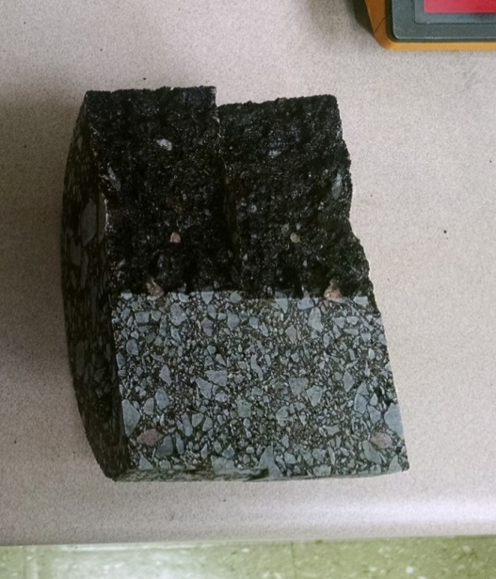
Other Considerations
Effects of Aggregate Quality
Granite LAR @ 500 = 18.2% Fracture Energy = 550 J/m² | Limestone LAR @ 500 = 32.0% Fracture Energy = 360 J/m²
At PG LT+10 failure mechanism is dependent on aggregate quality because the stiffness of the mastic influences the crack path. For weaker aggregates, the path travels through the aggregate, for stronger mixes the crack path goes around (Braham, TRB 2007).

Slide 24
Tentative Mix Performance Guidelines
Traffic | LT |  | MT |  | HT
PG-LT | -28 | -34 | -28 | -34 | -28 | -34
Test Temp | -18 | -24 | -18 | -24 | -18 | -24
DCT Minimum Fracture Energy (Short-Term Aged 4hrs) J/m² | 300 |  | 400 |  | 500
DCT Minimum Fracture Energy (Long-Term Aged 12hrs) J/m² | 250 |  | 300 |  | 350
Discussion Points
Short term aging vs. Long term aging:
  Possible benefit of long term aging is identifying poor materials (i.e. high RAS or REOB).
  Use one or both conditions?
Limits for different traffic levels:
  Increases reliability, but based on effect of aggregate could exclude established sources for MT and HT mixes.

Slide 25
SCB MN Test
Guidelines
Traffic | LT |  | MT |  | HT
PG-LT | -28 | -34 | -28 | -34 | -28 | -34
Test Temp | -18 | -24 | -18 | -24 | -18 | -24
SCB-UMN Minimum Fracture Energy (Short-Term Aged 4hrs) J/m² | 200 |  | 350 |  | 500
SCB-UMN Minimum Fracture Energy (Long-Term Aged 12hrs) J/m² | TBD |  | TBD |  | TBD
Items to address
  Aging
  Aggregate effect
  Test Procedure/Standardization

Slide 26

Thank you

