Slide 1
Wisconsin Highway Research Program (WHRP) Update
Wisconsin Transportation Builders Association
2018 Contractor-Engineer Conference
January 25, 2018
Diane Gurtner, Research and Library Services
WisDOT

Slide 2

Wisconsin Highway Research Program Overview
WHRP established in 1998 by the Wisconsin Department of Transportation in collaboration with the University of Wisconsin-Madison
WHRP budget in FFY 2017 -- $1,229,536
Primary research areas
  Flexible Pavements
  Rigid Pavements
  Structures
  Geotechnics
http://wisconsindot.gov/Pages/about-wisdot/research/whrp.aspx

Slide 3
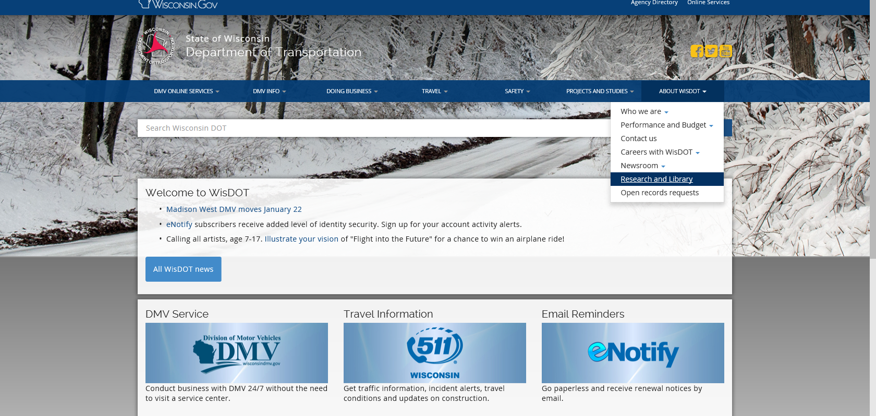
Navigating to the Website

Slide 4
Wisconsin Highway Research Program Staff updates
  The WisDOT Research program is part of the Office of Policy, Finance and Improvement within the Executive Offices
  WisDOT research program staff
    Jacquelyn Irving, Performance, Policy & Research Section Chief / WHRP Steering Committee Chair
    Diane Gurtner, Research & Library Services Supervisor
    Heidi Noble, Contracts Specialist Senior
  UW-Madison technical support
    Dr. Dante Fratta, Associate Professor, Civil & Environmental Engineering

Slide 5
Wisconsin Highway Research Program
Current RFPs
Six RFPs for FFY 2019, proposals due Jan. 26
Rubber Asphalt Study for Wisconsin
Recycled Asphalt Binder Study
Roadway Concrete Barrier Design and Performance - Material Durability Issue
Internal Curing of Bridge Decks and Concrete Pavement to Reduce Cracking
Comparison of ASTM Standards for the Evaluation of Geogrid Strength
Textured Epoxy Coated and Galvanized Reinforcement to Reduce Cracking in Concrete Bridge Decks and Components
  http://wisconsindot.gov/Pages/about-wisdot/research/researchers.aspx

Slide 6
Wisconsin Highway Research Program Project highlights
Featuring two WHRP projects
Dr. Qian Liao, Associate Professor, UW-Milwaukee WisDOT Analysis and Feasibility of Asphalt Pavement Understanding and Complying with Storm Water Mitigation Guidelines from the EPA
(WHRP 0092-13-03)
Signe Reichelt, Behnke Materials Engineering
WisDOT Asphaltic Mixture New Specifications Implementation – Field Compaction and Density Validation
(WHRP 0092-15-09)

