Slide 1
Safety Certification Process Training
Dan Brugman
Kevin M. Scopoline
Bureau of Traffic Operations
October 20, 2022
Notes:
This presentation will discuss the Safety Certification Process.

Slide 2
Learning Objectives
Understand how the Safety Certification Process interacts with other BTO and safety processes
Roles and responsibilities
Safety Certification Process procedures
Documentation requirements
Notes:
This training is geared towards the users of the Safety Certification Process but will cover some frequently asked questions and general nuances with interpreting the crash prediction results. The learning objectives will cover how the Safety Certification Process interacts with other Department processes, roles and responsibilities, the Safety Certification Process steps, and requirements for documentation.

Slide 3
Bureau of Traffic Operations
Bureau of Traffic Operations (BTO) manages:
  Intersection Control Evaluation: FDM 11-25-3
  Safety Certification Process: FDM 11-38
  Operations Certification Process: FDM 11-52
BTO supports:
  Highway Safety Improvement Program (PMM 4-1-10)
    Evaluation of crash modification factors (CMFs)
    Program goals and tools
    Screening list development
Notes:
This slide provides an overview of what processes the Bureau of Traffic Operations (BTO) manages. BTO manages three processes: The Intersection Control Evaluation (ICE) process, Safety Certification Process, and Operations Certification Process. These are all handled within the Traffic Analysis and Safety Unit.
In addition to these processes, BTO also supports the Highway Safety Improvement Program (HSIP). Key tasks within our support role are to review the safety analyses, evaluate crash modification factors within the SCP as well as HSIP process, support tools and program goals, and help to create screening lists for Region use.

Slide 4
Intersection Control Evaluation
Intersection Control Evaluation (ICE):
  Goal: Document the justification or support for intersection/interchange decision made within an improvement project
  Considers all factors and not exclusive to safety and/or operations:
    Oversized/Overweight (OSOW)
    Bicycle and pedestrian
    Environmental factors
    Real estate impacts
    Public involvement
    Safety
    Operations
Notes:
This will provide a high-level overview of the Intersection Control Evaluation Process, or ICE Process. The ICE process has a goal of documenting the justification or support of an alternative at an intersection or interchange within an improvement project.
The ICE process allows for a consistent, objective and defensible assessment of the alternatives reviewed. This process differs from other processes as it encompasses all factors that a project considers when determining an alternative to define the purpose and need.

Slide 5
Intersection Control Evaluation
Intersection Control Evaluation (ICE):
  ICE is required when:
    Changes to existing traffic control are proposed
    New traffic control installation
    New alternative type is investigated
    Offsetting intersections
  ICE may be required when:
    Access/median restrictions occur on the State Highway
Notes:
When is an ICE required?
The ICE process is a required process when there are proposed changes to traffic control, a new installation of a traffic control device, a new type of alternative intersection is being considered such as a new reduced conflict intersection or interchange, or when offsetting intersections may occur.
An ICE may also be required should there be access, median restrictions or cul-de-sacs that cause considerable impacts to traffic patterns. Please contact BTO should you have any questions on whether an alternative considered is required to follow this process or not.

Slide 6
Intersection Control Evaluation
ICE Process has two phases
  Phase I (Scoping)
    Serves as a brainstorming device
    Identifies all possible alternatives to carry into the Phase II
    Provides considerations for multiple factors (e.g., safety, roadway context) to aid decision making
  Phase II (Alternative Selection):
    In-depth analysis of remaining alternatives
    Document final decisions for a reasonable alternative
Notes:
The ICE process has two phases: the scoping phase (Phase 1) and alternative selection (Phase 2).
The scoping phase serves as a planning-level device to aid a project in identifying reasonable alternatives to meet the purpose and need of a project. The Phase 1 ICE contains brainstorming tools to help users consider all potential reasonable alternatives and eliminate others that do not meet the intended goal of the project. Any remaining reasonable alternatives are carried forward in the project process and require a Phase 2 ICE.
The Phase 2 ICE serves to document the alternative selection. This provides a much more detailed review of the reasonable alternatives and uses support from public opinion, environmental factors, and safety or operations considerations to select an alternative.

Slide 7
Operations Certification Process
Operations Certification Process (OCP):
  Optional process
  Quantifies operations and safety for proposed improvements for either mainline or intersections
  When completed:
    Locations identified through network screening or reviewed from local knowledge (i.e., Operational Sites of Promise)
    Alternative investigation
    Safety and Operations Evaluation and Economic Appraisal
Notes:
The Operations Certification Process (OCP) is an optional process completed within the scoping phase of a project. This aims to use performance-based practical design approach principles to quantify the operational benefits, as well as safety impacts for any proposed operational improvement on the mainline or at an intersection.
When this process is completed, analysts identify Operational Sites of Promise either through network screening or through local knowledge. This process follows a similar procedural outline as the Safety Certification Process by identifying alternatives, evaluating the safety and operational benefits, and completing an economic analysis.
This training will not cover the OCP in detail, as there is a separate training with that information. The important takeaway is that the OCP performs the same steps as the SCP when evaluating alternatives for the safety benefits. These safety benefits are combined with operational benefits.

Slide 8
Safety Certification Process
Safety Certification Process (SCP):
  Required process for most improvement project work types
    See FDM 11-1 Attachment 10.1
  Analysts investigate safety for proposed improvements
    Safety Sites of Promise (required)
    Additional Sites (not required)
  Undergoes Safety Evaluation and Economic Appraisal
Notes:
The Safety Certification Process is a required process within the scoping phase of a project for most improvement project work types. This uses performance-based practical design principals to quantify the safety of a proposed countermeasure, independent of other factors, which is used to perform an economic analysis. The result of this process produces an economic evaluation of an alternative which compares the safety benefit to the construction cost.
The Safety Certification Process requires analysts to investigate all Safety Sites of Promise and is optional for any additional locations considered for improvements.

Slide 9
Highway Safety Improvement Program (HSIP)
Highway Safety Improvement Program
  Process overview:
    https://wisconsindot.gov/Pages/doing-bus/local-gov/astnce-pgms/highway/hsip.aspx
  Separate process from the SCP
    Federally-driven
    Goal is to develop and implement safety projects to reduce the number and severity of crashes on all streets and highways (state and local)
Notes:
The Highway Safety Improvement Program, H-S-I-P, commonly referred to as hiss-sip, is a separate and independent process from the SCP. This is a core federal aid program which has a goal of reducing fatal and serious injury crashes on all roadways: local and state.

Slide 10
Process Interaction
How do these process interact?
Notes:
How do these processes interact with one another?

Slide 11
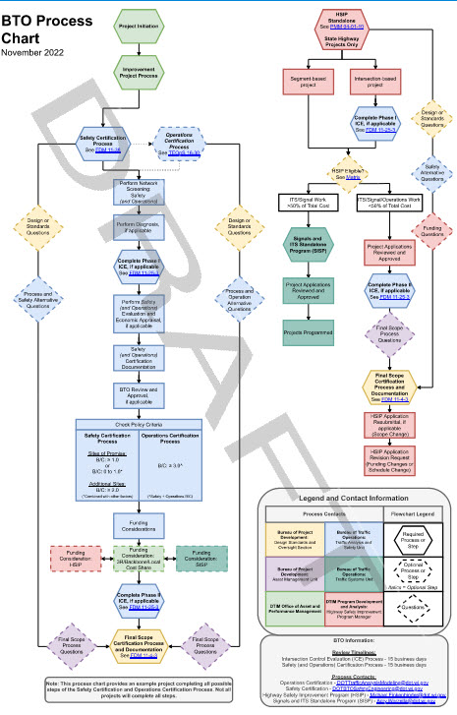
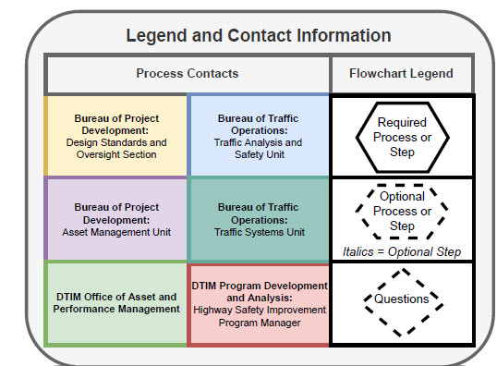
Process Interaction
Process flowchart within the Traffic Engineering, Operations and Safety Manual (TEOpS 1-30)
Notes:
WisDOT uses asset management philosophies to make data-driven decisions. These processes interact throughout and involve many different individuals and sections within the Department. To aid a user in how these processes interact, and the appropriate contacts throughout, BTO created a process flowchart which is within the Traffic Engineering Operations and Safety Manual.

Slide 12
Process Interaction
Highway Safety Improvement Program (HSIP)
Notes:
First, lets go through how the HSIP program interacts with BTO processes.

Slide 13
Process Interaction (HSIP)
HSIP role within the SCP
  Improvement program project
    Projects undergo network screening. Safety countermeasures considered can use HSIP as a funding mechanism
    Both the HSIP process and SCP are required
  Standalone HSIP projects
    Projects evaluated for HSIP, originating outside of the improvement program due to a safety need, do not need to complete the SCP
      FDM 11-4-3.3.3
Notes:
The Highway Safety Improvement Program has two potential scenarios that interact with the SCP. The first is when an improvement project is loaded into the program. This project undergoes the Safety Certification Process which screens the project for locations experiencing crash issues. Locations identified through this process, or brought forward by other areas or concerns, may be eligible to receive HSIP funding to make safety improvements. A Region may choose to submit a countermeasure for HSIP funding to make proposed improvements investigated within the SCP. In this situation, both the Safety Certification Process and HSIP process need to be followed and HSIP acts as a funding mechanism which is tied to the improvement project.
The second scenario is when a project is identified through an existing safety issue or brought forward by other stakeholders. In this situation, an immediate need is identified which originates outside of an upcoming improvement project. A Region or local municipality may submit a proposed project for HSIP funding. If approved, these standalone projects would not be required to follow the Safety Certification Process, as they originated outside of the improvement project and the purpose and need is defined. For these situations, the HSIP application would be the safety documentation for the project.

Slide 14
Process Interaction (HSIP)
HSIP role within the SCP
  Examples
    Segmental Site of Promise with lane departure trend
      Investigated shoulder widening – Requires SCP, could utilize HSIP
    Project corridor has lane departure trend but there are no Sites of Promise identified
      Investigated shoulder widening – Requires SCP, could utilize HSIP
    HSIP – Project originated from HSIP funding
      HSIP application approved for a roundabout – Does not require SCP, utilizes HSIP

Slide 15
Process Interaction (HSIP)
HSIP role within the SCP
  Examples
    Network screening identified an intersection Safety Site of Promise
      Investigated improvements – Requires SCP, could utilize HSIP
    Region identified a crash hotspot from HSIP screening lists or Regional screening procedures (outside of the improvement program)
      Investigated improvements and submitted a HSIP application – SCP not required
    Network screening identified an intersection of Site of Promise, and the Region created a separate project ID to treat the intersection
      Requires SCP, could utilize HSIP. This is not considered HSIP Standalone even if the construction occurs in a later year.

Slide 16
Process Interaction
Intersection Control Evaluation (ICE)
Notes:
Now let's discuss how the Intersection Control Evaluation Process interacts with other processes

Slide 17
Process Interaction (ICE)
ICE serves to document all factors
Recommended to complete Phase I ICE prior to performing the Safety Evaluation Procedure within the SCP
  Confirms alternatives that should be analyzed which fit within the purpose and need
  Helps document decisions for alternatives which weren’t analyzed within the SCP
Notes:
The ICE process serves to document decisions and includes all factors considered within an improvement project. When completing the SCP, it is recommended to get concurrence on the alternatives investigated prior to performing the safety evaluation by completing the ICE process. Completing the ICE process at this time may reduce the workload of the analyst by ensuring additional alternatives are not added later and removing unreasonable alternatives from being evaluated.
An important takeaway here is that the ICE documents all factors, including those that aren’t quantifiable, which can be used to supplement any results within these processes to help with decision making within a project.

Slide 18
Process Interaction (ICE)
Safety Certification Process completed
  Use safety evaluation results (i.e., IHSDM results) in Phase II ICE
Operations Certification Process completed
  Use safety and operation evaluation results in Phase II ICE
Highway Safety Improvement Program Standalone Project
  Use Performance Evaluation Factor (PEF) worksheet
Notes:
The processes managed by BTO are intended to work together, utilizing the analysis from one process as supporting documentation in others.
When the Safety Certification Process is completed, the crash prediction results can be used within the Phase 2 ICE report. Be sure to supply or document the location of these results should a different section be responsible for the completion of the Phase 2 ICE report. The intent is that once the safety evaluation is performed within the SCP, it does not need to be updated.
Similarly, when the Operations Certification process is completed, the evaluation results can be used for both the safety and operational components of the ICE process.
Lastly, when completing the ICE process for a standalone HSIP program project, which initiated through the HSIP program outside of an improvement project, the Performance Evaluation Factor or PEF worksheet can be used for the safety component of the ICE.

Slide 19
Safety Certification Process
Notes:
Now we will go through the Safety Certification Process in more detail.

Slide 20
Overview
Purpose of the Safety Certification Process (SCP)
When to perform
Steps involved
Notes:
This portion of the training will cover the background and purpose of the Safety Certification process, when to perform it, and the procedures involved.

Slide 21
Safety Certification Process
Why does WisDOT have this process?
Notes:
Why does the Department have this process?

Slide 22
Safety Certification Process
The Safety Certification Process (SCP)
  Defined in FDM 11-38
  Implements a performance-based practical design (PBPD) approach to asset management (FDM 11-1-10)
    An approach to decision making that encourages engineered solutions rather than reliance on maximum values or limits found in design specifications
    Is grounded in performance management
    Exercises engineering judgment to address the purpose and need
    Considers both short and long-term project and system goals
Notes:
The Safety Certification Process, or SCP, is defined in the Facilities Development Manual chapter 11-38. The Department is continuously balancing fiscal constraints with competing highway needs. This process was created to implement a performance-based practical design approach as part of the Department’s asset management philosophy. This approach helps with decision making by encouraging engineering solutions in areas of need, rather than reliance on maximum or desirable values found in design specifications, also referred to as nominal safety. Using this approach ties into the performance measures by targeting locations of need with improvements that demonstrate a positive return on investment from a safety perspective. This process exercises engineering judgement to address the purpose and need of a project and considers both the short and long-term goals of a project.

Slide 23

Safety Certification Process
Evaluates safety-driven roadway improvements
  Uses evidence-based tools to evaluate the current and future safety performance of roadway improvements
  Predicts the number and severity of crashes for each project alternative, allowing safety performance to be considered independent of other factors
  Allows WisDOT to target investments with more confidence and reduce severe crashes
Notes:
The Safety Certification Process uses a data-driven approach to quantify the safety component of a project. This involves using tools which evaluate the current and future safety performance of a roadway which compares the cost of crashes to the construction cost of an improvement. These tools use predictive crash modeling to determine the number and severity of crashes for each project alternative. Predictive crash modeling evaluates the safety of a project and does not evaluate other factors such as operations, vehicle travel time, delay, maintenance cost, or environmental factors. By quantifying safety, independent of these other factors, it allows the Department to target and prioritize investments with more confidence which can reduce severe injury crashes.

Slide 24
Safety Certification Process
Purpose of the SCP
  Assists in defining the purpose and need of a project
  Identifies locations with the highest potential for crash reduction
  Investigates safety countermeasures focused on crash history
  Quantifies safety to determine safety improvement impacts
  Consistent application of safety analysis
Notes:
The Safety Certification Process was created to ensure that identifying safety needs is completed early in the project development process to assist the Department in identifying the purpose and need of a project. This process identifies locations on the state highway network that have the highest potential for crash reduction. These locations are investigated for safety countermeasures based on existing crash trends and the safety benefits are quantified to determine the impacts of the reviewed countermeasures. By completing these steps, it provides a consistent approach to performing an analysis which increases the reliability of safety analyses and avoids unnecessary expenditures for improvements that aren’t needed.

Slide 25
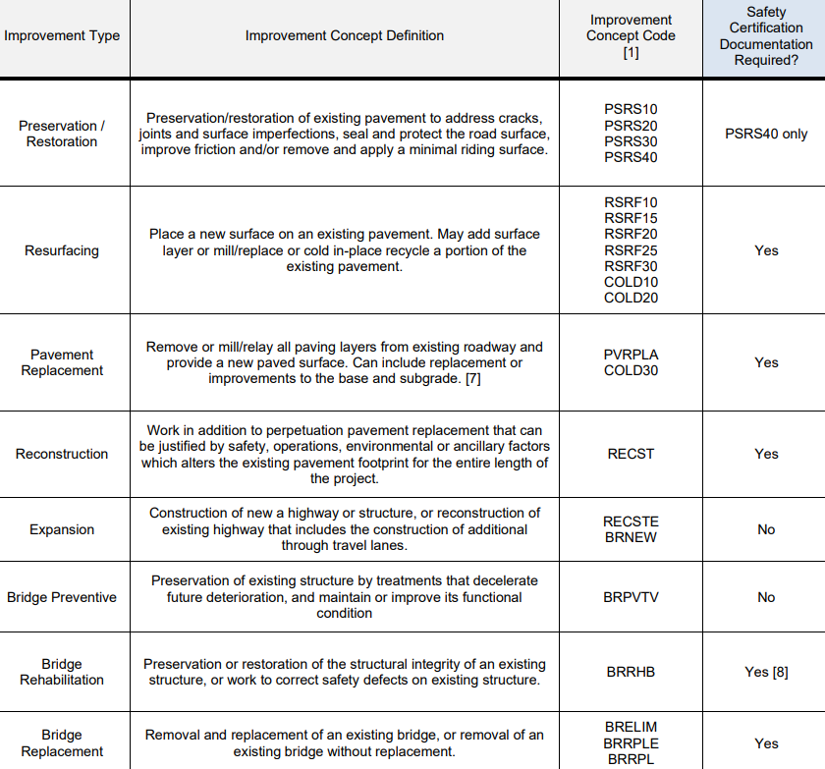
When is this completed?
  Required on all improvement projects except preservation/restoration, maintenance and expansion improvement types
    FDM 11-1 Attachment 10.1
Notes:
When does this process need to be completed? The Safety Certification Process is required for most projects, as identified by the improvement concept code in FDM 11-1 Attachment 10.1. Some work types are exempt from the process, such as preservation, bridge, and emergency projects. Also exempt from the SCP are projects that have a Modernization Improvement Strategy as these projects construct facilities to the upper end of design criteria.

Slide 26
When is this completed?
State and Connecting Highway Projects
  Complete the Safety Certification Process
  BTO approves documentation for any project completing the Safety Evaluation Procedure
Local Projects (FDM 11-40-1.2.1.1)
  Can complete the Safety Certification Process
    Network screening does not include local roads. Screening based on local knowledge.
  BTO can provide guidance and recommendations but does not approve documentation
Notes:
The SCP is required on State Highway Projects, which includes projects occurring on connecting highways. BTO is responsible for approving the documentation for any projects that complete the Safety Evaluation Procedure, meaning, that any time an alternative is investigated, BTO would review the safety information of the project to determine if it followed the process correctly.
For local projects, the Safety Certification Process can be used to aid a local municipality in alternative selection. A key difference between State and Local projects is that WisDOT does not have a network screening tool which includes local roadways. Screening for these types of projects would be based on local knowledge of locations in need of improvements. For local projects, BTO serves in a guidance role and can provide assistance, however, local agencies are responsible for documenting and approving the process.

Slide 27
Safety Certification Process
Overview of the Safety Certification Process Steps
Notes:
Overview of the SCP steps.

Slide 28
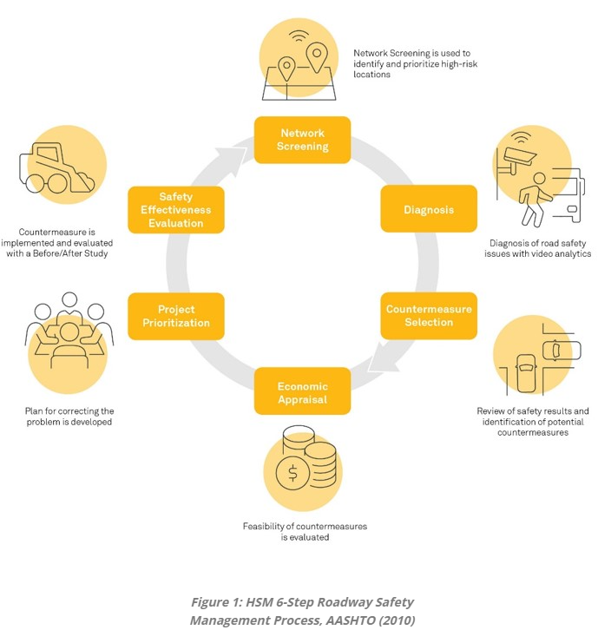
Safety Certification Process
Aligns with the Highway Safety Manual’s (HSM) Roadway Safety Management Process
  Network Screening for Safety Sites of Promise
  Diagnosis of Safety Sites of Promise
  Countermeasure Identification
  Safety Evaluation & Economic Appraisal
  of Alternatives
  Documentation
Notes:
The American Association of State Highway and Transportation Officials’ Highway Safety Manual (HSM) was released in 2010. This manual contains the Roadway Safety Management Process which agencies can use to implement a continuous approach to safety. The SCP implements components of the Roadway Safety Management Process by performing the five steps outlined on the slide.
The last step of the process is Documentation. While the process identifies it as a last step, documentation occurs throughout the process as the SCP serves to document any decisions or engineering judgement throughout.

Slide 29
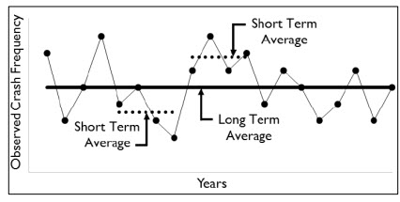
Step 1: Network Screening
Network Screening for Safety Sites of Promise
  Uses Highway Safety Manual (HSM) methodologies to account for potential regression to the mean bias.
Notes:
The first step in the SCP is the Network Screening for Safety Sites of Promise.
The SCP was developed to incorporate more reliable safety methodologies to account for regression to the mean bias. Traditionally, safety analyses were preformed by analyzing 3 to 5 years of crash data and calculating crash and severity rates, assuming this trend continued into the future. Research has shown that due to the random nature of crashes, short term periods with relatively high crashes are likely followed by periods with relatively low crashes. This phenomenon is referred to as regression-to-the-mean. Assuming short term crash rates will continue in the future does not account for this regression-to-the-mean bias and can result in inefficient or unnecessary improvements. The Safety Certification Process uses methods that account for this bias.

Slide 30
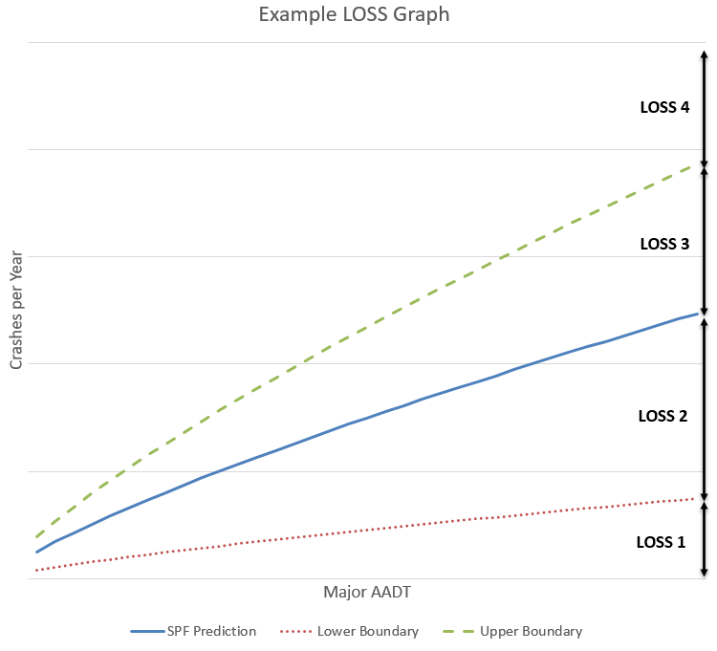
Step 1: Network Screening
  Network Screening for Safety Sites of Promise
  Finds potential improvement locations
  Uses Level of Service of Safety (LOSS) and Crash Flags in Meta-Manager
Notes:
Within the network screening procedure, intersections use the Level of Service of Safety and segments use Crash Flags from Meta-Manager to identify safety sites of promise. Locations that are “flagged” by this network screening are investigated further since they are performing worse than their peers.

Slide 31
Step 1: Network Screening
WisDOT developed network screening safety performance functions (SPFs) for predictive modeling
  Based on network-level, site-specific information (e.g., geometric configurations and volume)
  SPFs produce “Predicted Crashes” for “an average” location
  Observed Crashes are used to estimate “Expected Crashes”
Notes:
Wisconsin developed network screening safety performance functions, or SPFs, to be used to identify safety needs for intersections. BTO has a project underway to create a similar screening tool for segment identification. These SPFs were developed using network level information for sites based on geometric configurations and area type. Applying these functions yields the number of predicted crashes, or the number of crashes an average location is likely to experience, for the given geometric and volume data. The observed crash history can be incorporated into the analysis using the Empirical Bayes, or EB, method. This method weights the observed crashes with the predicted crashes to produce the expected crashes. Utilizing this method adjusts the average prediction to site specific trends and is considered the most reliable as per the HSM.

Slide 32
Step 1: Network Screening
Observed Crashes
Expected Crashes
CRASHES
SPF
Predicted Crashes
VOLUME
Notes:
Let’s provide a visual to this. The SPF generates the predicted crashes for “an average” location. However, the location has an observed crash history which is larger than this predicted total. To account for potential fluctuations due to the random nature of crashes, the expected crashes are calculated to represent what would be expected for long term safety performance.

Slide 33
Step 1: Network Screening
CRASHES
SPF
Predicted Crashes
Expected Crashes
Observed Crashes
VOLUME
Notes:
Another visual of this is to provide an example of where our crash prediction is actually higher than what may be observed at a particular site. This example would show a location which is performing better than what our SPF is predicting.

Slide 34
Step 1: Network Screening
Expected crashes are used to categorize into four Level of Service of Safety (LOSS) groups
  LOSS 1 performing better than SPF
  LOSS 2 performing at or better than SPF
  LOSS 3 performing at or worse than SPF
  LOSS 4 performing worse than SPF
WisDOT uses two screening metrics
  TOTAL Crashes (Property Damage + Injury)
  KABC (Injury) Crashes
SPF
Notes:
The expected crashes, which balance the observed crash history with the predicted crash totals, are used to categorize our locations into four Level of Service of Safety, or L-O-S-S, groups.
The graphic on this page illustrates how these LOSS categories are viewed. The solid blue line on the graph is the SPF prediction for "an average" location given the site-specific parameters. LOSS 3 & 4 locations are experiencing more crashes than their peers. LOSS 4 is where we are choosing to focus our efforts, at this time, since these locations are experiencing significantly more crashes (although not all have an engineering solution). We can adjust where the breakpoints are for the split between LOSS 3/4 and LOSS 1/2 by setting different thresholds in the gamma distribution (which is done in Excel and is managed by BTO). Hopefully over time, we will see a general trend of "flattening" the curves and seeing overall fewer crashes.

Slide 35
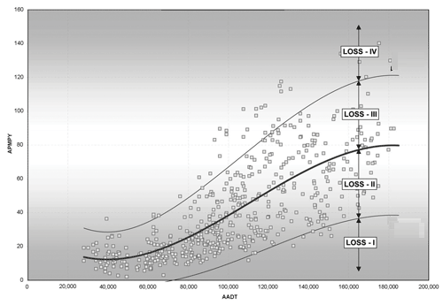
SPF
Source: FHWA-SA-11-02; 2011
Notes:
Here is another visual representation of sample data and how these categories would be viewed. The LOSS 4 category shows the worst performing locations which is the focus of the SCP.

Slide 36
Step 1: Network Screening
Calculates a Potential for Safety Improvement (PSI)
  Difference between “Expected” and “Predicted” crashes
  Estimates how much potential exists which the long-term crash frequency could be reduced at a particular location
Potential for Safety Improvement (PSI)
Expected Crashes
CRASHES
SPF
Predicted Crashes
VOLUME
Notes:
Another metric which the screening process calculates, is the Potential for Safety Improvements, or PSI. This value is simply the difference between the Expected and Predicted crashes. This estimates how much potential there is for long-term crash reduction at a particular location.

Slide 37
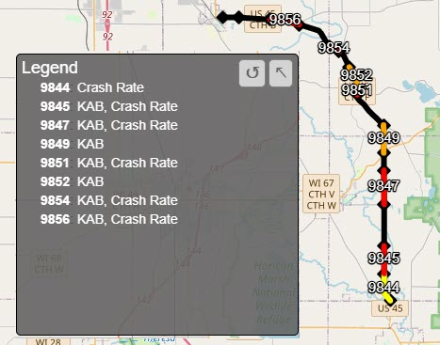
Step 1: Network Screening
Safety Sites of Promise (Segments)
  Utilizes Meta-Manager
    Screening is based on peer group crash rates (i.e., statewide crash rates)
  Identified as a Safety Site of Promise for any of the following:
    Crash Rate Flag ≥ 1.0
    KAB (Severe Injury) Crash Rate Flag ≥ 1.0
    Bicycle Crashes ≥ 1
    Pedestrian Crashes ≥ 1
Notes:
WisDOT screens the network for both segments and intersections. Let's discuss the metrics which determine how Safety Sites of Promise are identified.
Segmental sites of promise are identified using Meta-Manager flags which are determined using 12 unique peer groups within Meta. These flags correspond to statewide average crash rates. In order to be identified as a Safety Site of Promise, any of the following conditions need to be met. A location is flagged when the crash rate or severe (KAB) injury crash rate flag is above a 1.0. The 1.0 indicates that a location is at least one standard deviation above the statewide average crash rates for that particular peer group.
A Segmental Safety Site of Promise can also be identified if the location experienced a single pedestrian or bicycle crash within the corridor. Pedestrian and Bicycle crashes are generally infrequent and unique, so this criteria was added to identify potential needs on the system where these crashes are occurring.

Slide 38
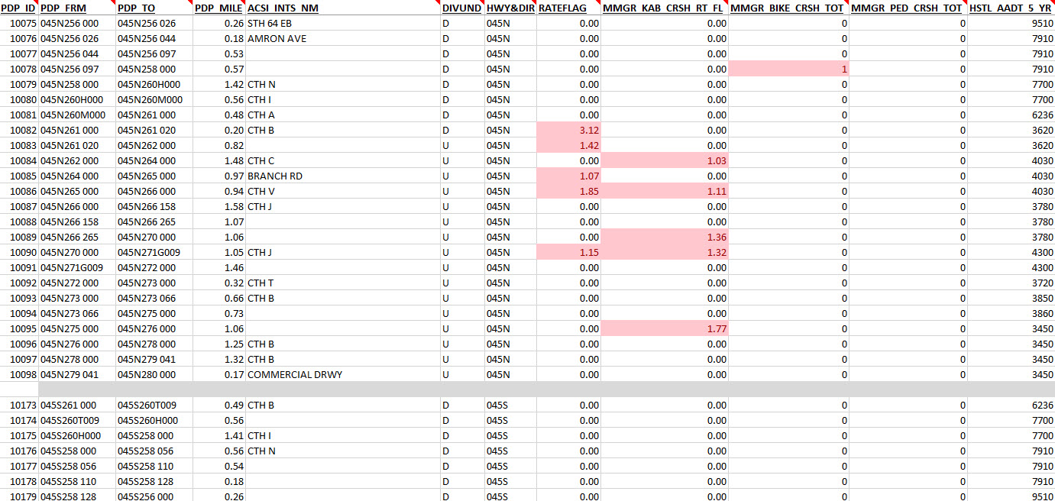
Step 1: Network Screening
Notes:
Here is a sample dataset of the Meta-Manager data. Meta-Manager contains a lot of information but the important information for the SCP are the crash rate flags, KAB crash rate flag, and the pedestrian and bicycle crash totals. This is a good example of what data is required within the SCP for network screening documentation, without showing all of the Meta-Manager fields.

Slide 39
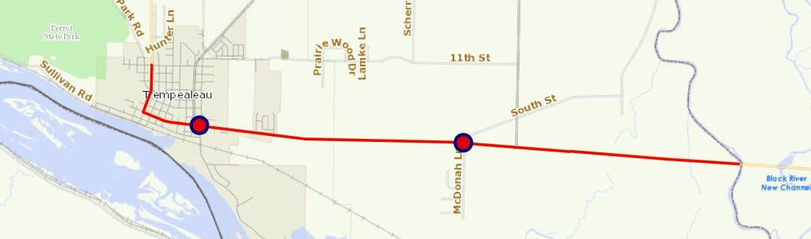
Step 1: Network Screening
Safety Sites of Promise (Intersections)
  Uses Level of Service of Safety (LOSS) and Potential for Safety Improvement (PSI) methodologies
    Emphasis on KABC (injury) rather than TOTAL crashes
  Requires at least 2 observed crashes within the 5-year period
  Identified as a Safety Site of Promise for any of the following:
    LOSS 4(TOTAL)
    LOSS 4(KABC)
Notes:
Intersections Sites of Promise are identified using our network screening safety performance functions and the Level of Service of Safety categories and require at least 2 observed crashes.
WisDOT utilizes two different LOSS categories. We identify Safety Sites of Promise when locations are identified as a LOSS 4 for either the Total crashes, or KABC (injury) crashes. WisDOT places more emphasis on the injury LOSS category, which means we cast a larger net on locations experiencing injury crashes.
The Total LOSS category has less emphasis placed on it, meaning we target less locations with large numbers of crashes. These locations are still important to identify but may be largely experiencing property damage crashes.

Slide 40
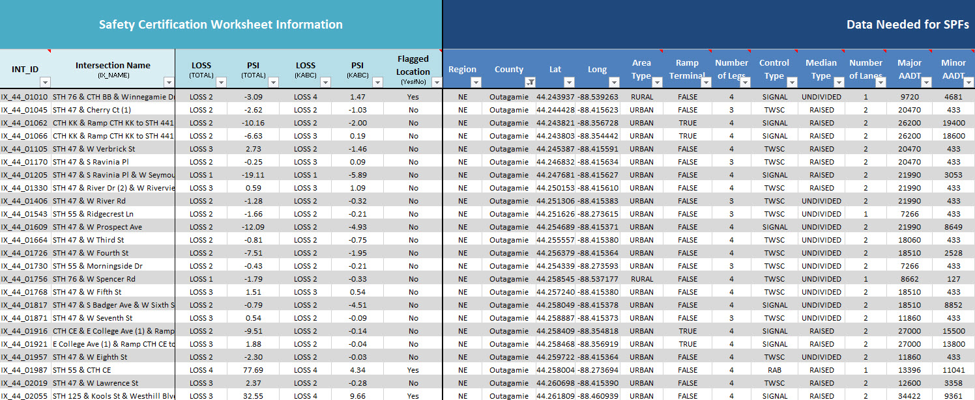
Step 1: Network Screening
Notes:
This is an example of the screening data for intersections within the Intersection Network Screening Spreadsheet. The information on the left side of the image is required information within the SCP network screening documentation.
The information on the right side does not need to be included within the attachments, however, this information is what an analyst should verify is accurate for the location. BTO encourages analysts to adjust data if it is incorrect. Anything entered within this portion of the spreadsheet automatically recalculates the screening metrics.
When adjusting site-specific information, please include the original screening data as well as making note of anything that was adjusted.

Slide 41
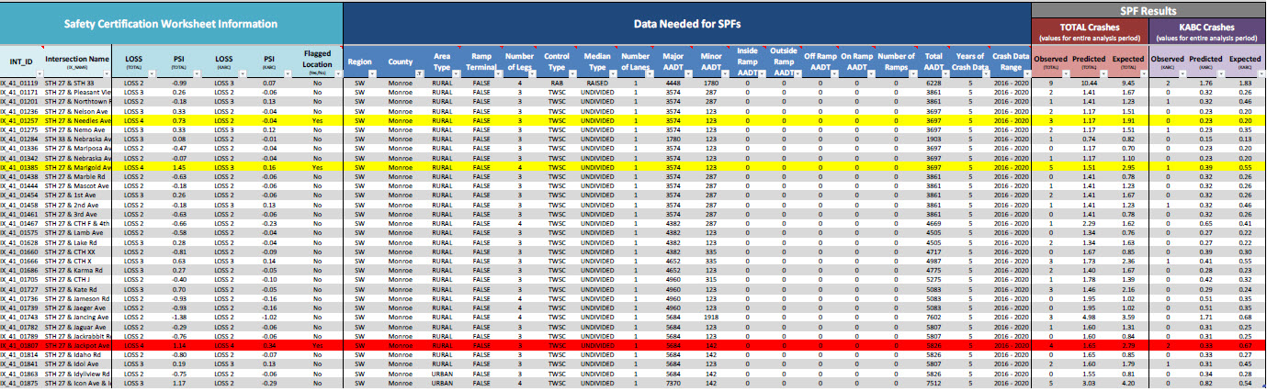
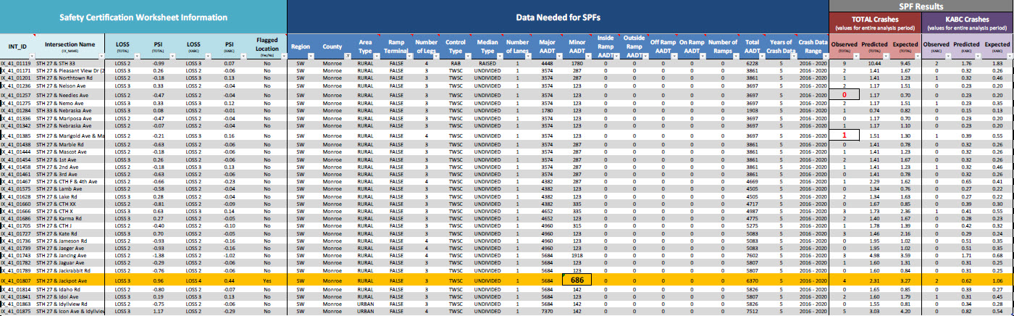
Notes:
Here is an example of how the data could be displayed within the SCP when corrections are made.

Slide 42
Step 1: Network Screening
Network Screening Tools Validation
  BTO updates tools as needed
    Crash information is updated annually
  Regional Analyst
    Verify intersections and/or segments exist
    Validate traffic volume (AADT) or other data inputs
Notes:
The network screening tools were developed using information made available at the time. On occasion, BTO updates information within these tools to reflect current conditions. On an annual basis, BTO updates the screening tool to incorporate the latest 5 years of finalized crash history.
Other information, such as volume data, new or modified intersections, are not updated frequently. An analyst should review data inputs.

Slide 43
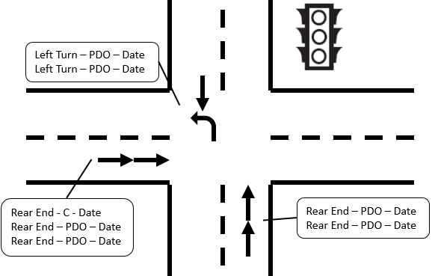
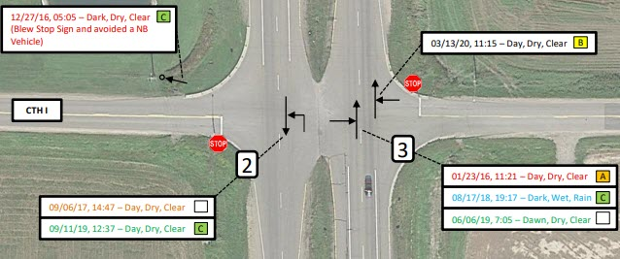
Step 2: Diagnosis
  Diagnosis of sites
  Understand the location conditions review crash data to identify contributing factors and trends
Notes:
Step 2 of the SCP is the Diagnosis step.
Within the Diagnosis step, for each identified location, the analyst should confirm the correct information is used in the screening process, and then review the crash data and site conditions. The goal of this step is to identify treatable crashes and the contributing factors causing crashes. These factors are important when considering potential countermeasures to implement. Please be aware that the crash history at a particular location may or may not have a specific crash trend.

Slide 44
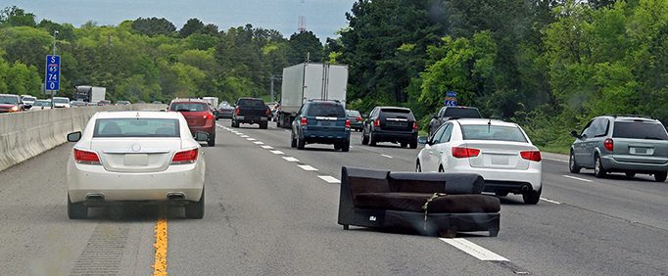
Step 2: Diagnosis
Safety Sites of Promise undergo crash vetting
  Additional, non-flagged sites can be investigated
Focus on crashes that can be mitigated by engineering solutions (treatable crashes)
  Remove crashes that engineering cannot address (e.g., trailer malfunctions, animal strikes, outside of project limits, etc.)
Create an understanding of the crash and determine potential contributing factors
  Why did the crash occur?
Notes:
Within this step, Sites of Promise are subject to a crash vetting process. Additional sites, or optional sites not flagged by safety, can still be investigated using the SCP.
When diagnosing the location, analysts look to identify the treatable crashes that can be mitigated or targeted by an engineering countermeasure. Crashes that should be removed include crashes that were incorrectly included within the data, or are outside of the project limits, equipment malfunctions, or animal crashes. The goal is to create an understanding of why the crashes are occurring, and the potential contributing factors.
An analyst can also identify other solutions within this step that could be mitigated by other means such as education, enforcement or behavioral changes. The SCP focuses on the engineering solutions, but these solutions could be communicated to our partners to help focus their efforts.

Slide 45
Step 2: Diagnosis
Small proportion of the system is identified as Safety Sites of Promise
Locations should not be removed due to crash total
  “Only 3 crashes”
  “There isn’t a significant pattern” (e.g., 2 rear-end crashes, 1 angle crash)
Focus on how the crashes or contributing factors could be mitigated with potential alternatives
Notes:
It is important to put things into perspective when investigating locations within the SCP. To follow asset management principals, we identify the worst performing locations on our system for potential safety improvements. This is a small proportion of the state system overall, and not all locations identified are locations that can be corrected by engineering countermeasures.
Because we are placing emphasis on our worst performing locations, they should not be removed due to an arbitrary crash total such as it only had 2 or 3 crashes. Furthermore, locations shouldn’t be removed because there wasn’t an exact trend within the timeframe we’re investigating. An example of this could be that the location only had 1 angle crash from one direction and one from another, or there was a mixture of crash types such as a rear-end crash, angle crash and a run-off-road crash.
The emphasis should be on how these crashes are occurring, and the associated contributing factors.

Slide 46
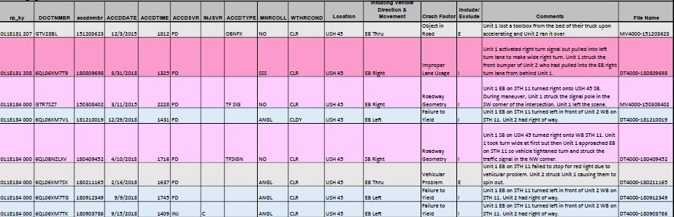
Step 2: Diagnosis
Document crash/vetting comments
Notes:
Crash vetting relies on a high level of engineering judgment. Crashes often occur because of a complex series of events and determining whether a safety improvement would have prevented a crash may be debatable between analysts. In general, you should keep a crash “in the process” if you are in doubt as to whether it has a potential safety treatment that would have prevented it or reduced its severity. Since significant judgment is used in this step, you should document your notes and thoughts while completing this step, so other analysts could understand your logic.
A high-level example may be crashes resulting from sun glare. While this seems like a crash with no possible engineering solution, consider a rear-end crash that resulted from sun glare, but the rear-end would have been prevented if a queue from a traffic signal would not have extended beyond a left turn storage bay. One could suggest that storage lane could be extended and thereby reducing chances of this rear-end crash that was initially assigned to a sun glare issue. In summary, use and document your professional judgment while completing the crash vetting process.

Slide 47
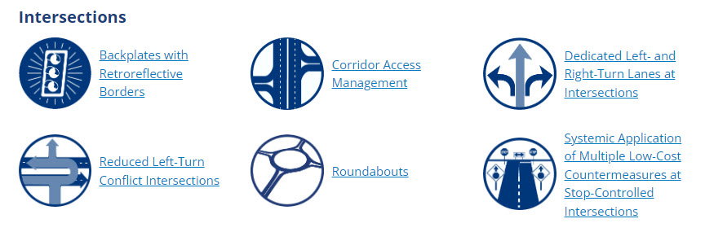
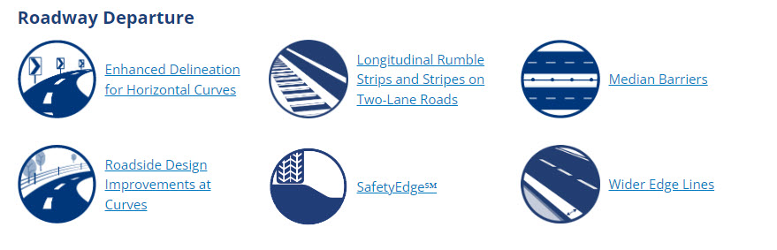
Step 3: Countermeasure Identification
Source: FHWA Proven Countermeasures
Notes:
The third step in the SCP is to identify potential countermeasures.

Slide 48
Step 3: Countermeasure Identification
From the Diagnosis procedure:
  Identified crashes that could be treated/mitigated
  Determined what factors led to the crash, crash type, or severity of the crash
Engineering judgement is used to select appropriate safety countermeasures
  It is likely that certain countermeasures may treat different or multiple factors and/or crash types
Notes:
Within this step, for each location, the analyst should use the crash information and contributing factors identified from the Diagnosis procedure when considering which countermeasures to pursue. Certain countermeasures may treat a specific crash trend or type, but often, safety countermeasures may impact safety at the location as a whole.
For example, it is important to look at what proposed improvements are often targeting. It may make sense to construct a roundabout where a series angle crashes are occurring at a stop-controlled intersection. It may not make sense to construct a roundabout at the same location if only run-off-road crashes are occurring.

Slide 49
Step 3: Countermeasure Identification
FDM 11-38 attachment 10.3
  Lists several common countermeasures with factors they could address
Notes:
FDM 11-38 attachment 10.3 is available to help identify potential countermeasures and crashes they often treat. This list is not exhaustive but may serve as a starting point when considering potential countermeasures.

Slide 50
Step 3: Countermeasure Identification
BTO recommends completing a Phase I Intersection Control Evaluation (ICE) report prior to moving on within the process (if needed)
  Confirms alternatives that should be analyzed fitting the purpose and need
  Removes alternatives that are not reasonable to carry forward
  Documents decision making
Notes:
BTO recommends completing the Phase 1 ICE report within this step, prior to moving forward within the SCP. This confirms that all alternatives being investigated fit within the purpose and need of a project and removes others that are not reasonable to carry forward. For example, an interchange alternative at an expressway within a resurfacing project may not be reasonable to carry forward.

Slide 51
Step 4: Safety Evaluation and Economic Appraisal
  Safety Evaluation and Economic Appraisal of alternatives
  Determines the safety benefit of each alternative using the appropriate analysis method
  Compares the safety benefits and cost of constructing the alternative
  Produces an economic analysis result (i.e., Benefit-Cost (B/C) ratio) for each alternative
Notes:
Once countermeasures are proposed, they are evaluated based on safety performance and cost in the fourth step of the SCP.
To determine the safety benefits for each alternative, the correct analysis method needs to be utilized. Per the HSM, the same analysis method must be used for all alternatives for the same location. This should be the most reliable method available. Additionally, all alternatives are compared to the lowest cost alternative, which is typically the alternative which perpetuates the existing, or base, conditions.
All alternatives that have a positive safety benefit-cost ratio, which is any value greater than zero, are considered reasonable. Those alternatives with a safety benefit-cost ratio greater than one are economically justified from a safety perspective. For alternatives investigated that are not identified as a Safety Site of Promise, a benefit-cost ratio of 2.0 or greater is required to economically justify the improvement from a safety perspective.

Slide 52
Step 4: Safety Evaluation and Economic Appraisal
Use the most reliable safety analysis method to evaluate all alternatives
Determine if Empirical Bayes (EB)/crash history can be used
  From the Highway Safety Manual: EB can be used for:
    Sites at which the roadway geometrics and traffic control are not being changed
    Projects in which the roadway cross section is modified but the basic number of through lanes remains the same
    Projects in which minor changes in alignment are made
    Projects in which a short passing lane is added
Notes:
The SCP requires the most reliable safety analysis method to be used across all alternatives.
Depending on the alternatives chosen, the Empirical Bayes or EB method, which utilizes the observed crash history, may or may not be included within the analysis. The HSM defines where EB can be used. EB can be used where significant changes do not occur at a particular site. These include sites at which the roadway geometrics and traffic control are not being changed, projects in which the roadway cross section is modified but the basic number of through lanes remains the same, and projects where only minor changes in alignment are made.

Slide 53
Step 4: Safety Evaluation and Economic Appraisal
    Method 1: Apply CMF to observed crashes → Estimated Crash Frequency
    Method 2: Use SPF to obtain predicted crashes → Predicted Crash Frequency
    Method 3: Use SPF to obtain predicted crashes and then apply EB method to weight the predicted and observed crashes → Expected Crash Frequency
External Crash Modification Factors (CMFs) are needed for Method 1 and may be needed for Methods 2 & 3
  Note: External CMFs are factors included from outside of IHSDM
  (i.e., WisDOT CMF table, CMF Clearinghouse)
Reliability Improves
Notes:
For each location, a separate safety evaluation and economic appraisal of alternatives is conducted. To determine the safety benefits for each alternative, the correct analysis method needs to be utilized, which depends on the countermeasures proposed. Use the most reliable method available. This method must be used for all alternatives considered at the location.
Method one is the least reliable method and should only be used if methods two and three are unavailable. This method results in the estimated crash frequency for each alternative.
Method two is the most common method used for intersections. This method is used when Empirical Bayes cannot be applied and results in the predicted crash frequency for each alternative. This method does not take into account the existing crash history at the location and solely uses the predicted crash total.
Method three is the most common method used for segments. This method is used when Empirical Bayes can be applied and results in the expected crash frequency for each alternative. This method does take into account the existing crash history at the location and balances it with the predicted crash total.
Sometimes external crash modification factors, or CMFs, are needed. Method 1 requires an external CMF to apply to the observed crash history, but they may or may not be needed for Methods 2 and 3. When including external CMFs, please document the source.

Slide 54
Step 4: Safety Evaluation and Economic Appraisal
    Method 1: Apply CMF to observed crashes → Estimated Crash Frequency
      Tool Used: Highway Safety Benefit-Cost Analysis Tool (Microsoft Excel spreadsheet)
    Method 2: Use SPF to obtain predicted crashes → Predicted Crash Frequency
      Tool Used: Interactive Highway Safety Design Model (IHSDM)
    Method 3: Use SPF to obtain predicted crashes and apply Empirical Bayes method to the predicted and observed crashes → Expected Crash Frequency
      Tool Used: Interactive Highway Safety Design Model (IHSDM)
Reliability Improves
Notes:
Now let's talk about the tools used for each method.
Method 1 uses a spreadsheet-based tool which applies the CMF directly to the crash history. This is most often used when a CMF is targeting a specific crash type, such as pedestrian improvements or overheight detection systems.
For Methods 2 and 3 the Interactive Highway Safety Design Model (IHSDM) is used. IHSDM is a software used for safety evaluation and economic appraisal. It allows for the use of Safety Performance Functions (SPFs) and application of Empirical Bayes.

Slide 55
Step 4: Safety Evaluation and Economic Appraisal
Example 1:
  Existing Conditions: Rural, 4-leg, two-way stop-controlled intersection without passing lanes and slightly askew
  Proposed Alternatives:
    Alt. 1: Realign minor road to reduce skew angle
    Alt. 2: Add major road left turn lanes
  Method used to analyze all scenarios (perpetuate existing, alt. 1, alt. 2) = Method 3
Example 2:
  Same as example 1, add Alt. 3: single lane roundabout
  Method used to analyze all scenarios (perpetuate existing, alt. 1, alt. 2, alt. 3) = Method 2
Notes:
Let's go through an example to illustrate which method to select for the analysis.
In the first example, there is a rural, four leg, two-way stop-controlled intersection with a slight skew angle and no passing lanes. Based on the existing conditions, crash trends, and contributing factors identified in the “Diagnosis of Safety Sites of Promise” step, the proposed alternatives are to either realign the minor road to reduce the skew angle or to add left turn lanes to the major road. Since neither of these alternatives changes the intersection traffic control, the number of through lanes, or significantly alters the flow of traffic from the existing conditions, Empirical Bayes can be applied. This means the crash history can be used and therefore method 3 is used for the analysis.
In the second example, we use the same information from the first example and add a third alternative: a single-lane roundabout. This new alternative changes the traffic control at the intersection, meaning Empirical Bayes cannot be applied for alternative three. Since the same method of analysis must be used for all alternatives, method two is used. Again, method two is used to analyze perpetuating the existing conditions and alternatives one, two, and three. This means that existing crash history is not included in the evaluation for any of the alternatives, including the future perpetuation condition.

Slide 56
Step 4: Safety Evaluation and Economic Appraisal
Data requirements for modeling
  Volume information
    Traffic Forecasts (if available)
    Planning-level estimates, historical traffic counts, Meta-Manager estimates, engineering judgement
  Intersection & Roadway Geometrics
    Skew angles, number of lanes, number of turn lanes, lighting, parking presence, etc.
  Roadway Characteristics
    Rural, Urban, Suburban, speed limits, etc.
  Crash Data (Methods 1 and 3 only)
    Method 3 utilizes all crashes (including those vetted out)
Notes:
The SCP was developed to use data-driven, performance-based practical design philosophies to support decision making. This requires a lot of data.
Volume data is required for crash modeling. To obtain accurate crash predictions, future volumes are also needed. The best source of information would be traffic forecast if they were completed for the project. If not, the Department provides several other sources an analyst can use such as high-level planning level traffic forecasts or historical traffic counts. When that information is not available at your site, an analyst can perform a special count or use engineering judgement.
Other information needed for crash modeling are site-specific information such as the number of lanes, speed limits, and roadway context.
Lastly, crash data may or may not be needed within the modeling portion of the SCP. This depends on the alternatives being investigated. When utilizing method 3, be sure to include the entire crash history at the site, including crashes that were previously removed within the diagnosis procedure. This includes animal crashes, or vehicle fires. All crashes need to be included within the IHSDM model as the national models included these types of crashes.

Slide 57
Step 4: Safety Evaluation and Economic Appraisal
Documentation Requirements
  Conceptual drawing(s)
  Cost Estimate(s)
    Includes “Base Case” and Alternatives
  Safety Evaluation Results
    IHSDM Crash Prediction Results
    Highway Safety Benefit-Cost spreadsheet Results (Method 1 only)
Notes:
This step requires many different attachments as part of the documentation.
When performing analyses on alternatives, concept drawings and cost estimates are required for all the alternatives, including the base case. BTO does not require detailed designs or cost estimates for each alternative. The information included needs to be enough to be able to accurately model and investigate the alternative for reasonableness.

Slide 58
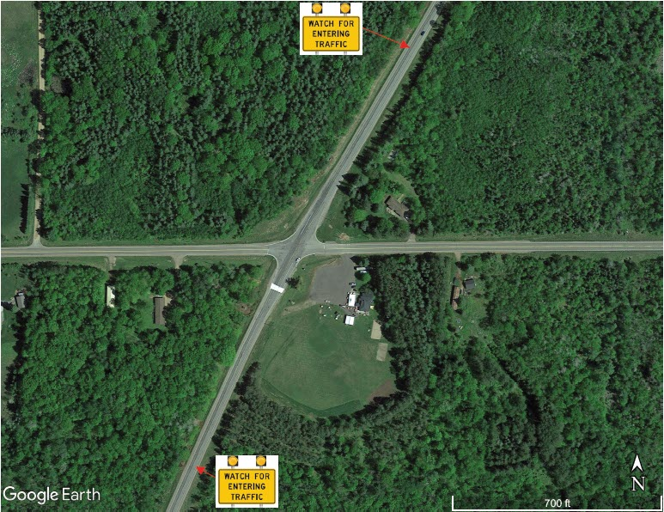
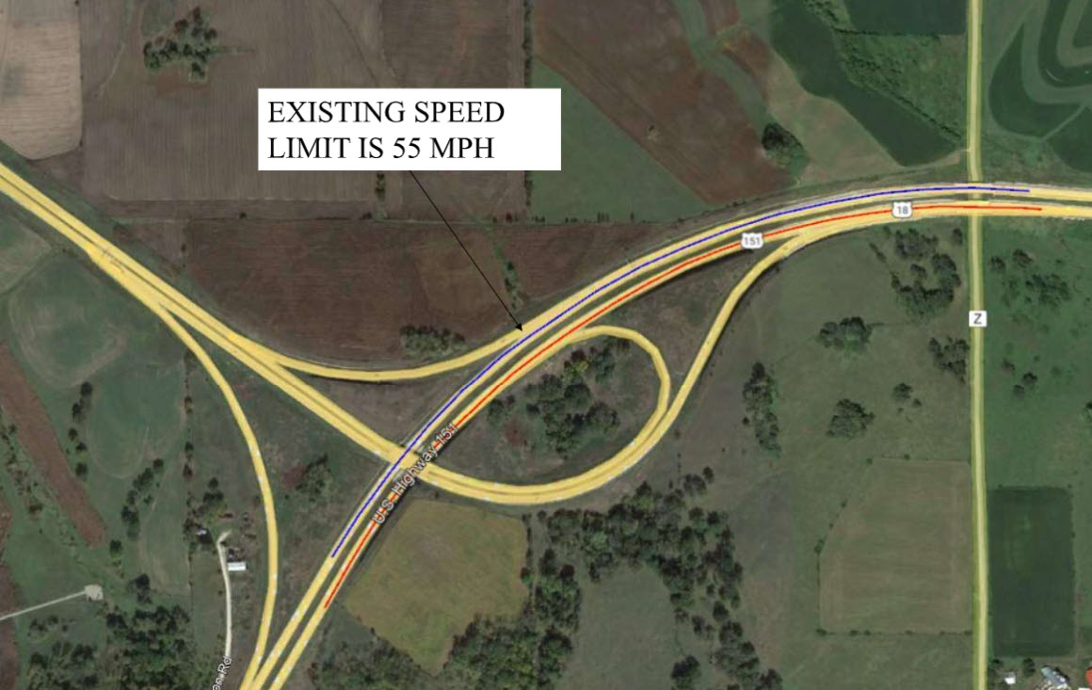
Step 4: Safety Evaluation and Economic Appraisal
Concept Drawings
  Need to provide enough context of the proposed improvement
  Does not need to be a detailed design
Notes:
For concept drawings, they need to provide enough context of the proposed improvement: how large of a footprint will it be? Will it require real estate? Again, these do not need to be a detailed design.
Let's look at a few acceptable examples:
The first set of images includes a Through Route Activated Warning System, or TRAWS and a proposed High Friction Surface Treatment.
The second set of images includes two different roundabout alternatives.
The third image is a more detailed design of a proposed realignment.

Slide 59
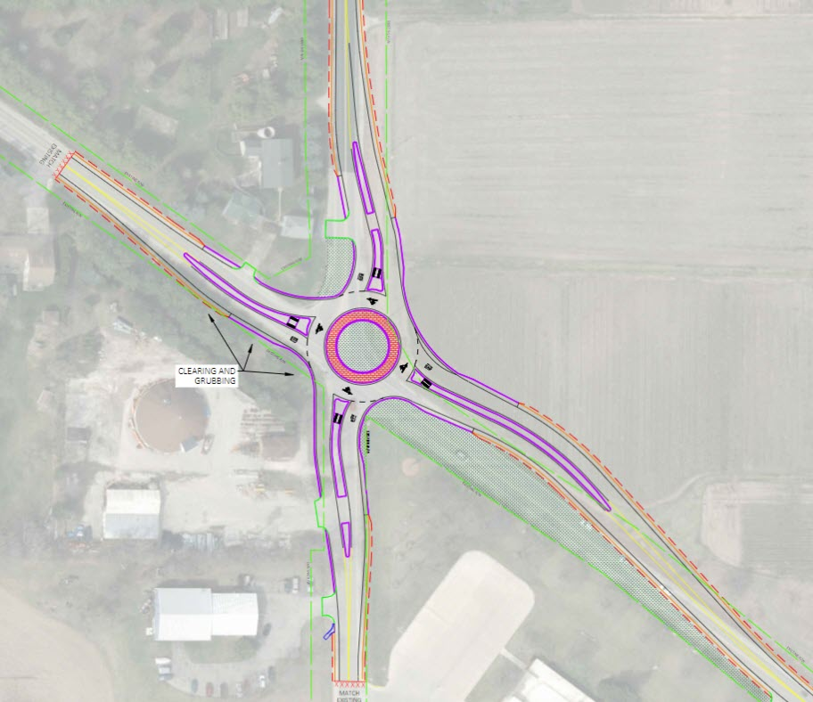
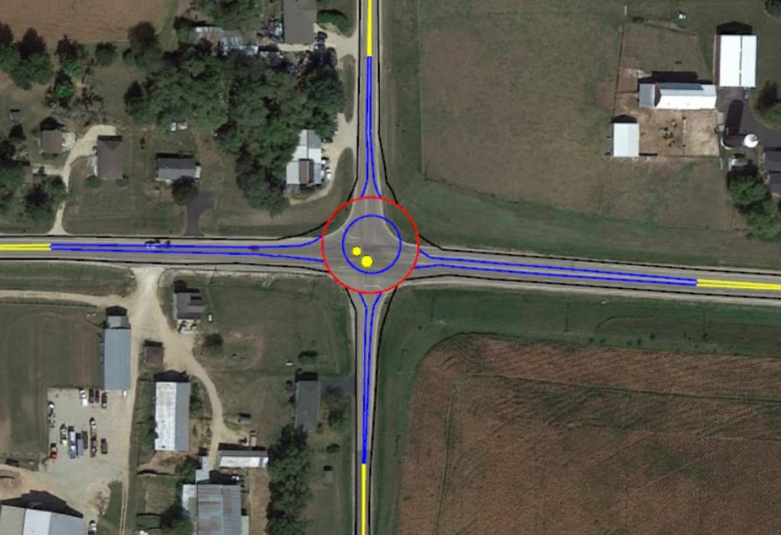
Step 4: Safety Evaluation and Economic Appraisal
Concept Drawings
  Need to provide enough context of the proposed improvement
  Does not need to be a detailed design
Notes:
For concept drawings, they need to provide enough context of the proposed improvement: how large of a footprint will it be? Will it require real estate? Again, these do not need to be a detailed design.
Let's look at a few acceptable examples:
The first set of images includes a Through Route Activated Warning System, or TRAWS and a proposed High Friction Surface Treatment.
The second set of images includes two different roundabout alternatives.
The third image is a more detailed design of a proposed realignment.

Slide 60
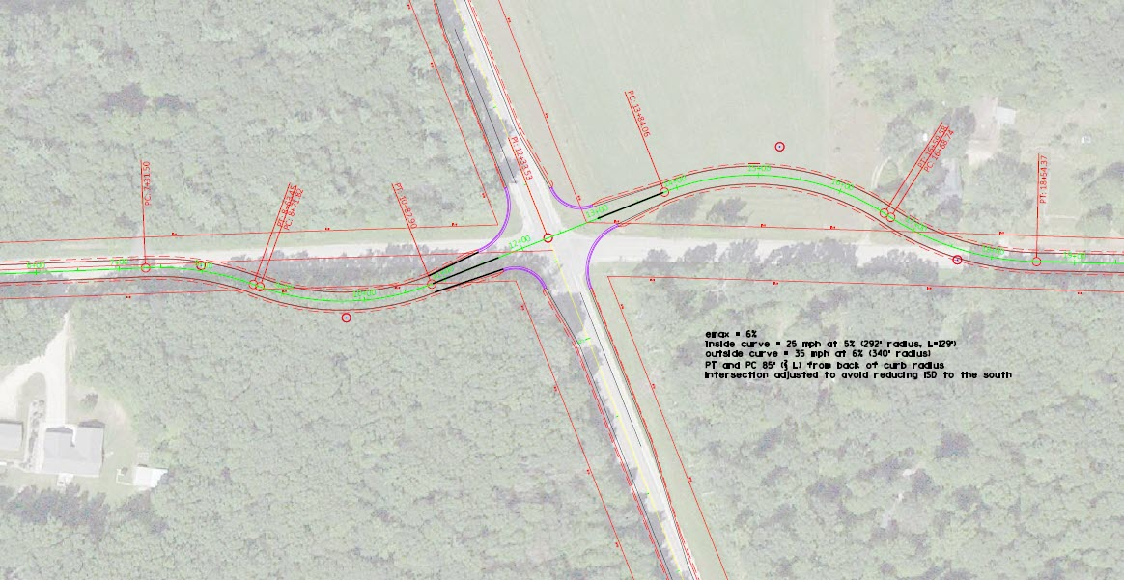
Step 4: Safety Evaluation and Economic Appraisal
Concept Drawings
  Need to provide enough context of the proposed improvement
  Does not need to be a detailed design
Notes:
For concept drawings, they need to provide enough context of the proposed improvement: how large of a footprint will it be? Will it require real estate? Again, these do not need to be a detailed design.
Let's look at a few acceptable examples:
The first set of images includes a Through Route Activated Warning System, or TRAWS and a proposed High Friction Surface Treatment.
The second set of images includes two different roundabout alternatives.
The third image is a more detailed design of a proposed realignment.

Slide 61
Step 4: Safety Evaluation and Economic Appraisal
Cost Estimates
  All alternatives (including the base case) require cost estimates
    Do not need to be detailed bid item estimates
  Costs Included:
    LET construction cost and other associated costs (e.g., real estate, utilities, railroad, etc.)
  Costs Excluded:
    Design or construction delivery, maintenance or operating costs
  Any cost estimates evaluated within the economic appraisal are to be viewed as a snapshot in time
    Do not need to be updated should revisions occur
Notes:
Cost estimates are another required attachment for the SCP when investigating alternatives.
All alternatives, including the base case, require an estimate. For each alternative, only the cost to construct the alternative is required within this step. This consists of the LET construction cost, and any other associated costs such as real estate. Design, construction delivery, and maintenance or operating costs are not included.
Any estimates used within the SCP are snapshots with information available at the time. These should be accurate enough and contain contingencies for unknowns at the time within scoping. If there are needed revisions in the future, after the safety documentation is finalized, the analysis does not need to be reinvestigated.

Slide 62
Step 4: Safety Evaluation and Economic Appraisal
Base Case
  Include any cost associated with the improvement strategy (i.e., Perpetuation, Rehabilitation, Modernization)
    Alternative Benefit-Cost (B/C) ratios determined by difference
    Demonstrates magnitude of proposed improvements
  Typically, the “base case” is perpetuation of the existing facility
    In some cases, the base case is more costly than an alternative
      Solution: Use the lowest cost alternative as the “base case”
Notes:
The base case is often the perpetuation or “replace in kind “alternative of the facility.
When completing the cost estimate for the base case, it consists of any cost associated with the improvement strategy, such as a thin mill and overlay. It is important to include this cost as it demonstrates the magnitude of proposed improvements compared to the replace in kind cost. In some instances, a larger pavement replacement project may not be much more costly than one of the alternatives.
In rare cases, an alternative may be less expensive than the replace in kind alternative. For these cases, the lowest cost alternative is used as the “base case” when performing the economic appraisal.

Slide 63
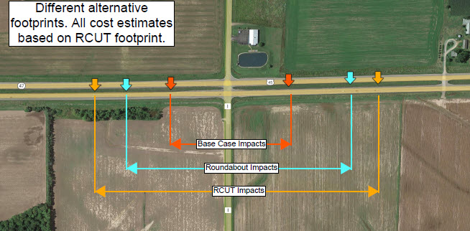
Step 4: Safety Evaluation and Economic Appraisal
Cost estimates should have the same footprint
Notes:
It is important to understand that the cost estimates need to be developed with the largest footprint in mind. In some cases, the cost is simply an “add-on” to the existing project such as shoulder widening, or application of a High Friction Surface Treatment. In other cases, the footprints may extend beyond the replace in kind alternative, and the footprints should match to accurately compare the alternatives.

Slide 64
Step 4: Safety Evaluation and Economic Appraisal
Safety Evaluation provides the predicted/expected crashes for each alternative
  Result: Crash total breakouts
Economic Appraisal provides an economic analysis comparing the safety benefits to the construction cost of an alternative
  Result: Benefit-Cost (B/C) Ratios
Notes:
The result of this step produces the estimated, predicted or expected crash totals of the proposed countermeasures.
These crash totals are used within the economical analysis to quantify the safety benefits or disbenefits. When compared to the construction costs, a benefit-cost ratio is determined.

Slide 65
Step 4: Safety Evaluation and Economic Appraisal
What justifies an improvement from a safety perspective?
Notes:
At this point we ask: What justifies an improvement from a safety perspective?

Slide 66
Step 4: Safety Evaluation and Economic Appraisal
Compare the safety benefits and cost of constructing the alternative
  A safety benefit-cost ratio greater than 1.0 are economically justified
  A safety benefit-cost ratio between 0 and 1 may be considered reasonable when combined with other factors (e.g., operations, environmental, etc.)
  Alternatives investigated at a non-Safety Site of Promise with a benefit-cost ratio of greater than 2.0 is economically justified
Notes:
All alternatives that have a positive safety benefit-cost ratio, which is any value greater than zero, are considered reasonable. Those alternatives with a safety benefit-cost ratio greater than one are economically justified. For alternatives investigated that are not identified as a Safety Site of Promise, a benefit-cost ratio of 2.0 or greater is required to economically justify the improvement from a safety perspective.

Slide 67
Step 5: Documentation
  Documentation
  Put all analysis, reports, diagrams, assumptions, engineering judgement, etc., into the Safety and Operations Certification Document (SOCD)
      Template: FDM 11-38 Attachment 10.5
      Note: There is a separate Operations Certification Process (OCP) that utilizes the same document for recording findings. OCP is found in FDM 11-52.
  Does not select a final alternative. Indicates which alternatives should move forward in the project development process.
  This document is included in the Final Scope Certification (FSC) to provide information pertaining to the existing safety and the safety of proposed alternatives.
Notes:
The final step in the SCP is to document all the data, diagrams, and findings in the Safety and Operations Certification Document, or SOCD. Documentation occurs throughout this process. It is recommended that as information is gathered it is placed in the document instead of waiting until the end.
The Safety and Operations Certification Document does not select a final alternative, as safety is one component of the decision-making process. Instead, it is a summary of the safety considerations for the project and is utilized in the Final Scope Certification (FSC). This document may also contain operational information if the OCP is completed.

Slide 68
Step 5: Documentation
  Safety (and Operations) Certification Document finalization
  BTO Approval required if:
    Safety Evaluation and Economic Appraisal is completed (i.e., alternatives investigated)
  BTO Approval not required if:
    No Safety Sites of Promise within the project limits and additional locations are not investigated
    Safety Sites of Promise are not valid (e.g., screening data incorrect, crashes are not treatable)
    No alternatives investigated
Notes:
BTO approval is required for the Safety and Operations Certification Document when alternatives are investigated. This ensures that BTO reviews the analysis performed, making sure it correctly follows the SCP. If CMF(s) are not available for the proposed alternative, please coordinate with BTO. BTO uses these to help identify gaps within our process and any missing CMFs are tracked for potential research projects.
BTO approval for this document is not required when alternatives are not investigated, or there are no Safety Sites of Promise and additional sites included in the project limits.

Slide 69

Step 5: Documentation
  Safety (and Operations Certification) Document finalization
  Regional Approval
    Planning/Traffic supervisor overseeing the section completing the certification document can approve the document
    Template was made to provide a document regardless if a Safety Certification is required for the project.
      For cases that do not require the Safety Certification Process, the Region supervisor can delegate the analyst to approve the document
Notes:
To finalize the documentation, regional approval comes from either the planning or traffic supervisor. The intent of this is the supervisor directly overseeing the process would sign the documentation to be used within the Final Scope Certification.
For projects that do not require a safety and operations certification document, a prompt explaining this was added to help communicate that the safety analysis was not required. For these cases, the signature line of the document can be delegated to the analyst.

Slide 70
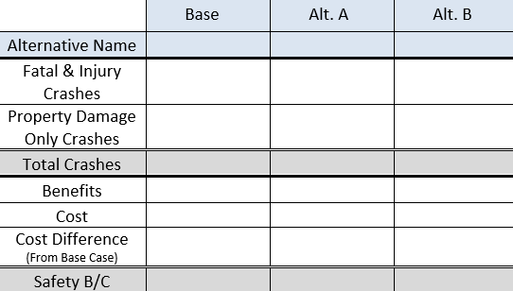
Step 5: Documentation
  Important to understand one number does not tell the whole story. There is nuance to the Safety B/C and Total Crash values.
Example 1: Safety B/C |  |  | Crash Distribution by Severity
Alternative | Benefit | Cost | B/C
Roundabout | $1,160,000 | $2,000,000 | 0.58
Double Up Stop Signs | $126,000 | $10,000 | 12.6
Example 2: Number of Crashes | Crash Distribution by Severity
 | Total | PDO | Fatal & Injury | K | A | B | C
Alt. 1 | 27 | 20 | 7 | 1 | 1.5 | 1.5 | 3
Alt. 2 | 35 | 25 | 10 | 0.25 | 0.5 | 1.25 | 8
Notes:
When documenting the results of the analysis, it is important to understand there is nuance to the crash values reported.
Let’s look at some examples.
Example one looks at the safety benefit-cost ratio. Doubling up the stop signs yields the best safety benefit-cost ratio. This is due to a very low cost for the benefit it provides. The roundabout provides a larger safety benefit, although at a higher cost, which is why it has a lower safety benefit-cost ratio. Depending on the purpose and need of the project, either alternative could be correct to implement. This information should be carried forward into the FSC where additional data can be considered.
In the next example, alternative one has fewer total crashes, property damage only crashes, and combined fatal and injury crashes when compared to the alternative two. However, the second alternative has fewer fatal crashes, injury A crashes, and injury B crashes. This reduction in the more serious injury and fatal crash types is likely a safer alternative even though the total number of crashes is higher.
These two examples illustrate the need to understand the complete safety picture, not just one or two numbers.

Slide 71
Step 5: Documentation
  Safety (and Operations Certification) Document Amendment
  Purpose is to capture the additional use of the SCP when documentation is finalized
    Only required if:
      New or additional alternative is analyzed which were not covered in the original document
      New Safety Sites of Promise/Additional sites (e.g., project limits change)
      Significant design changes (e.g., # of approaches adjusted, shoulder width changes)
    Not required if:
      Cost estimates changes
      Design changes (e.g., curve radii, splitter island length)
      Existing roadway context changes (e.g., speed limits adjusted, volumes change)
Notes:
The Safety Certification Process also has an amendment process. As a project evolves, sometimes project limits are adjusted after the safety analysis was performed or another alternative is brought up through public involvement.
This process is required when new alternatives or additional sites are investigated that weren’t included in the approved analysis. It is also required if the alternative investigated has substantial changes to the design. Examples of this may include a change in the number of approaches, or shoulder widths are changed.
The amendment process is not required if cost estimates fluctuate, or there are minor design changes such as curve radii or island adjustments.

Slide 72
Step 5: Documentation
  Safety (and Operations Certification) Document Amendment
  Documentation requires:
    Reasoning for the amendment
    Crash trend, contributing factors discussion (for new sites only)
    Narrative of additional alternatives reviewed
    Analysis results
      For analyses completed in the original document these do not need to be updated
  When completed, documented within:
    Final Scope Certification (Scoping Phase)
    Design Study Report (DSR) or Environmental Document (outside of Scoping)
Notes:
The Amendment requires a few additional pieces of information. The intent of this process is to include the additional information for the project and use the prior documentation as reference. For new sites investigated, the crash information is included, and the screening information, diagnosis, and alternative analysis would be completed.
If a location investigated prior has a new alternative being proposed, only information relevant to that alternative needs to be included such as concept drawings and cost estimates.
When this is required, it is documented within either the Final Scope Certification if still within the scoping phase, or within the Design Study Report/Environmental Document if the project is outside of the scoping phase.

Slide 73
Safety Certification Process
Bureau of Traffic Operations (BTO) Role
Notes:
What is the Bureau of Traffic Operations’ role in the SCP?

Slide 74
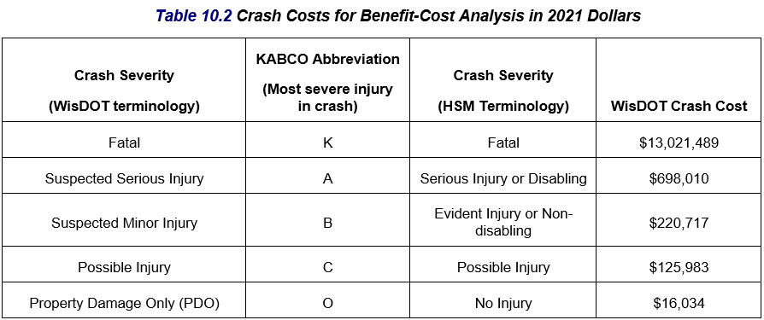
Bureau of Traffic Operations Role
Maintain and update safety analysis tools
  Evaluate and distribute tools when new versions are available
  Manage Calibration Factors and Crash Severity/Type Proportions within IHSDM
  Update crash costs
Approve Certification Document when safety evaluations are completed
  Verify methodology and analyses
Notes:
The role of the Bureau of Traffic Operations is to maintain the SCP policy and update safety analysis tools as needed. These tools are periodically updated to incorporate newer volume information, crash information. When new Safety Performance Functions are developed nationally, BTO calibrates them using Wisconsin specific data, so they are more representative of Wisconsin roadways. Crash costs are also updated periodically to account for inflation and other trends.
Updates to software packages are coordinated with BITS and pushed to WisDOT computers. External partners can access the updated files on the WisDOT webpage, shown on the next slide.
When a Safety and Operations Certification Document (SOCD) is produced where at least one site performs step 4, Safety Evaluation and Economic Appraisal of Alternatives, the SOCD is sent to BTO for review and BTO approval is required. BTO’s responsibility is to verify that the SCP policy was followed and documented correctly. It is the responsibility of the analyst and Region to review the inputs and data.

Slide 75
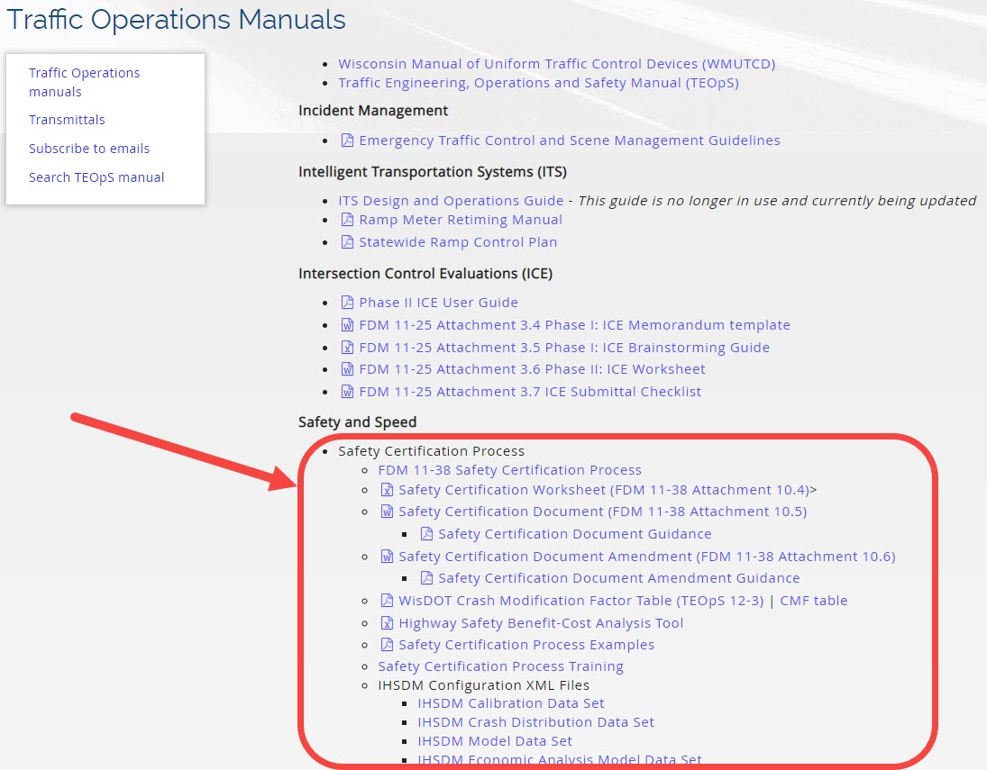
Resources
https://wisconsindot.gov/Pages/doing-bus/local-gov/traffic-ops/manuals-and-standards/manuals.aspx
Notes:
The Safety Certification Process is defined in FDM 11-38. In addition to this, the WisDOT webpage for Traffic Operation Manuals contains templates, configuration files, training materials, and examples.

Slide 76
BTO Contacts
BTO General Mailbox for SCP
DOTBTOSafetyEngineering@dot.wi.gov
Kevin M. Scopoline
State Traffic Safety Engineer – Research
KevinM.Scopoline@dot.wi.gov
Dan Brugman
State Traffic Safety Engineer – Improvement
Daniel.Brugman@dot.wi.gov
Notes:
If you have questions regarding the Safety Certification Process, please contact BTO by emailing them

