Slide 1
Work Zone Training
Bureau of Traffic Operations
WisDOT
March, 2020
Notes:
Read me notes regarding this WisDOT PowerPoint template: Wide screen size of 1920 by 1080, includes either blue or light gray backgrounds
This WisDOT PowerPoint template has a widescreen (16:9) aspect ratio (1920 x 1080).
Use if you will be doing one of the following:
showing your presentation on a large widescreen television.
showing your presentation using a display in widescreen format.
converting your presentation to video in the future.
Use the WisDOT PowerPoint template that has the standard (4:3) aspect ratio (1024 x 768) if you will be doing one of the following:
Presenting with a WisDOT projector that displays in standard (4:3) or 1024 x 768.
Presenting at a conference location which uses projectors that display in standard (4:3) or 1024 x 768.
Title slide
Slide 1 and slide 8 are layouts for the title slide of your WisDOT presentation. The title of your presentation goes at the top in the white text (for the light gray background) or blue text (for the gray background). The title may be one or two lines.
Managing placeholders
If your presentation does not need all the text placeholders, delete the placeholders you do not need and then you may need to lower or adjust the height between lines.
Various slide layouts
Slides 2 through 6 and 9 through 13 are examples of five slide layouts you may use in your presentation. The headline of each example describes which content placeholders are available in its layout. Review the slide layouts and decide which one best suits your content.
Blank slides
Slides 7 and 14 are blank slides for custom layouts in your presentation.
Ways to transfer a PowerPoint presentation from another design to this template.
The recommended way is to copy text line by line, slide by slide, from the other PowerPoint design. Then paste it into Notepad, copy from Notepad, then return to this template, select the text in the desired placeholder and copy. If you would like to get all your text out of the other design at once, choose file, save as .rtf, then copy all text from the .rtf, paste it into Notepad. Then use the Notepad file to copy the text line by line into this template by selecting the desired placeholder and copying. (Notepad will clear styles from the other PowerPoint design.)
How to paste text and keep template’s font styles and color
Select text in placeholder, then copy. If copying and pasting text into a slide layout does not preserve the template’s font styles, select text in placeholder and right click on the placeholder and select the first paste option: use destination theme. Doing so will keep your pasted text in the font style and color designed for WisDOT template.
How to add more slides with the layout you want
To add a new slide layout to your presentation: in normal view, on the home tab, select new slide. Slide layout options for the WisDOT template will appear. Select the slide layout you want.
Changing a current slide layout on to a different current slide layout is not recommended.
Changing a current slide layout on to a different current slide layout is not recommended, as sometimes this results in additions of unmatched text and placeholders. It’s best to add a new slide layout to your presentation: in normal view, on the home tab, select new slide. Slide layout options for the WisDOT template will appear. Select the slide layout you want and add new text to this slide layout.
When to choose the blue background
Slides 1 through 7 have a dark blue background. Use with its white and gold type styles. Use if you have reverse or negative versions of graphics and logos. Some experts say if you're presenting with most of the lights off in the room or in a darker presentation area, consider using the blue background color, then the background won't intrude on the message and the lighter components will stand out. Other experts say that if your copy is kept short and sweet, the lightness or darkness of the background is irrelevant, as viewers then have little to read.
When to choose the light gray background
Slides 1 through 7 have a light gray background. Use with its navy and red type styles. Use if you have positive versions of graphics and logos. Some experts say if you're presenting in a small room with most of the lights on, use a lighter gray background, then the background will tend to fade away while the other components will grab attention. Other experts say that if your copy is kept short and sweet, the lightness or darkness of the background is irrelevant, as viewers then have little to read.
Use these sizes and colors of fonts for template with LIGHT GRAY background and wide aspect ration (1920 x1080).
Font sizes may be adjusted either 2 points smaller or 2 points larger from sizes listed.
Slide 1 with GRAY background
Title text = Arial Narrow Bold, 63 point, Color: navy blue R0 G65 B106, Title text may be one or two lines. 3 or more lines are not recommended.
Name of Presenter = Arial Narrow Bold, 48 point, Color: red R164 G40 B76, Keep to 1 line
Title of Presenter = Arial Narrow, 40 point, Color: red R164 G40 B76, Keep to 1 line
Name of conference or event, Location, City, State = Arial Narrow, 28 point, Color: navy blue R0 G65 B106, Keep to 1 or 2 lines
Month, Day, Year = Arial Narrow Bold, 25 point, Color: red R164 G40 B76, Keep to 1 line
Slides 2, 3, 4, 5, 6 with GRAY background
Example heading = Arial Narrow Bold, 48 point, Color: navy blue R0 G65 B106, Heading may be one or two lines. 3 or more lines are not recommended.
Red subhead = Arial Narrow Bold, 39 point, Color: red R164 G40 B76, Keep to 1 line
Bullet 1 = Arial Narrow, 35 point, Color: navy blue R0 G65 B106
Bullet 2 = Arial Narrow, 32 point, Color: red R164 G40 B76
Paragraph text = Arial Narrow, 28 point, Color: navy blue R0 G65 B10
Use these sizes and colors of fonts for template with BLUE background and wide aspect ration (1920 x1080).
Font sizes may be adjusted either 2 points smaller or 2 points larger from sizes listed.
Slide 8 Title slide with BLUE background
Title text = Arial Narrow Bold, 63 point, Color: white R255 G255 B255, Title text may be one or two lines. 3 or more lines are not recommended.
Name of Presenter = Arial Narrow Bold, 48 point, Color: gold R216 G184 B70, Keep to 1 line
Title of Presenter = Arial Narrow, 40 point, Color: gold R216 G184 B70, Keep to 1 line
Name of conference or event, Location, City, State = Arial Narrow, 28 point, Color: white R255 G255 B255, Keep to 1 or 2 lines
Month, Day, Year = Arial Narrow Bold, 25 point, Color: gold R216 G184 B70, Keep to 1 line
Slides 9, 10, 11, 12, 13 with BLUE background
Example heading = Arial Narrow Bold, 48 point, Color: white R255 G255 B255, Heading may be one or two lines. 3 or more lines are not recommended
Red subhead = Arial Narrow Bold, 39 point, Color: gold R216 G184 B70, Keep to 1 line
Bullet 1 = Arial Narrow, 35 point, Color: white R255 G255 B255
Bullet 2 = Arial Narrow, 32 point, Color: gold R216 G184 B70
Paragraph text = Arial Narrow, 28 point, Color: white R255 G255 B255
Contact the WisDOT Learn Center for training in PowerPoint. A link to the WisDOT Learn Center may be found on the dotnet home page.

Slide 2
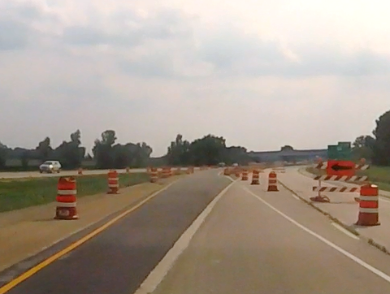
Overview
Intro
Work Zone Components
Work Zone Devices
Work Zone Field Manual
Operations

Slide 3
Why work zones?
Work Zone Safety and Mobility Rule
Final Rule by FHWA published Sept. 9, 2004
All states that receive Federal-aid highway funding
Provide a systematic and structured approach to work zone traffic management
Emphasize safety and mobility
Development of TMPs and TCPs
Data-driven improvements to WZ policy/process/procedures

Slide 4
Work Zone Drivers
Video not posted

Slide 5
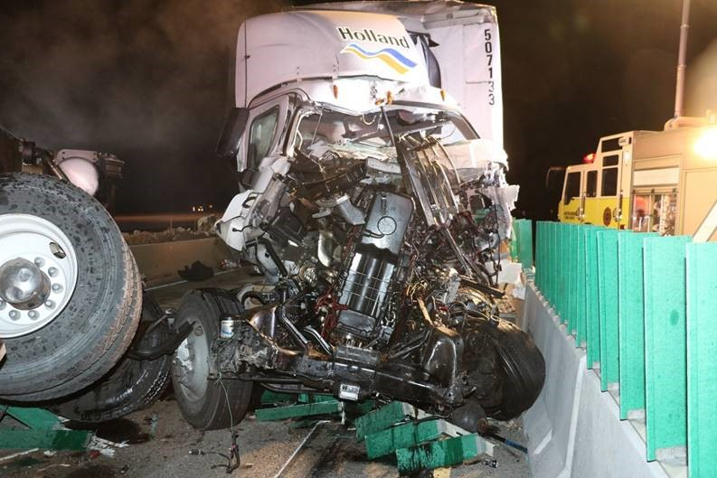
Crashes
Total Work Zone Crashes per year 2015-Preliminary 2019
Crash Severity per year 2015-2019
Crash Location 2017-2019
  Data began being collected in 2017 with updated crash report form
Crash Type 2015-2019
  All 2019 crash data is preliminary. Private Property and Parking Lot Crashes are not reported.

Slide 6
Work Zone Crashes per Year
2015 to 2019
** 2019 are preliminary crash statistics **
Notes:
So jumping right in, here I have a summary of total work zone crashes over the last 5 years with 2019 still being preliminary stats. In 2018 we had the highest reported number of crashes over the last 5 years. It should be noted that work zone crashes rely heavily on law enforcement accurately documenting the crash and checking the work zone box on the DT4000 report.
We also do not compare the number of lane miles under construction each year so that may be a reason crashes fluctuate between the years. With out upgrade to LCS we will be able to get this metric to be able to understand if there were more active work zones in certain years than others.
We consider tracking work zone crashes an indicator rather than a performance measure. Our primary goal at WisDOT is to reduce crashes and keep workers and the traveling public safe.
This is a comparison of work zone crashes reported for the last 5 years.
These crashes are heavily reliant on law enforcement checking the box that the crash occurred in the work zone
We also do not have an exposure measure that compares lane miles of work zones each year so we can’t say for certain that crashes increased or decreased, we would need to also compare the number of work zones throughout the year as well
We consider these indicators, not performance measures
Our goal is to continue to reduce crashes in work zones by continually updating policies and standards as well as through the implementation of smart work zones which can reduce certain types of crashes.
Always looking for new technologies and innovative ideas to pilot and implement.

Slide 7
Work Zone Crashes per Year by Severity
2015 to 2019
** 2019 are preliminary crash statistics **
Notes:
Up on the slide I have gone a step further and broken down work zone crashes by severity. Fatal, injury and property damage only. Based on preliminary stats from 2019, there were about 15 fatalities, 600 injuries and 1800 property damage crashes.
I also wanted to mention that we see most crashes during the weekday, with less occurring on the weekends along with most crashes occurring during prime construction season Aril to October or about 67% of crashes.
Injury Severity total of A, B and C injury crashes
A = incapacitating injury
B = non-incapacitating injury
C = possible injury
PD = property damage only
In general weekday crashes average the about the same percentage of crashes, around 15-17% and weekends are around the 10% of work zone crashes.
April through October is where we see a large percentage of our crashes as well (about 67%), which makes sense since it is prime construction season.

Slide 8
Total Work Zone Crashes by Region
2015 to 2019
** 2019 are preliminary crash statistics **
Notes:
Up here I have broken out the crashes over the last 5 years by Region.
Over the last 5 years, SE Region has contributed to 50% of all work zone crashes – several factors could be the large scale projects that have been on-going in the last several years

Slide 9
Type of Work Zone Crash
2015 to 2019
** 2019 are preliminary crash statistics **
Notes:
This slide shows the types of crashes we are seeing in work zones. The biggest percentage of crashes are rear-end crashes with 43%. We are hoping to see this number decreases as we start installing more end of queue detection in work zones.

Slide 10
Work Zone Location
2017 to 2019
** 2019 are preliminary crash statistics **
Notes:
In 2017 a new report for law enforcement came out, a DT 4000 which replaced the MV4000. Within that report several work zone elements were added and work zone location was one of them. Based on the data provided, 70% of the crashes are occurring in the activity area.
DT 4000 Report came out in 2017, therefore this specific work zone data started to be collected after 2017.
Majority of crashes occur in the activity area on Wisconsin state highways

Slide 11
Work Zone Type
2017 to 2019
** 2019 are preliminary crash statistics **
Notes:
Another element added was the work zone type, lane closure type, moving WZ, lane shift/crossover, work in median/shoulder or other. From the data 37% of crashes are happening during lane closures and 26% during shoulder/median work.

Slide 12
Why are we doing this training?
Goal: To ensure the safety of traveling public and workers in Wisconsin work zones.
Objectives:
Identify the different components of a work zone.
Identify the proper devices to use and quality standards.
Identify the proper notification for work.
Eliminate the use of high risk operations.

Slide 13
Work zone videos for counties and utilities
Video not posted

Slide 14
4 C’s of Traffic Control
Conspicuous
Clear
Consistent
Credible

Slide 15

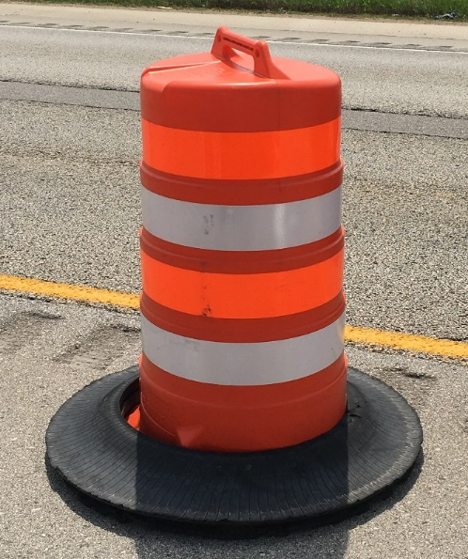
Conspicuous

Slide 16
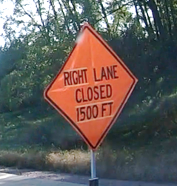
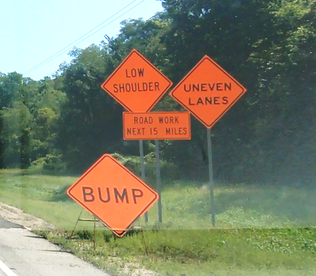
Clear
Good
Bad
Notes:
All signing, guidance and other information must be clear. Humans are only able to processes a limited amount of information at once. Do not overload the drivers with information.
Source: Improvements in Safe Working on Roads, Technical Committee C.1 Safer Road Infrastructure: http://www.piarc.org/en/order-library/18274-en-Improvements%20in%20safe%20working%20on%20roads.htm

Slide 17
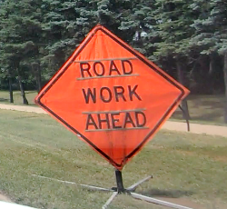
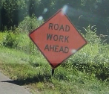
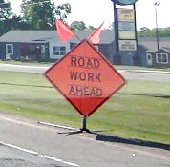
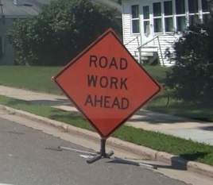
Consistent
Notes:
Drivers can be conditioned to behave and act in certain ways, but the traffic control they encounter must be consistent to produce these results. Provide users with what to expect. Following standards will reduce variations among different projects.
Source: Improvements in Safe Working on Roads, Technical Committee C.1 Safer Road Infrastructure: http://www.piarc.org/en/order-library/18274-en-Improvements%20in%20safe%20working%20on%20roads.htm

Slide 18
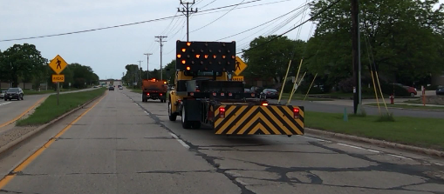
Credible

Slide 19
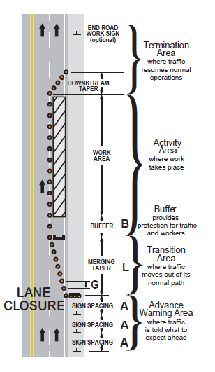
Components
Advance Warning Area
Transition Area
Buffer
Work Area
Termination Area

Slide 20
Video not posted

Slide 21
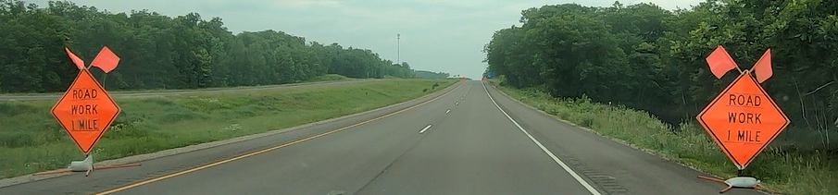
Advance Warning Area
Area in advance of the work zone
Alerts drivers of the upcoming work
Barron Co. 7/9/2019

Slide 22
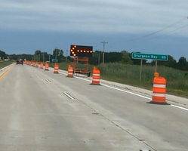
Transition Area
Normal traffic conditions to work zone traffic conditions
On high speed facilities two arrow boards are used
  50 mph and above
Avoid placing on curves
Do not perform work in this area
Brown Co. 7/18/2019

Slide 23
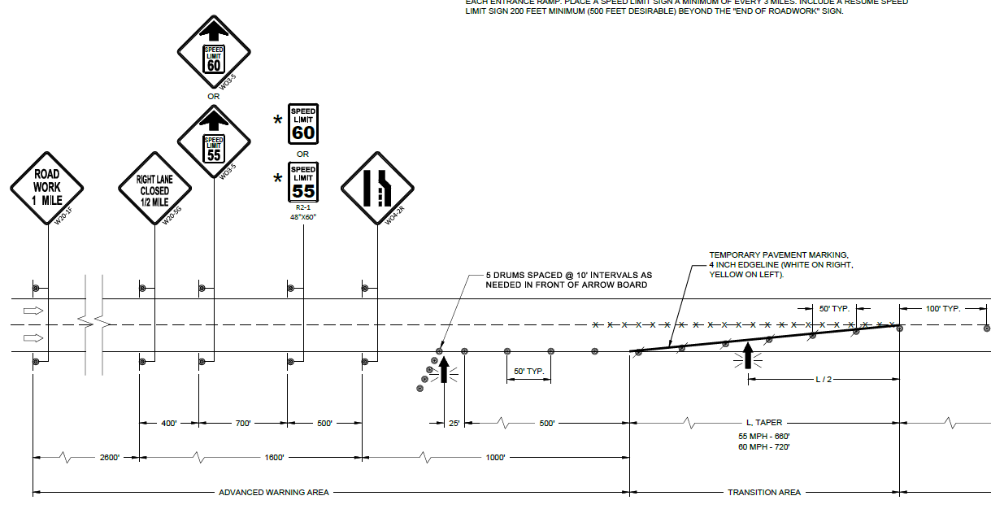
Advance Warning and Transition Area
Divided 50 mph and greater

Slide 24
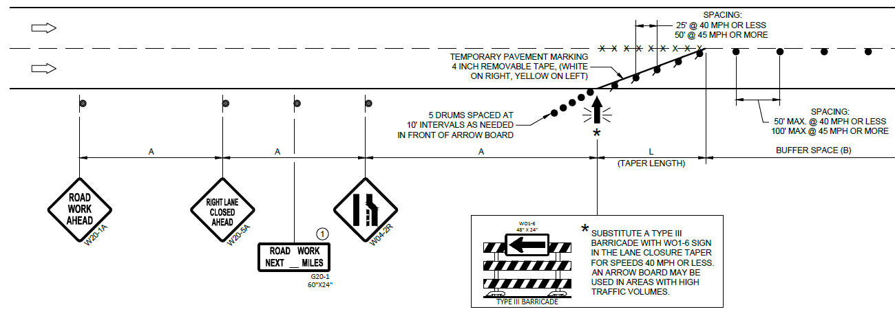
Advance Warning and Transition Area
Undivided and Divided 45 mph and less

Slide 25
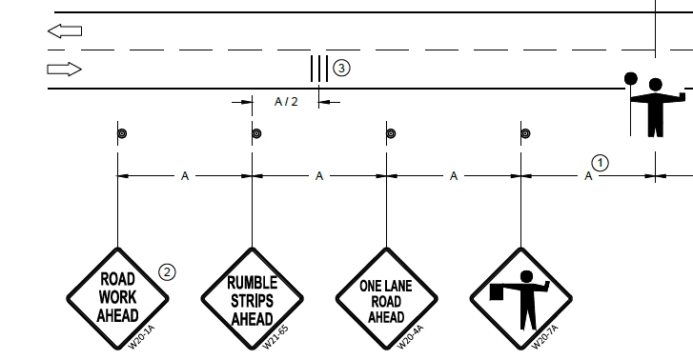
Advance Warning and Transition Area
Flagging

Slide 26
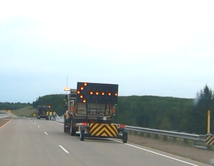
Buffer Space
Space between the transition area and the work space
Gives room for error
Do not perform work or store equipment in this area
Lincoln Co. 8/21/2019

Slide 27
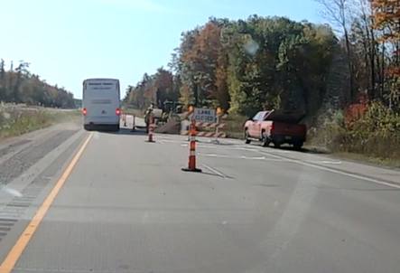
Work Area
Area where the work is taking place in
Oconto Co. 10/7/2019

Slide 28
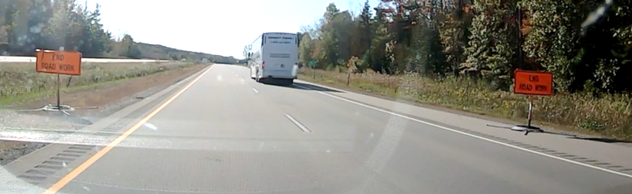
Termination Area
End Road Work
Return to normal lane and speed configuration
Oconto Co. 10/7/2019

Slide 29
What is good about this work zone?
What is missing in this work zone?
Notes:
Good:
Advance warning signs
Bad:
Work in the transition area

Slide 30
Video not posted

