Slide 1
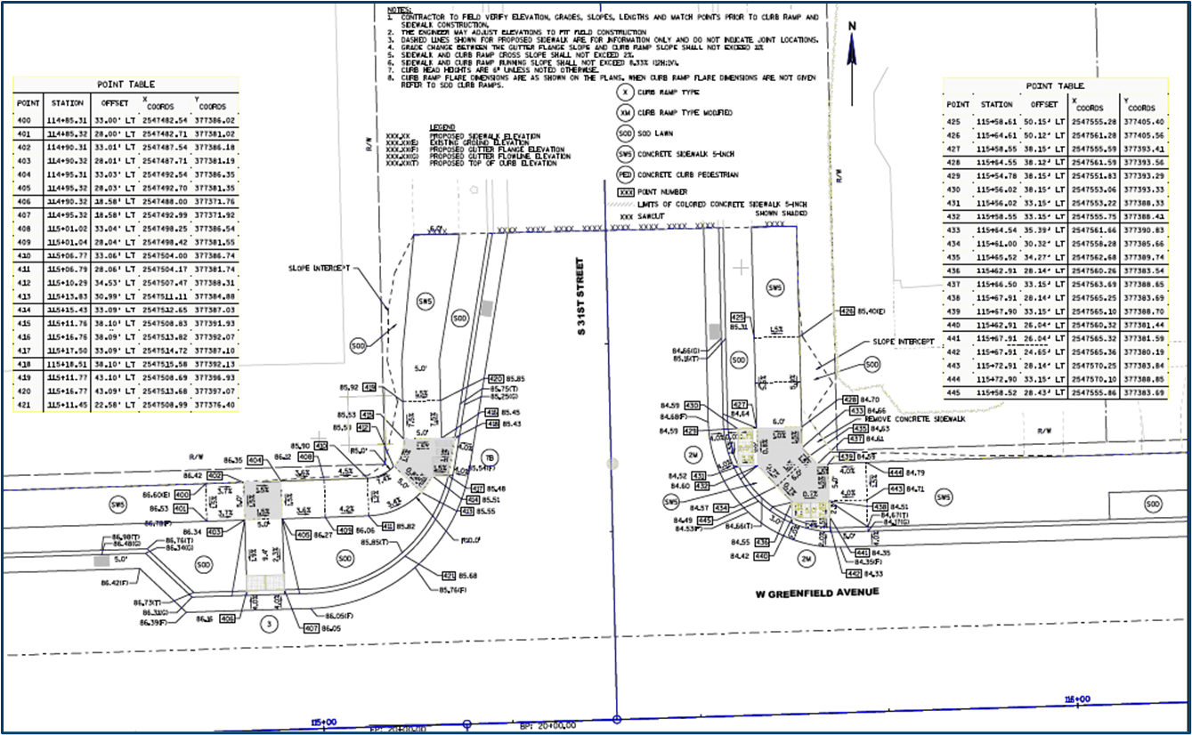

Curb Ramp Construction Documentation
Before Construction Project Begins
  Review Curb Ramp Construction Details
    Have designer correct any errors/issues that are found
  If curb ramp has technical infeasibility
    Have designer explain any technical infeasibility issues if there are questions
  Discuss Curb Ramps with contractor at the Construction Precon meeting
    Chance to answer any curb ramp related questions in advance of construction

Slide 2
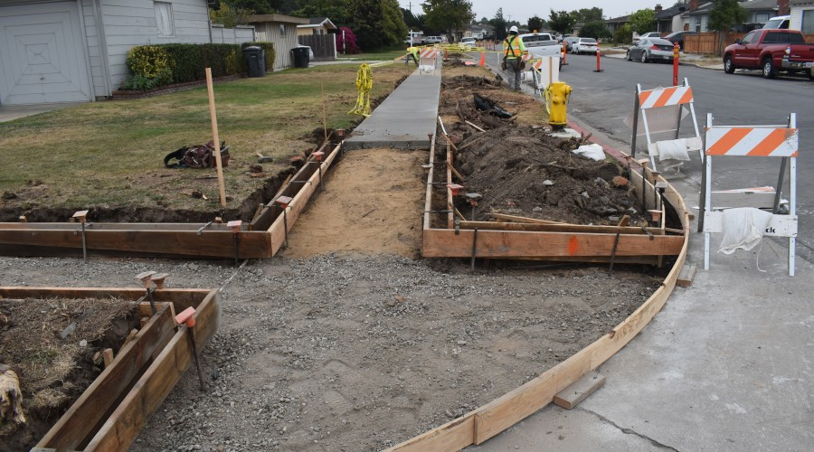
Curb Ramp Construction Documentation
Before Curb Ramp Construction Begins
  Review sidewalk and flange line match elevations
    If elevations differ from plan elevations, have designer review differences and adjust curb ramp construction details accordingly
  Verify curb ramp dimensions, slopes and elevations once forms are placed
    This should be done prior to placing concrete
  Address any errors that are identified
    Have designer address issues

Slide 3
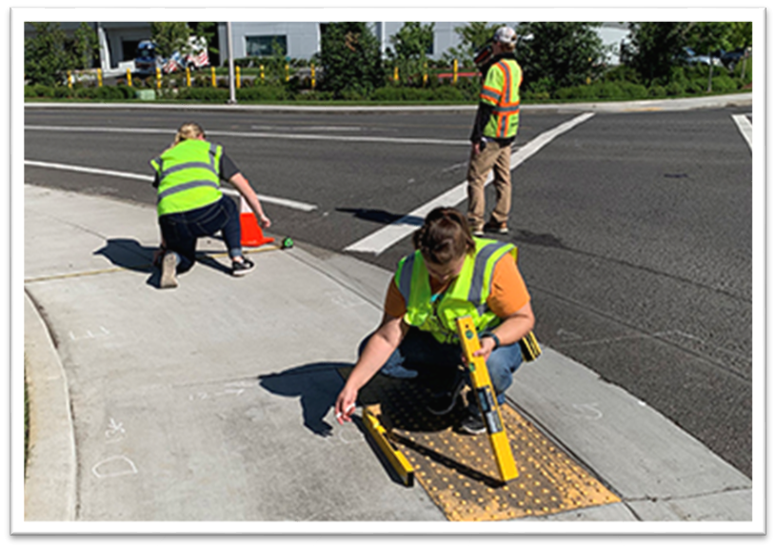
Curb Ramp Construction Documentation
After Curb Ramp Construction
  Measure curb ramp components
    Record data using the Post Construction Curb Ramp Compliance Form
  Make sure to fill out the Post Construction Curb Ramp Compliance Report
    Fill out form once concrete has cured
  If non-compliance components found
    Notify contractor immediately
    Check for Technical Infeasibility that was not known about

Slide 4
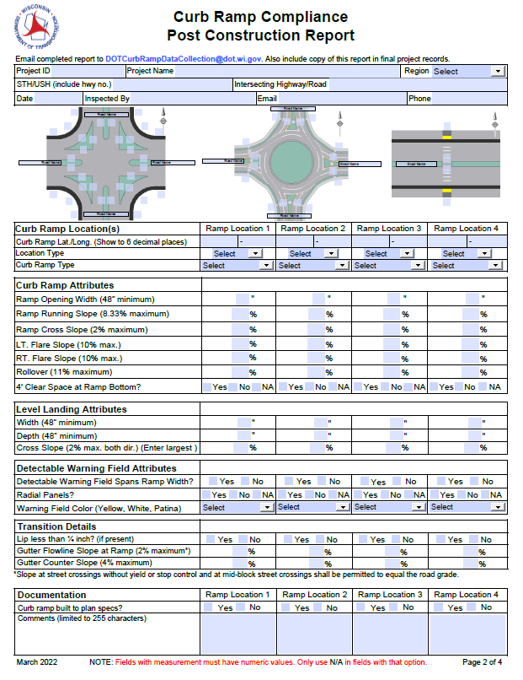
Curb Ramp Construction Documentation
Filling out Post Construction Compliance Report
  Check Pantry to get current version of the form
  Make sure Lat./Long. is shown to 6 decimal places
  Do not use N/A for any data fields
  If curb ramp not built to plan specs, make sure to document what was done and why it was done in the space provided in the form
  Information entered into WisDOT GIS database
  Used to help navigate

