Slide 1
2022 Spec Training
Semi-Rigid Barriers

Slide 2
What are semi-rigid barriers?
Long-Spans, Type K, LHW, Half and Quarter Post Spacing
Class A Beam Guard
MGS Beam Guard
Thrie Beam Transitions
Thrie Beam Barrier
End Treatments (Can act like beam guard in some impacts)
EATs
Type 2 New SDD in Aug 2021
Thrie Beam Bullnose New in Aug SDD 2020
Notes:
Note that grading is important.
Steel post
Install hardware as detailed.

Slide 3
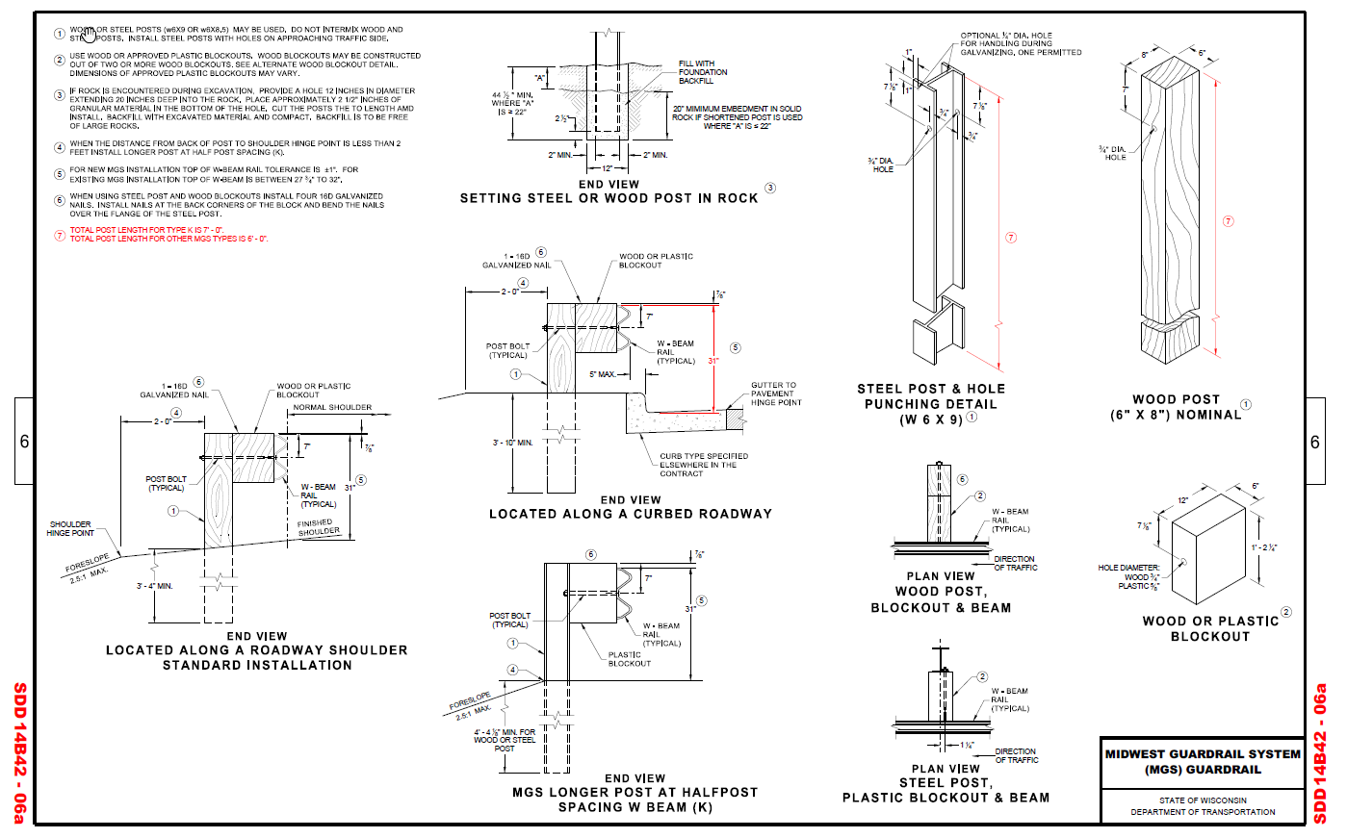
Review the SDDs in your plan
What SDD is associated with the barrier installation?
What SDDs are in the Plan?
What version of the SDD are you using?
MGS SDD 14B42
MGS Thrie Beam Approach SDD 14B45
EAT SDD 14B44
SDD14B42 – 06a
Notes:
Don’t mix and match SDDs

Slide 4
Review the SDDs in your plan
What post should be installed according to the SDD?
than these posts..
These post are different than..
Part 2

Slide 5
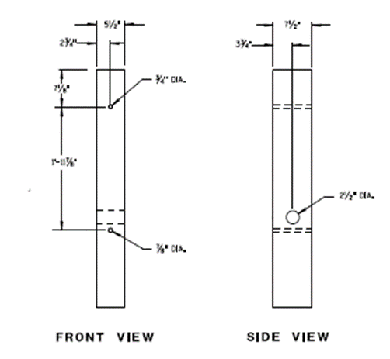
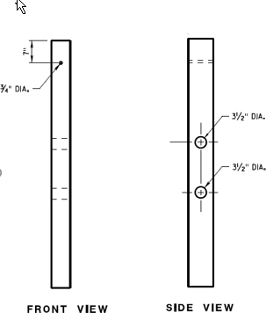
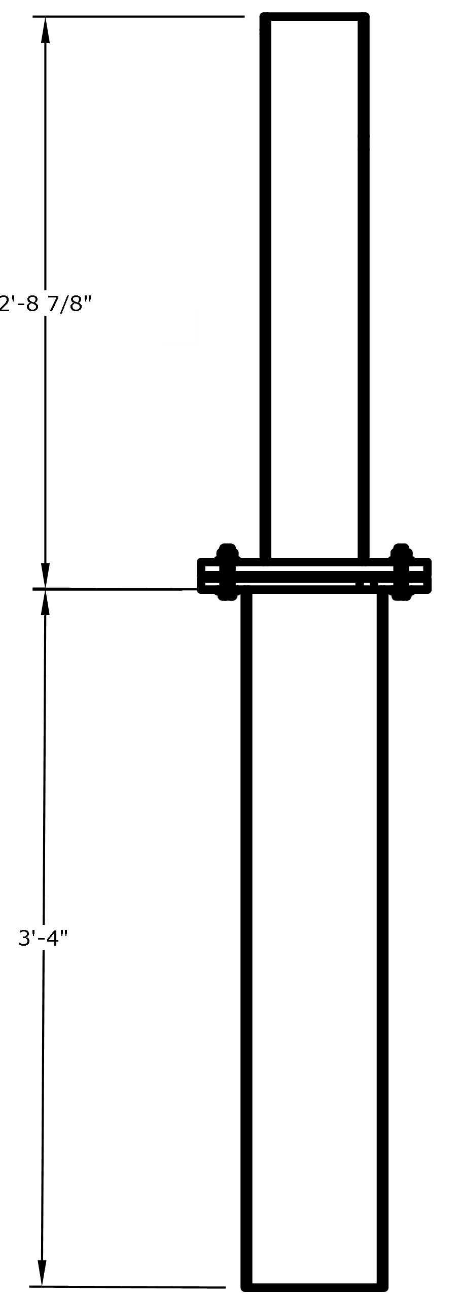
Know the different post types.
Is this the correct post being installed?
Material
Wood
Steel
Type
BCT
CRT
MwRSF Slip Post
“Normal”
Length
BCT
CRT
MwRSF Slip Post

Slide 6
What is considered unacceptable?
Posts that are more than 3” short are not acceptable.
Posts that are too long are not acceptable.
Using the wrong type of post is not acceptable:
Using a CRT post where “normal” post should be installed.
Using steel posts where wood posts are needed.
Missing posts are not acceptable.
Mixing posts types and post spacing.

Slide 7
What actions to take?
Install the correct posts.
If correct posts cannot be installed discuss with:
Project Engineer
If needed, discuss with Designer, or Construction Oversight Engineer
Future designs can be improved.
Construction Oversight Engineer may know how to handle these situations or call on central office staff for assistance.

